Slide 1
Truist Financial Education Equipment Financing: Do’s and Don’ts
Presented by Staci Zacharko, Maria Lepkowicz & Matt Pallo

Slide 2
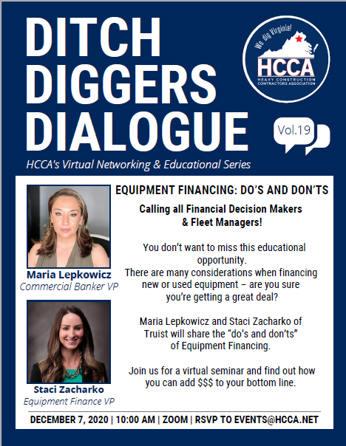
Contact Info
Maria Lepkowicz
(703) 663-0660
Maria.Lepkowicz@truist.com
Staci Zacharko
(910) 286-8611
Staci.Zacharko@truist.com
Mathew Pallo
(703) 442-1617
Mathew.Pallo@truist.com

Slide 3
AGENDA
Why Should you Finance
Different Types of Financing
Pros and Cons
Key Takeaways

Slide 4
Why Should I Finance?
Save your cash. Invest it in your business and people.
Start early and engage your banker.
If you need multiple pieces, set up a line.
Don’t tie up your bank lines with equipment.
Often no cost to set up a line.
Can save money on rate and fees by being proactive.

Slide 5
General Process for a Line
Engage your banker.
Submit financials – typically 3 years plus interims.
Obtain credit approval.
Sign Master Loan Agreement.
Identify your equipment.
Term equipment into a note with fixed rate and payment.

Slide 6
Lease vs. Finance Overview
Lease vs. Finance
Loan
Lease
A loan allows you to purchase a piece of equipment. Once you’ve repaid your loan according to its terms, you fully own your equipment.
A lease allows you to rent equipment from the vendor or the bank for a stated monthly payment, but you don’t own the equipment during the lease term.
Lender will provide the capital to pay for the purchase. Once you repay the loan, you fully own the equipment.
You don’t own the equipment, you rent it.

Slide 7
Lease vs. Finance Overview
Lease vs. Finance
Two main types of leases:
Operating Leases
Lower monthly payments. Option to buy the equipment at the end of the term for its then fair market value.
Capital Leases
Structured more like a loan so payments are higher than an operating lease. Option to buy the equipment for $1.

Slide 8
Financing Structures Overview
Financing Structures
Loan
$1 Out Capital Lease
Fair Market Value Lease (“FMV”)
Client takes immediate possession of the equipment asset, and lender takes a security interest. Fixed, floating and swap rate options are all available.
A capital lease transfers to the lessee most rights and obligations concerning the leased asset. The asset will be reported on the balance sheet of the lessee throughout the duration of the term. At end of term, full ownership will be transferred to the lessee for a $1 purchase price.
FMV leases are structured where the lessor rents the equipment to the lessee, who typically deducts rents as an expense for tax purposes. At end of term, the lessee has the right, but not the obligation, to buy the leased asset for a price that represents the item’s then-current value.
First Amendment Lease
Synthetic Lease
TRAC and Split TRAC Lease
A First Amendment lease is a lease with a base term similar to a FMV structure. At the end of the original term, the lessee has the option to purchase the equipment for a stated amount, or renew the lease for a defined period, after which the lessee has the opportunity to purchase the equipment at fair market value or return the equipment.
A synthetic lease is structured as a tax lease for accounting purposes and a loan for tax purposes. The client will guarantee a portion of the residual amount as indicated in the lease agreement.
Split TRAC and regular TRAC structures are designed to finance licensed and titled motor vehicles used for the client’s business. The client guarantees all of the TRAC amount in a TRAC lease, or a designated portion of the TRAC amount in a Split TRAC lease as indicated in the lease agreement.

Slide 9
Pros and Cons
Leasing:
Beneficial when the equipment you need will become outdated in a few years
Generally requires no money down
Generally requires no additional collateral
Keep cash for other business expenses
At the end you can purchase the equipment, refinance and keep paying or return the equipment
Cons: If you purchase the equipment at lease end, you could end up paying more.
Loans:
Self-collateralized, lender can take the equipment and sell it
You own the equipment
Cons: Considered higher risk so down payment may be required

Slide 10
Which is Right?
Key things to keep in mind:
How quickly will the equipment become outdated?
If the piece of equipment will last a long time, loan might be the right decision.
If you do not want to keep the equipment at the end of the term, a lease might be the best decision.
Leasing can offer tax incentives, speak with an accountant to inquire.

Slide 11
Key Takeaways
If you can afford to purchase outright, it may be worth doing so to avoid paying interest.
Leasing can be more affordable in the short term, allowing your business to save money for other projects. Important if your business is growing or if you need capital for larger purchases.
Leasing can make it easier to upgrade equipment, you can turn it in at lease end.
Leasing can help you stay competitive by helping with cash flow (put that money somewhere else!). Also allows you to use the latest and greatest equipment on the market.

Slide 12
Key Takeaways
If you have a banker you like working with, get to know them. Ask if multiple products will help you get a better rate.
Sounds simple but ask, "Is this the best you can do?”
Shop around!

