Slide 1


Incident Investigation – Reporting – Prevention
December, 2023
Jason Jeran, MS, CSP
Gallagher Risk Management
Heavy Construction Contractors Association

Slide 2
Goals for this Training
Learn simple tools that can be used to investigate simple and complex incidents.
Learn the importance of root cause analysis.
Walk away with resources and knowledge that can help minimize the occurrence of harmful contact incidents at your job sites.

Slide 3
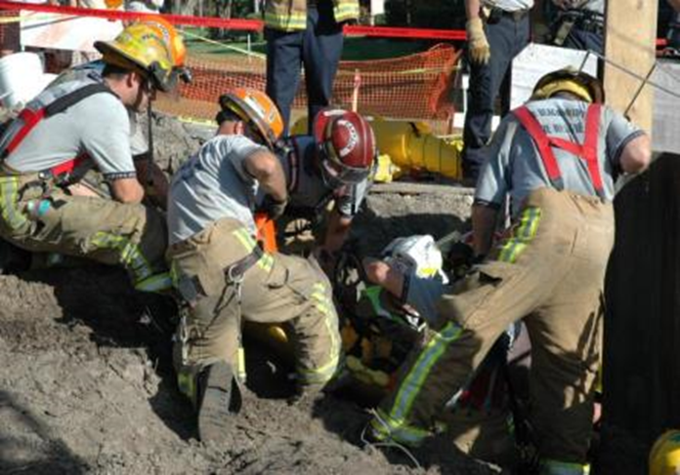
What is an Incident?
An uncontrolled or unplanned release of energy that causes or contributes to illness, injury, death and/or damage to property, equipment or materials.
All incidents have a cause and effect
Notes:
By definition, an incident would be…
“An uncontrolled or unplanned release of energy that causes or contributes to illness, injury, death and/or damage to property,
equipment or materials.”
All incidents, we will discover, have a cause and effect.
Unplanned and unwanted event that disrupts work processes by causing injury or damage.
Incidents are caused occurrences, rarely due to a a random happening or “Act of God.”
Accidents/Inccidents are preventable and even predictable events.
As Safety Processionals, we do not use the word “accident” as it implies an uncontrollable event.
Instead, unplanned harmful contact injury/collision is more accurate.

Slide 4
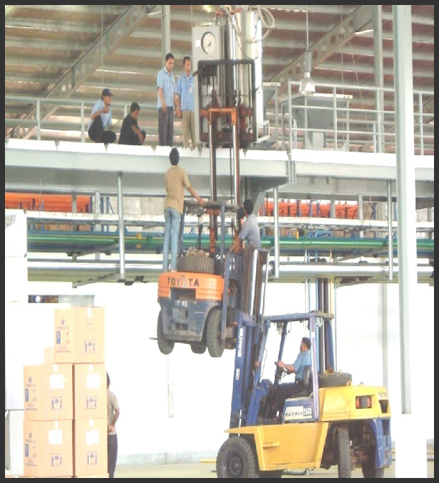
And What Is A Near Miss?
A Near Miss Is An Incident Resulting In Neither Injury Nor Property Damage, BUT Containing The POTENTIAL To Cause BOTH If Its’ Cause is Not IMMEDIATELY Corrected.
A.K.A. – an accident waiting to happen!

Slide 5
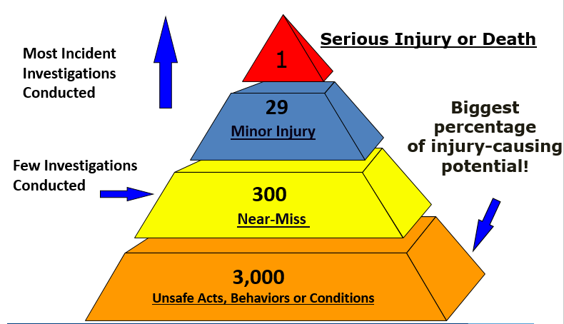
Incident Ration Model
- Heinrich’s Theory
Notes:
This pyramid was developed in 1931 by William Heinrich showing a total of 3,330 incident/accident situations from a defined breakdown according to:
1. Unsafe acts, behaviors or conditions
2. 300 near-miss situations (these first 2 categories are not often investigated due to lack of injury)
3. 29 minor injuries occur, and
4. 1 serious injury or death that may result from this total of events.
Although categories 1 & 2, unsafe acts, behaviors or conditions, and near-misses are not investigated as rigorously if at all, they have the potential to escalate to more intense conditions.

Slide 6

Why Investigate?
Main Reason - To prevent reoccurrence
  To uncover deficiencies in procedures and training or draw attention to needed repairs/maintenance.
  To identify and take corrective actions that prevent reoccurrence of accidents.
    Also, to determine the costs associated with an incident
    To determine compliance with applicable safety regulations
    To obtain facts and process claims
    Investigations are often required by law for serious accidents
Notes:
The primary objective of investigating accidents on a large construction site is prevention.
It is an essential aspect of safety management.
When we can find the causes of a harmful incident, we can take the necessary steps to eliminate or at least control them to prevent future incidents from happening.

Slide 7
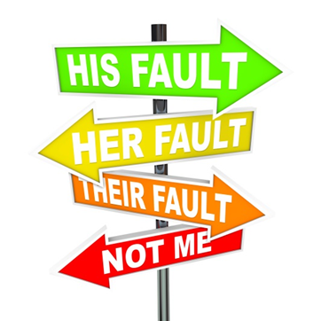
The Aim of the Investigation
Is Not To:
Exonerate individuals or management
Satisfy insurance requirements
Defend a position for legal argument
Assign blame
Remember, fact finding – not fault finding
Find out the what, when, where, who and WHY – to prevent reoccurrence of similar situations
Notes:
It’s a fact finding mission, not fault finding. The goal it to put forth measures to mitigate or prevent reoccurrence.
Foremost in the investigator’s mind should be that the investigation is NOT TO:
Exonerate individuals or management
Satisfy insurance requirements
Defend a position for legal argument
Assign blame
Investigations are about fact finding - - not fault finding.

Slide 8
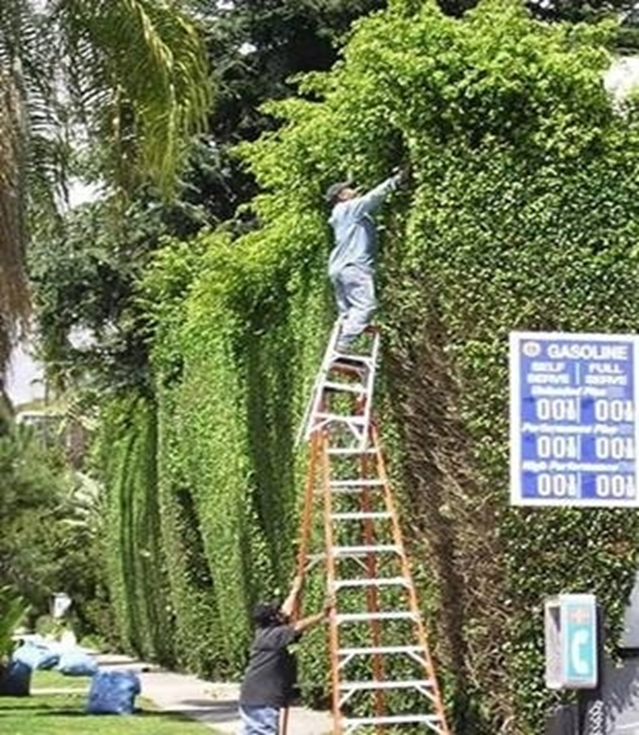
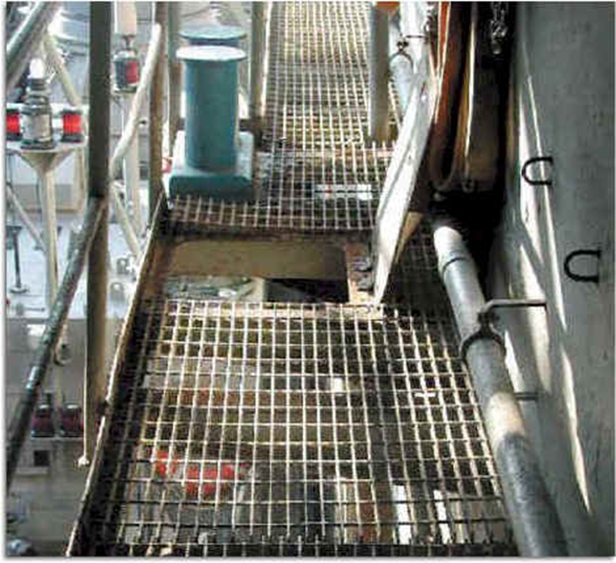
Incident Causes
What are the causes of an incident? There are two basic causes of incidents:
Unsafe Acts, and
Unsafe Conditions
Act – Individual standing on ladders that are set up unsafely.
Condition – Open access hatch (fall hazard).
Notes:
An unsafe act or an unsafe condition can cause an accident.
Safety management systems should focus more on these two areas than hazardous situations for accident prevention.
First, many people focus on gathering physical evidence to account for an accident but give little effort to address unsafe acts.

Slide 9
Unsafe Acts vs Unsafe Conditions
Unsafe Acts
Using unsafe equipment
Improper lifting
Horseplay
Influence of drugs/alcohol
Operating without
authority
Not using fall protection
Unsafe Conditions
Congested area
Noise exposure
Wet floor
Inadequate machine
guards
Inadequate warning
system
Defective/damaged tools

Slide 10
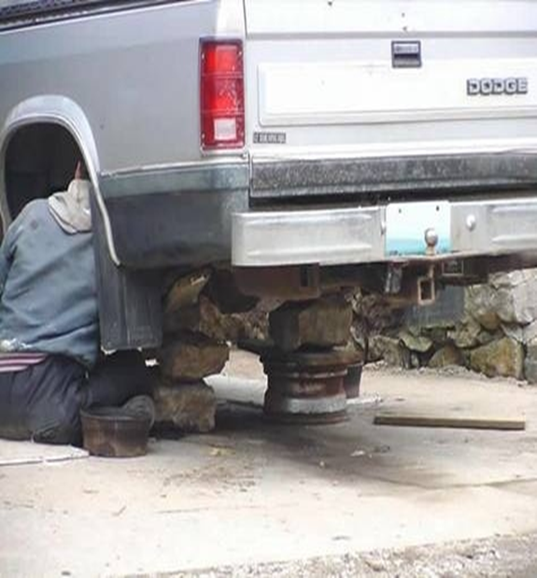
Unsafe Acts vs. Unsafe Conditions
85-90 percent of all harmful incidents are caused by unsafe acts of people, as opposed to unsafe mechanical or physical conditions.
Human failure is the primary cause of incidents.
Notes:
Approximately 85 to 90 percent of accidents happen because of unsafe acts. Only 10 to 15 percent can be attributed to physical conditions. Although improving the physical safety of construction sites is essential, more effort has to be placed to eliminate unsafe acts. It means that the safety management effort of the construction industry has to shift to this goal. While identifying and preventing dangerous acts may be challenging, it is the ultimate way to reduce accidents in a construction project.
But, its also the unsafe acts that lead to the unsafe condition (e.g. open excavation)

Slide 11
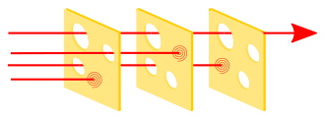
Accident Causation
The Swiss Cheese model
The Swiss cheese model of accident causation illustrates that, although many layers of defense lie between hazards and accidents, there are flaws in each layer that, if aligned, can allow the accident to occur. In this diagram, three hazard vectors are stopped by the defenses, but one passes through where the "holes" are lined up.
Notes:
Accidents in construction sites usually occur because of multiple causes. In an incident investigation, there are many factors to consider. For example, the worker or supervisory experience, the job constraints, and the work environment may all play a role in causing an incident. Is there a lack of personal protective equipment (PPE) or inadequate construction safety training for the workers? It is crucial to the safety management effort to determine how the accident occurred.

Slide 12
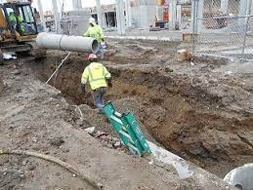
Common Surface Cause - at construction sites
Some of the common causes of incidents in construction projects include the following:
Falling objects
Collapsing materials or cave-ins
Unsafe conditions
Slips and falls
Lack of safety protection and precaution for workers
Deficient machinery and equipment
Power line electrocutions
Vehicular accidents from dump trucks, backhoes, forklifts, etc.
Tripping as a result of hazardous construction materials
Missing protections or guards on power tools
Mechanical defects on power tools and machinery
Insufficient training and experience of workers
Notes:
Every year, thousands of accidents happen in large construction sites leading to injuries, property damage, and loss of life. Some of the most common cases involve being struck by falling debris, electrocution, and being caught between massive objects. Some of these things typically happen due to non-compliance with operations and safety standards or the lack of safety equipment. Sometimes, employees are not adequately trained on safety precautions or have a bad experience.
Statistics show that accidents are caused mostly by unsafe acts of human behavior. Hence, most accidents can be avoided by focusing on changing the attitude of workers towards safety.
65.5% of all construction deaths result from a Focus Four incident 8
Falls (including slips and trips): 35%
Struck-by incidents: 17%
Electrocution: 7.6%
Caught incidents: 5.8%
All other injuries: 34.6%

Slide 13
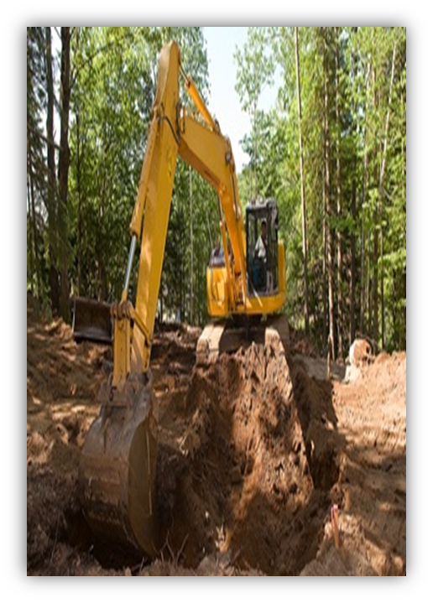
Supervisor Comments – pitfalls
“When the determinations of the causal chain are limited to the technical flaw and individual failure, typically the actions taken to prevent a similar event in the future are also limited: fix the technical problem and replace or retrain the individual responsible. Putting these corrections in place leads to another mistake: The belief that the problem is solved. – Columbia Investigation Board, NASA 2003
“Carelessness”
“Human error”
“Inattention”
“Rushing”
“N/A”
“Accidental injury? I wasn't present.”

Slide 14
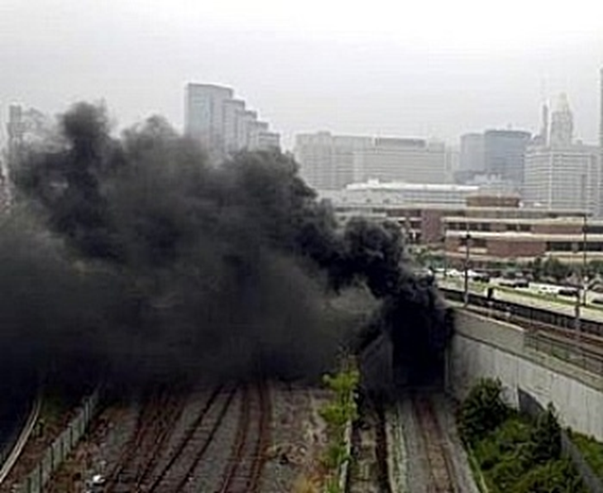
Incident Causes
Basic causes of an incident can generally be grouped into five (5) basic categories:
Task
Material/Equipment
Environment
Personnel
Management
Notes:
Task - In this category, the actual work procedure being performed at the time of the incident is looked at.
Was a safe work procedure used? Did conditions change to make the normal procedure unsafe? Were the appropriate tools and materials available and used? Were safety devices (example: machine guards) in place and working properly?
Material/Equipment - In this area, look for possible causes resulting from the equipment and materials used.
Equipment failure? If so, what caused the failure? Was the machinery poorly designed/maintained? The right tool for the job (the big screw driver)
Were hazardous substances involved? If yes, were they clearly identified and properly labeled? Was a less-hazardous alternative substance available?
Was the raw material substandard in some way? Was PPE used? If yes, was it appropriate for the task being performed and was it in “serviceable condition?”
Environment - The physical environment, including sudden changes to it, are factors that need to be identified.
What were the conditions in the work area (example: cold, hot, damp, etc.)? Was poor housekeeping a problem? Was noise a problem?
Was there adequate light? Weather conditions? Were toxic or hazardous gases, dusts or fumes present?
Personnel - The physical and mental conditions of those directly involved must be explored.
Was the employee experienced in the work he/she was doing? Was the employee adequately trained for the task being completed?
Can the employee physically perform the work? Employee’s health status at the time of the incident?
Was the employee fatigued? Was the employee under work or personal stress?
Management - Management holds the legal responsibility for safety in the workplace!
Were safety rules communicated to and understood by all employees? Were written procedures available?
Were the procedures/rules being enforced? Was there adequate supervision? Is supervision held accountable?

Slide 15
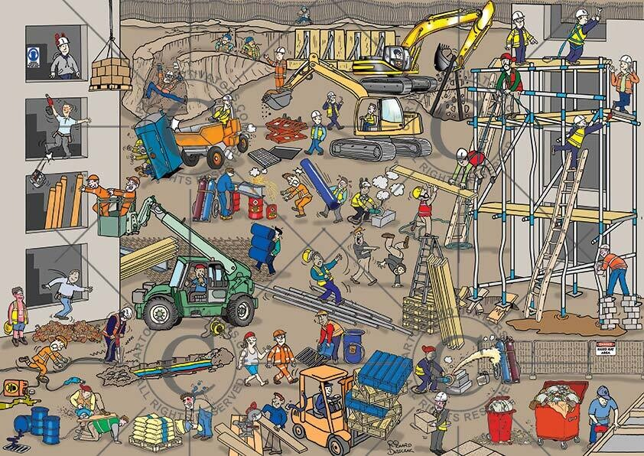
When an Incident Occurs
When an Incident Occurs
  Organize the Incident Investigation Team
  Conduct the Investigation
  Communicate Findings
  Implement Corrective Actions
  Retain Incident Records
Notes:
Incident Investigation Team - Depending on the complexity and severity of the incident
Conduct the Investigation – we will review general steps next
Communicate Findings – whatever means you have, toolbox talks, site meetings, all employee meetings, safety stand downs, lesson from loss documents, etc.
Implement Corrective Actions – identify, track for completion
Retain Incident Records – and preserved any physical evidence.

Slide 16
Incident Investigation Process
First and foremost, provide first aid/medical care if there is an injured party.
Preserve/secure and document the scene.
Collect facts through interviews/observations.
Develop event sequence.
Determine causes.
Recommend improvements
Complete report.
Notes:
Not done after completing the report:
Track corrective actions and follow up for completion
As a best practice, create a “lesson from loss” summary and disseminate to work force via safety talks, meetings, etc.
Track progress as a committee

Slide 17
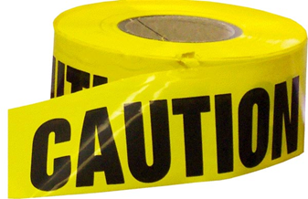
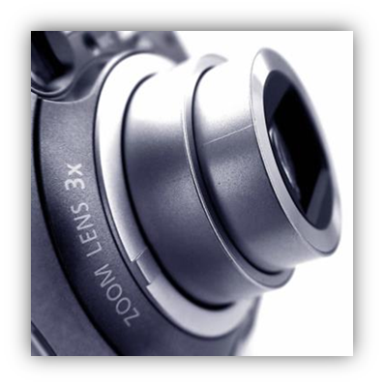
2. Preserve and Document the Scene
Take immediate action to prevent injury or damage.
Secure and preserve the scene until the investigation is complete.
Communicate with employees in the area.
Take (many) photos from various view points.
*For injuries that result in hospitalization or fatality, it is against the law to move any equipment until authorities give the okay unless you must move the equipment to remove victims or prevent further injury.
Notes:
Pictures: To obtain a history of the incident, take pictures or video.
Take a picture of the incident scene (equipment, damage, environmental conditions, positioning, hazards, etc.)
First, expand then zoom/work your way in
Note the date, time and your location
Pictures can be very helpful if further investigation is necessary or a dispute occurs

Slide 18

3. Collect Facts Through Interviews
Interview affected employee(s) and witnesses as soon as possible.
Interview at the accident scene, if possible.
Keep the purpose of the investigation in mind. Make sure the interviewee understands as well.
Ask for the interviewee’s suggestions.
Notes:
Every effort should be made to interview any witnesses.
Witnesses can be a very good source of information regarding the cause of an accident and the conditions associated with it
Witnesses should be interviewed as soon as possible after the incident.
Witnesses should be interviewed alone, rather than in a group.
Have witnesses document their statements and ask them to date and sign.

Slide 19
Interviewing Witnesses
When interviewing, DO NOT:
Attempt to intimidate
Interrupt
Prompt
Ask leading questions
Show your emotions
Make lengthy notes while the witness is talking
Instead, DO THIS:
Ask open-ended questions.
Use probing questions to get more information.
Repeat witness’s answer back to them.
Have the witness write their statement and then sign, date, time (you also sign, date, time).

Slide 20
4. Develop the Sequence of Events
Analyze the accident by breaking down
  Events prior to accident
  Events during
  Events immediately after
Identify gaps in your timeline and gather additional facts and information as needed.

Slide 21
6. Determine the Causes
Direct Cause – The immediate source of the accident, often quickly identified
Indirect Cause – An unsafe action or condition
Root Cause – Policies, decisions, environmental or personal factors
“Accidents usually result from multiple and interacting causal factors that may have organizational, cultural, technical or operational systems origins. If accident investigations do not relate to actual casual factors, corrective actions taken will be misdirected and ineffective.” (Manuele, 2011)
Notes:
Again, remember the Swiss Cheese model.
To prevent future occurrences you need to determine the root cause!

Slide 22



WEED OUT THE CAUSES OF INJURIES AND ILLNESSES
Direct causes of injury/illness
Strains
Burns
Cuts
Unguarded machine
Horseplay
Broken tools
Create a hazard
Surface Causes of the Accident
Chemical spill
Ignore a hazard
Defective PPE
Fail to report injury
Conditions
Untrained worker
Fail to inspect
Behaviors
Lack of time
Fail to enforce
Too much work
Fail to train
Inadequate training
No recognition
No discipline procedures
Inadequate labeling procedures
No orientation process
Outdated procedures
Root Causes of the Accident
Inadequate training plan
No recognition plan
No accountability policy
No inspection policy
If we eliminate the root cause of an incident, we can reduce the likelihood of similar incidents in the future!
Notes:
On the left, “above-ground” conditions that could contribute to injuries are listed; these are contributing factors to an injury.
The same is true on the right side dealing with behaviors. The visible, “above-ground” behaviors are but surface causes.
We need to determine the invisible “root causes” of both conditions and behaviors, remove them to mitigate the incident from reoccurring!
Root Cause Analysis
Root Cause Analysis (RCA) is a tool that helps teams discover not only what went wrong, but also provides members with the framework to develop a countermeasure to prevent future occurrences of the issue – similar to how the immune system learns to recognize viruses it has seen before to prevent them from causing harm in the future.
Definition
A systematic method of analyzing possible causes to determine the root cause of a problem.

Slide 23
The Five Whys
Developed by Sakichi Toyoda
Part of the Toyota Production System
  Responsible for driving sustainable growth, employee accountability, and continuous process improvement
Kaizen, lean manufacturing, Six Sigma (6σ)
  Can be used all levels of employees
  Can be integrated into all job functions
The Five Whys – A Simple Example
  Pose a situation meriting further investigation
  List possible causes of said situation
  Repeatedly asking the question “Why” may lead you to the root cause of an accident. You will find that the most obvious cause will only lead to more questions.
Notes:
TQM, Six Sigma, etc – QA

Slide 24

The Five Whys
Repeatedly asking the question “Why” may lead you to the root cause of an accident. You will find that the most obvious cause will only lead to more questions.
Simple Example 1: You are on your way to work and your truck stops in the middle of the road.
Why did your truck stop?
- Because it ran out of gas.
Why did it run out of gas?
- Because I didn’t buy gas on my way to work.
Why didn’t you buy gas on your way to work?
- Because I didn’t have any money.
Why didn’t you have any money?
- Because I lost it all during a poker game last night.
Why did you lose at poker?
- Because I’m terrible at bluffing.
Notes:
Benefits of asking the 5 Whys:
Simplicity: Easy to use and requires no advanced mathematics or tools.
Effectiveness: Helps to quickly separate symptoms from causes and identify the root cause.
Comprehensiveness: Helps to determine relationships between various problem causes.
Flexibility: Works well alone and when combined with other methods.
Engaging: Fosters teamwork.
Inexpensive: A guided, team-focused exercise with no additional costs.

Slide 25
The Five Whys - Simple Example 2
Simple Example 2: My truck won’t start
Why won’t your truck start?
- Because the battery is dead.
Why is the battery is dead?
- Because my alternator is not functioning.
Why is your alternator is not functioning?
- Because the alternator belt is broken.
Why is the alternator belt broken?
- Because my alternator belt was beyond its useful service life.
Why is the belt beyond its useful service life?
Root Cause: Because the vehicle was not maintained according to the manufacturer's recommended service schedule
Alterable behavior
In the workplace: A management control, such as devising a process to ensure maintenance logs are kept and scheduled maintenance is preformed can be put in place to prevent the situation from arising again
Notes:
Scenario: My car won’t start
Cause: My battery is dead
Cause: My alternator is not functioning
Cause: My alternator belt is broken
Cause: My alternator belt was beyond its useful service life
Why?
Answer: The vehicle was not maintained according to the manufacturer's recommended service schedule
Scenario: My car won’t start
Root Cause: The vehicle was not maintained according to the manufacturer's recommended service schedule
Alterable behavior
In the workplace: A management control, such as devising a process to ensure maintenance logs are kept and scheduled maintenance is preformed can be put in place to prevent the situation from arising again

Slide 26
The Five Whys - Simple Example 3
Problem Statement: Excavator bucket lost pressure and struck a concrete vault (Why?)
First Why: The hydraulic line was frayed and severed while in use. (Why?)
Second Why: The equipment was not properly inspected prior to operation. (Why?)
Third Why: Pre-operational inspection are being “pencil-whipped.” (Why?)
Fourth Why: Operators are not held accountable for true and proper inspections. (Why?)
Fifth Why: There are no formal accountability measures to ensure for quality inspections of equipment. (Root Cause)
Notes:
Alterable behavior:
A management control, such as developing and implementing a mandatory inspection, auditing and accountability process to ensure proper pre-operational inspections completed.

Slide 27
Limitations of using the
Five Whys
Different individuals can determine different root causes
  Relies on investigator’s current knowledge
Tendency to settle on a single root cause
Tendency to not “dig deep enough”
  Five iterations may be sufficient, however every incident will be different and command a different depth of investigation
Too basic?
Notes:
The process isn’t easily repeatable. A person analyzing the problem through a different lens may come to a different conclusion.
Sometimes there are more than one possible causes to complex problems, which is why 5 Why Analysis is often used in combination with other Lean methods for bigger problems.
You can only operate within the information you know; you can’t find the actual root cause if you are lacking important information.
Generally, a single root cause is identified at the end of the process when, in reality, some problems result from a number of errors (also common in bigger problems).

Slide 28
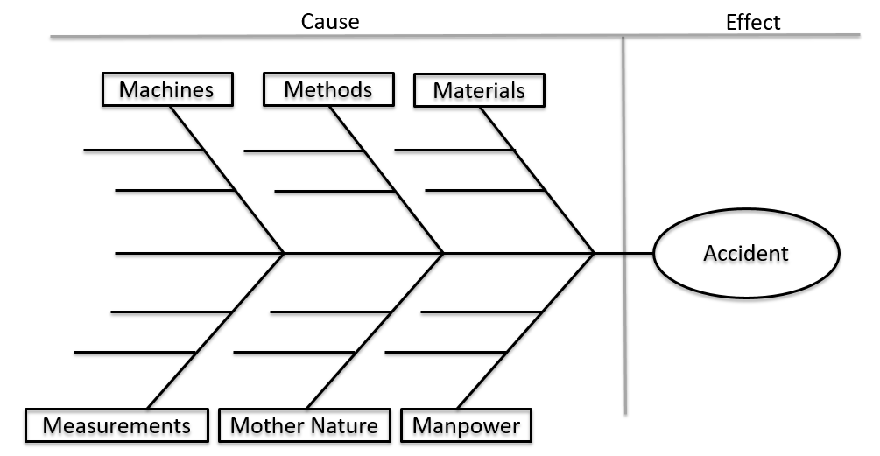
Ishikawa (Fishbone) Diagram
Notes:
Fishbone Diagram
A fishbone diagram for root cause analysis allows teams to investigate and consider several possible root causes to a singular problem. Used in conjunction with 5 Whys and PDCA thinking, this Root Cause Analysis template helps to provide a fuller picture of what went wrong and how to address it.

Slide 29
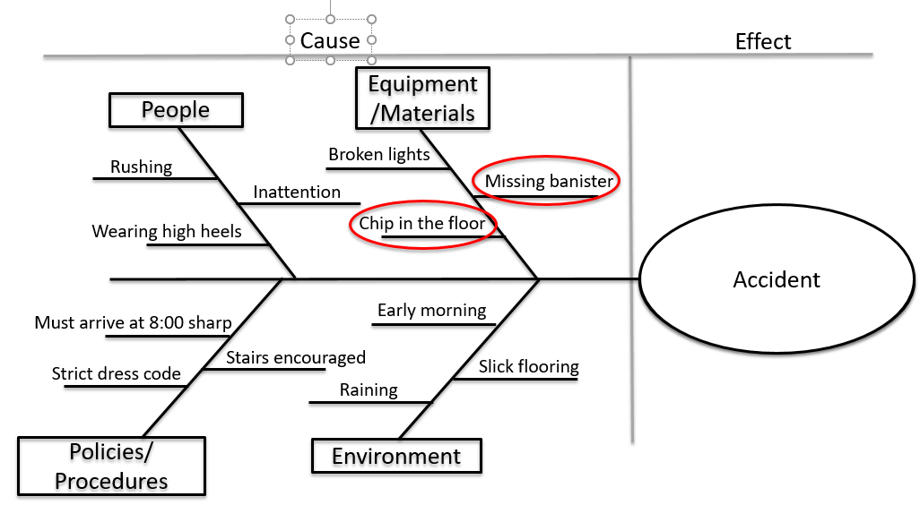
Ishikawa (Fishbone) Diagram

Slide 30
6. Recommend Improvement/Corrective Actions
Using your root cause analysis, look ahead to see how the risk of similar incidents can be reduced.
Identify solutions that are practical, specific, effective, and based on consultation.
Rank your solutions in order of priority.
Make a plan and take the first step.
Follow-up.

Slide 31
Corrective Actions – pitfalls
Told to be more careful
Explained safety rule on trenching
Instructed employee to read Safety Data
Sheet (SDS)
Had co-worker review proper procedures
ARE THESE EFFECTIVE MEANS OF CORRECTIVE ACTION? WHAT DO YOU THINK?
Not really! These actions do not really correct anything.

Slide 32
Better Corrective Actions
Met with employee to discuss incident and reviewed proper procedures and then...
  Observed employee perform the procedure
    Showed employee SDS, reviewed how to interpret; use of appropriate PPE
      Checked for understanding
        Scheduled time to discuss the incident with all employees in the department at the next meeting

Slide 33
7. Complete the Report
Document your findings in the Incident report.
Set a target date to complete your suggested corrective actions.
Once you complete the corrective actions or take the first step to completing the corrections, the report can be closed.
Continue to follow-up and make steps towards improvement.
Notes:
Incident-injury report should also ensure:
There is a detailed description of what happened to cause the accident.
There are appropriate/detailed comments as to what action(s) will be taken to prevent future accidents.
Make sure the form is completely filled out with all applicable information.
Accidents resulting in a fatality or hospitalization must be reported OSHA

Slide 34

Incident-Injury Report
WHAT SHOULD BE INCLUDED IN A REPORT?
All the facts, statements, documents, photos, etc. that were obtained during the investigation
Remember, no opinions (e.g. “I think that, I believe that”…)
Analysis of the cause
Corrective actions
Notes:
Also, consider a initial first report of incident form to get the claim reported and processes quickly and a more detailed supervisory incident investigation report

Slide 35
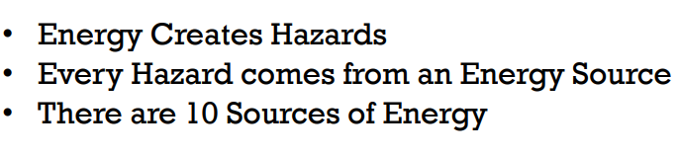
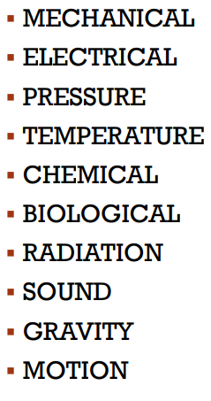

Hazard Recognition – The Energy Wheel

Slide 36
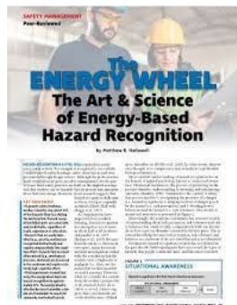
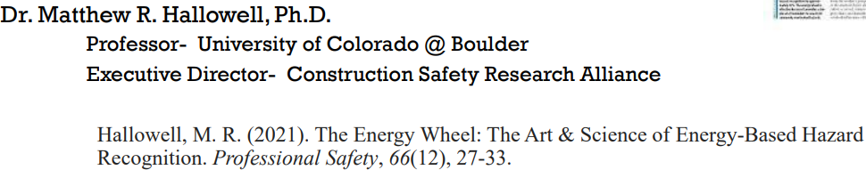
Follow the data…

Slide 37
Putting it all together…
Use what you’ve learned from past losses/root causes
Train employees on effective hazard identification practices
Utilize a behavioral based safety process and recognize safe leaders
Ensure employees and supervisors are consistently held accountable for safety
Then, track and communicate for continuous improvement
= A robust safety management process to prevent harmful incidents and evolve the safety culture to a more interdependent level.
Notes:
The investigation process/root cause identification
Like, the Energy Wheel
Some kind of BBS process - to capitalize on the base of in incident pyramid (i.e. those 3,000 unsafe behaviors, acts, conditions)
Consistency is key!
The, track and communicate improvements along the way
= A robust safety management process to prevent harmful incidents and evolve the safety culture to a more interdependent level.

Slide 38
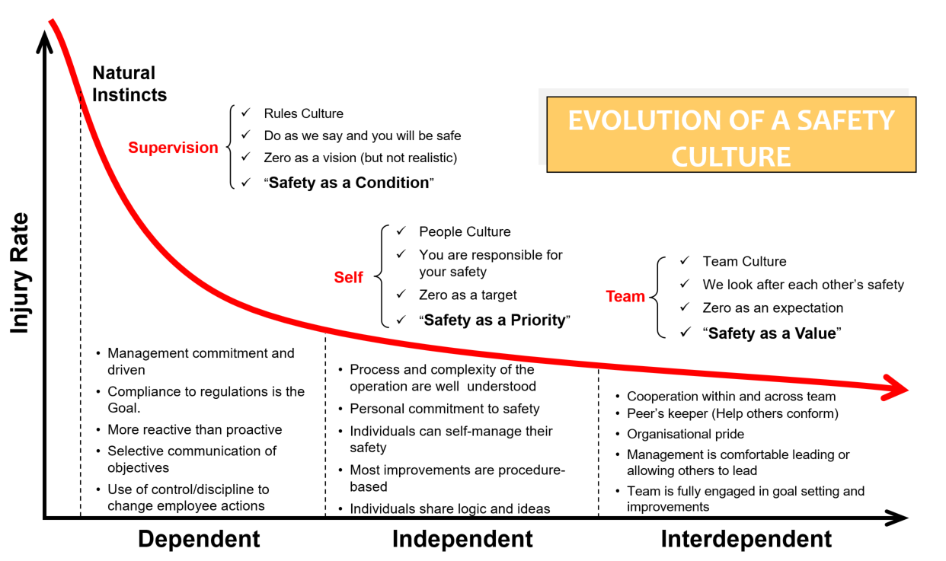
Notes:
Construction workers have long had a reputation for stubbornness and stoicism, at times to a fault. Compliance with safety rules — like wearing hard hats and tethers — carried a stigma among some hard-nosed old-timers, often preventing widespread adoption. Fortunately, times are changing in many ways. PPE, safety harnesses, and high-visibility vests seem to be more prevalent — and proudly worn — on more jobsites than ever.
Today’s construction leaders recognize the impact of investing in a culture of safety.
The Bradley Curve

Slide 39

Questions?

Slide 40
Gallagher Construction Practice
Solely focused on the Construction Industry
>30% of our staff has construction industry experience
Industry Leading Client to Staff Ratio <2:1
40% of our clients are in group or single parent captives
85% of our clients recognize a 28% reduction in their WC EMR in 3 -4 years
Risk Management Assessment
Medical Director Program
Construction Industry Claim Advocates and Safety Professionals
Construction CEO Mentoring
Recruiting
Notes:
What makes us different?
Our approach and resources
We have hired very differently
We have time to implement
We are extremely relationship driven
We are a team model
Proven track record of sustained client success
Fully committed to a strong ethic of integrity, teamwork, innovation and responsiveness
We exist to pull companies forward

Slide 41
Construction Safety Trends 2023
Since 2008, construction has experienced more total deaths than any other industry (and that figure doesn’t include fatalities from suicide — of which this industry also has the most).
Construction professionals have higher injury rates than most other professions and experience some of the highest rates of alcohol abuse.
65.5% of all construction deaths result from a Focus Four incident (Falls 35%; Struck-by 17%; Electrocution 7.6%; Caught-in 5.8%; All others 34/6%
About 40% of construction injuries result in days away from work
$1,460: Average penalty per citation (2011 - 2020)
$156,259: The maximum OSHA penalty for each willful or repeated violation
$8.35 million: The highest OSHA penalty ever issued to a single contractor
$5 billion: The annual cost of construction-related deaths, measured in lost production, lost family income, and pain and suffering
$7.87 billion: The cost of workers’ compensation direct costs from the top five injury causes in construction

