Slide 1
The Great Supply Chain Disruption:
Causes & 2022 Outlook
John Drake, Vice President, Supply Chain Policy

Slide 2
How We Got Here…
Global trade is surging
COVID-19 led to huge U.S. fiscal stimulus
Consumer spending habits shifted as a result of COVID-19
Shifts in demand lead to bigger disruptions

Slide 3
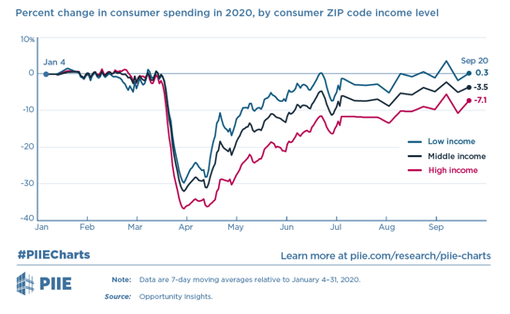
U.S. consumption drops, then rebounds following robust stimulus.
Then-President Trump signs the American Rescue Plan Act of 2021 into law on March 11, 2020, injecting $1.9 trillion into the economy.

Slide 4
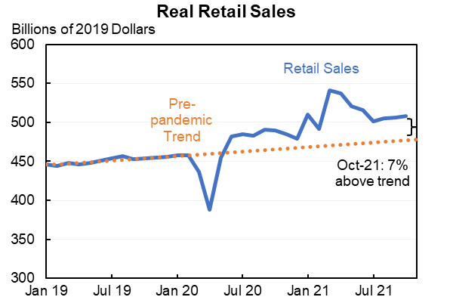
…and leads to a surge in consumer spending
U.S. consumers shift spending patterns due to quarantines, moving discretionary dollars away from travel, restaurants, etc.
Note: Nominal values deflated by CPI for commodities.
Source: U.S. Census Bureau; Bureau of Labor Statistics; Macrobond; author’s calculations

Slide 5
But…COVID forces other disruptions…
Many businesses cut orders, leading to shortages of key inputs (e.g., semiconductors) when demand returns with a bang.
COVID forces factory closures in Asia, disrupting the flow of goods to the United States.
COVID puts 3x usual number of trucking companies out of business in 2020. Thousands of workers laid off and many take early retirement, contributing to today’s 80,000 driver shortage.
The U.S. workforce is 4 million workers below pre-pandemic levels. If you are a business, you will pay more for labor in 2022. (Immigration, the Great Resignation, COVID recovery) all putting additional strain on labor supply.
Five to seven years of e-commerce growth was compressed into a single year, placing enormous stress on transportation and logistics industries and a huge increase in transportation costs.

Slide 6
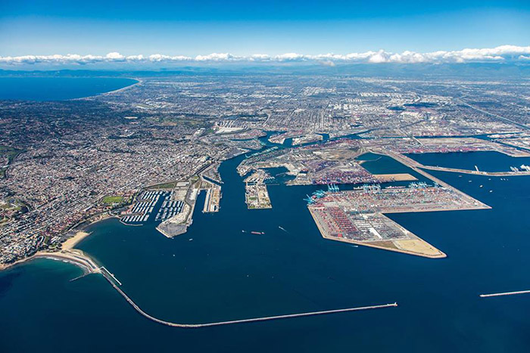
In Focus: Ports of Los Angeles & Long Beach
The Ports of Los Angeles and Long Beach are two of the world’s busiest seaports and the leading gateway for international trade into the United States.
40%
of all seaborne imports to the United States enter through these two ports.
2,981,000
jobs created throughout the United States.
Source: The Port of Los Angeles; The Port of Long Beach

Slide 7
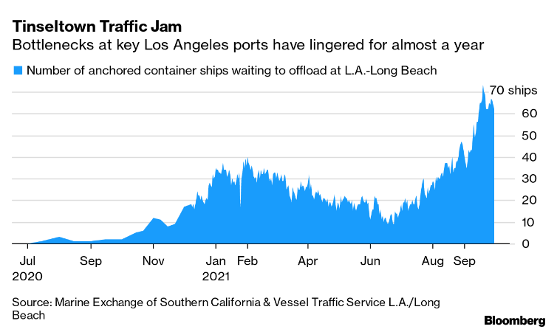
Backup of Container Ships at POLA/POLB
Container ship back ups peaked at over 100 ships late last year, and down to over 50 this month.

Slide 8
Calendar Year Projection
Annual Container Statistics
10,800,000+
9,343,192.95
9,458,748.50
9,337,632.40
8,856,783.00
9,213,395.95
TEUs
8,160,458.00
Source: The Port of Los Angeles

Slide 9
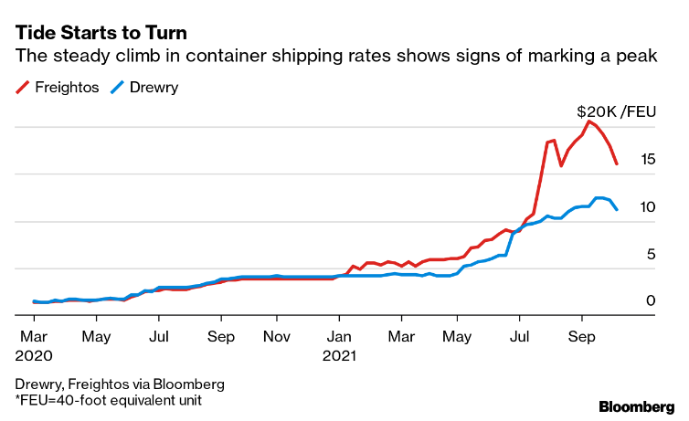
Are we through the worst?
Actions taken by POLA/POLB appear to be working.
Average ocean rate for 40-ft container have declined for 12 weeks
Spot pricing for Shanghai-Los Angeles route is down about 19% from September peak
Fewer containers lingering for 9+ days at POLA/POLB.

Slide 10
Short answer: NO!!!
COVID looms large…
Potential supply chain blockages due to Omicron and other COVID variants (e.g., China’s zero tolerance & lockdowns in Tianjin, Shenzhen, and Beijing)
Potential for hording and future volatility of key supplies (e.g., semiconductors)
Service disruptions at West Coast ports due to new labor contract negotiations
Aftershocks of these disruptions on other aspects of supply chain

Slide 11
U.S. ports are under the microscope…
U.S. has some of the least productive ports in the developed world – contributing to current challenges.
Port of Los Angeles and Port of Long Beach handle approximately 40% of all U.S. imports – but rank #328 and #333 out of 351 ports worldwide.
Ports in Asia, the Middle East and North Africa dominate the top 50 spots, while four U.S. ports are in the top 100 – Philadelphia (#83), the Port of Virginia (#85), New York & New Jersey (#89) and Charleston, South Carolina (#95).
* Top five ports worldwide: (#1) Yokohama (Japan); (#2) King Abdullah (Saudi Arabia); (#3) Chiwan (China); (#4) Guangzhou (China); and (#5) Kaoshiung (Taiwan).

Slide 12
Geopolitics is driving new decision-making
U.S. government focusing increasingly on “supply chain resilience.” (America’s Supply Chain Executive Order, U.S. Innovation and Competition Act, recent riders on National Defense Authorization Act, etc.)
China looms large (14th Five Year Plan on self-sufficiency in core technologies; the “Quad” (US, India, Japan, and Australia) & supply chain resilience, etc.)
Increasing competition over the energy transition & “critical minerals”
U.S. businesses should expect more political scrutiny in impacted sectors (especially manufacturing, ICT, and extractive sectors) and more “ad hoc” interventions – leading to more uncertainty and higher costs.

Slide 13
Businesses are taking a hard look at “business as usual.”
Increasing C-suite discussions around shifting supply chains to adjust to new uncertainties…
Regionalization
Near shoring (ex., United Colors of Benetton)
Re-shoring (moving production back to country originally located)
But – estimates of up to $1 trillion over five years to move production out of China.

Slide 14
Thank you.

