Slide 1
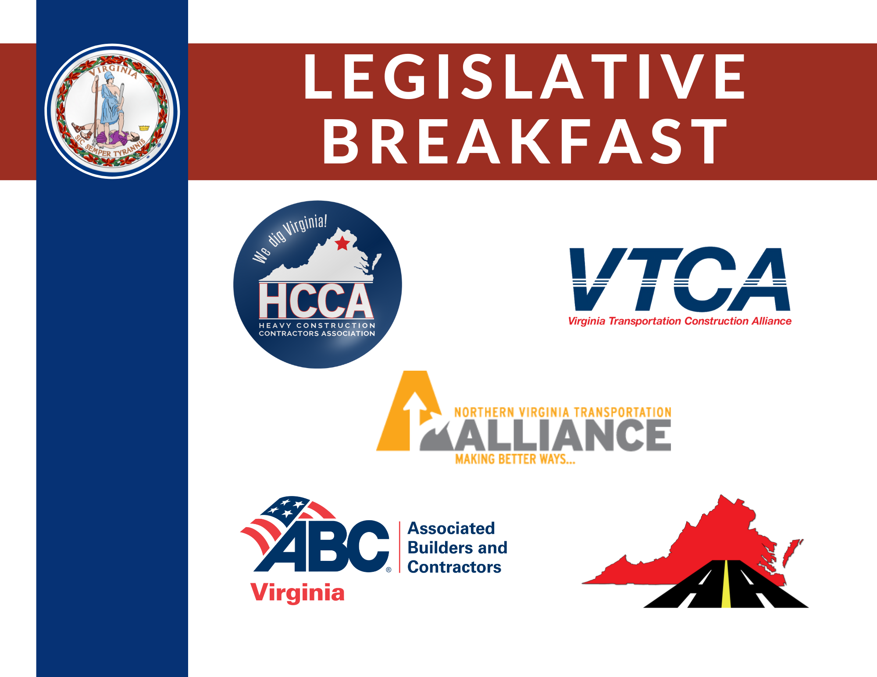

Slide 2
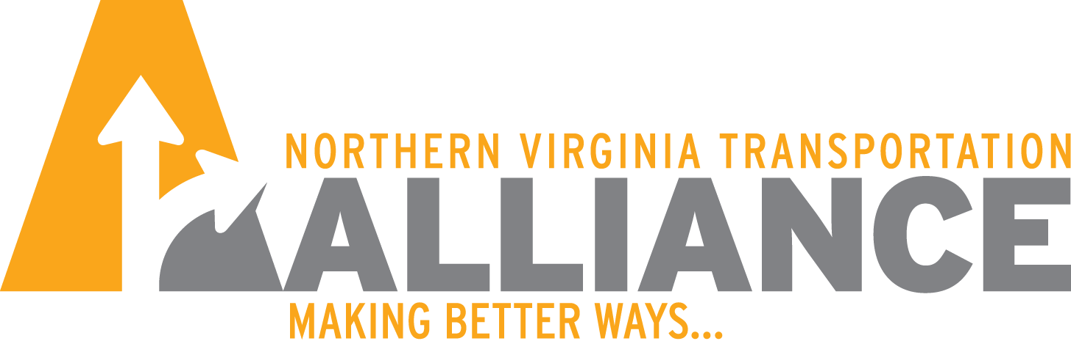
Regional Transportation Overview
Advancing Transportation Solutions

Slide 4
67% of total funding to Transit
32% of total funding to Roadways

Slide 8

Public Opinion on Transportation Issues
66% of DC area residents ranked reducing traffic congestion and improving travel times as their top transportation goals
84% supported continued investment in our roadway network
73% opposed allowing traffic congestion to worsen to discourage people from driving cars
61% opposed eliminating funding for roadway improvements as a strategy to reduce GHG emissions
Only 33% supported diverting funding from other transportation priorities to close Metro’s funding gap

Slide 9
Key Takeaways
Northern Virginia is growing and TOD alone is not going to solve our transportation challenges
We need a comprehensive approach to transportation that includes roadway and transit improvements
Eliminating or diverting funding from roadways to other priorities is bad for transportation and extremely unpopular

Slide 11


