Slide 1
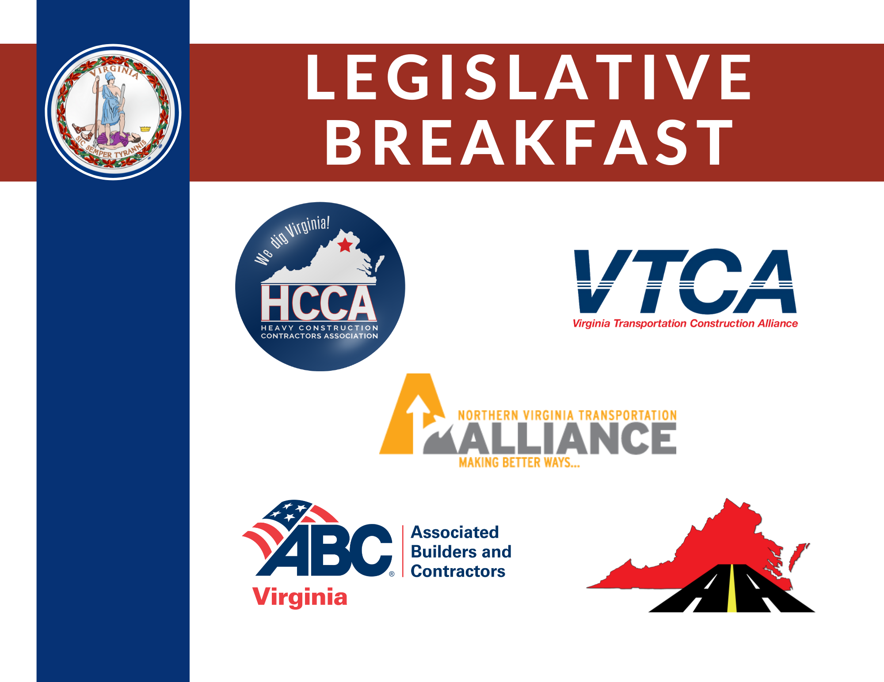

Slide 2
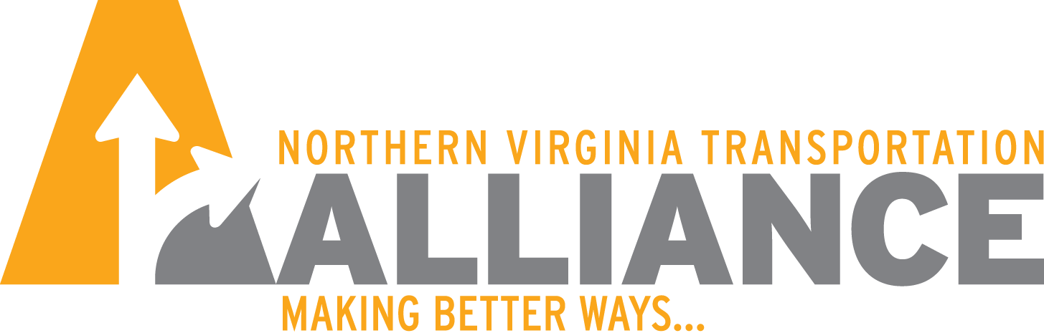
Regional Transportation Overview
Advancing Transportation Solutions

Slide 5
67% of total funding to Transit
32% of total funding to Roadways

Slide 10

Greater Washington
Transportation Issues Survey
2022
Steve Raabe
President, OpinionWorks LLC

Slide 11
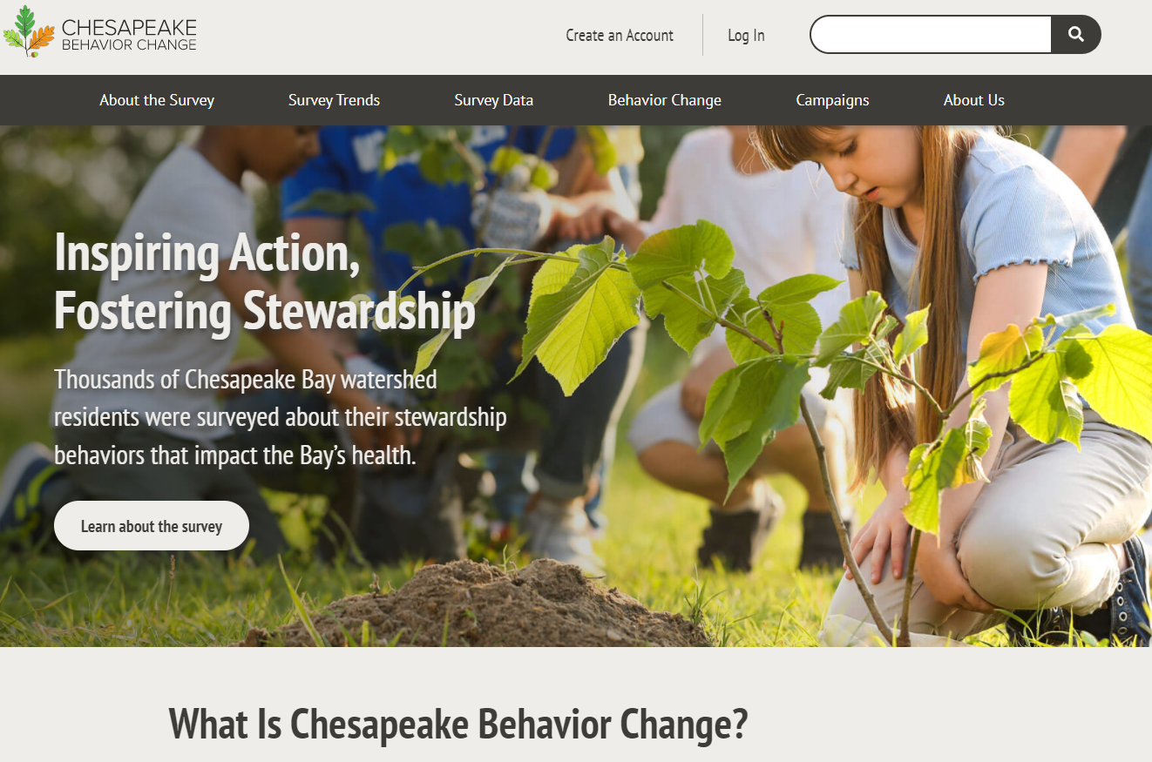

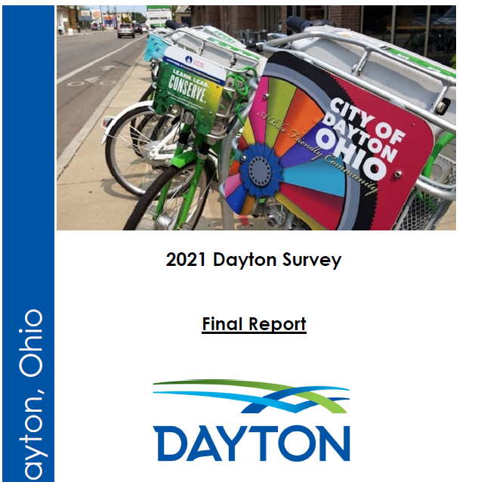

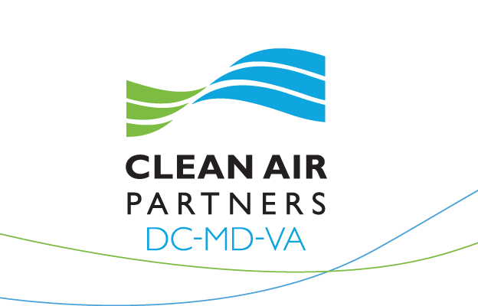

OpinionWorks Credentials
Measuring perceptions, attitudes since 2001
Surveys, focus groups, in-depth interviews
    The Baltimore Sun
  Chesapeake Bay Program
  Metropolitan Washington Council of Governments
  The Recycling Partnership
  William Penn Foundation
  American Heart Association
  Animal Humane Society
  Waterfront Partnership of Baltimore
  Los Angeles County, California
  City of Lexington, Kentucky
  Ocean City, Maryland
  Montgomery College
  New York University
  University of Richmond

Slide 12
Point 1:
Transportation
Is the Leading
Regional Concern

Slide 13
Greatest Long-Term Challenges
In your opinion, what is the greatest long-term issue or challenge facing the Greater Washington region? (Open-ended; categorized responses shown.)

Slide 14
Congestion Could Cause Me
to Leave the Area
How much to you agree or disagree with the following statements?
If traffic congestion and convenient transit options don’t improve in the next five years, I would consider moving out of this area.

Slide 15
Point 2:
Transportation
And Climate Change

Slide 16
Climate Change Impacts Should be Considered
How much to you agree or disagree with the following statements?
Elected officials need to consider the impacts of climate change when planning for transportation in the future.

Slide 17
Most Important Transportation Goals
(Combined 1st and 2nd choice rankings)
Leaders of the Washington region have adopted a 25-year transportation plan that guides future road and transit projects. This plan focuses on achieving specific goals. Which of these goals would you rank as most important, and which one is second most important?

Slide 18
Point 3:
People Support a Comprehensive Approach

Slide 19
Priority for Future
Transportation Investment
When it comes to future investments in transportation improvements, is it more important to invest in new (rotate): [road projects, transit projects], or a combination of both?

Slide 20
Allow Traffic Congestion to Worsen So People are Persuaded Not to Drive
How much to you agree or disagree with the following statements?
We should allow traffic congestion to worsen so people are persuaded not to drive.

Slide 21
Point 4:
People Oppose Diverting Funding from other Transportation Priorities

Slide 22
Climate Strategies: Lower Tier
Rankings based on favorability
Following are several major strategies to reduce greenhouse gas emissions that regional transportation planners are considering. Please say if you strongly favor, somewhat favor...
Convert some existing travel lanes to bus-only lanes.
Prohibit the sale of gas-powered vehicles by 2030.
Convert some existing free travel lanes to toll lanes.
Eliminate all funding for roadway widening and improvements to discourage car travel.
Charge a fee to drive into Arlington and DC.
Charge a fee of 5 to 10 cents per mile traveled by car within the Washington region.
Eliminate all free parking at workplaces across the region.

Slide 23
Preferred Strategies for Metro System
Rankings based on favorability
The Metrorail and Metrobus system is currently facing a funding shortfall due to low ridership and higher operating and capital costs. Here are some strategies that Metro is considering to close the funding gap. Please say if you strongly favor, somewhat favor...
Redesign the region’s bus network to better integrate Metro and local bus system.
More aggressively pursue non-passenger revenue such as advertising, real estate development, and retail in Metro stations and on WMATA-owned properties.
Strengthening enforcement to reduce fare evasion.
Increase Metrorail and Metrobus fares for individual trips, while offering more discounted multi-day pass options.
Eliminate bus routes with low ridership.
Divert funding from other transportation priorities such as roadway improvements.
Run trains and buses less frequently.

Slide 24
Key Takeaways
Land use is not a silver bullet for transportation or climate Change in Northern Virginia
80% of trips in the DC area will still be taken via automobile in 2045
We need a comprehensive approach to transportation that includes roadway and transit improvements
Eliminating or diverting funding from roadways to other priorities is bad for transportation and extremely unpopular

Slide 25
Transportation Programs Face a Variety of Challenges
Last year’s elimination of food tax is estimated to reduce transportation revenues by $741.4 million over six years.
Inflation in material and wage costs affects all modes.
  VDOT projects are facing an approximately 11 to 17 percent increase in bids based on contract lettings.
  CTB recently set aside $130.0 million for budgeted contingency.
  CTB may need to do the same in 2023
SMART SCALE requests have exceeded available funding $7 to $1. (Round 5 is $7.7B)
Unlike state motor fuels tax, regional motor fuels taxes are forecast to decline from increased electrification of vehicle fleet.
  Regional Authorities do not have access to forward-looking highway use fee.
  Some concern that current funding formulas do not address all needs adequately.

Slide 26
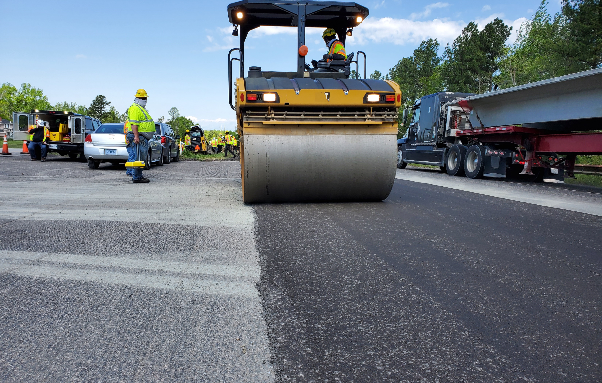
2022
NOVA Legislative Breakfast
Work Force Challenges and Efforts
VIRGINIA ASPHALT ASSOCIATION
Tuesday, November 29, 2022
8:00 AM | NOVA Realtors Office
Trenton M. Clark, P.E., President
HEAVY CONSTRUCTION CONTRACTORS ASSOCIATION
Debora Harvey, Executive Director

Slide 27
Work Force Challenges
Virginia Work Force 125,000 Smaller
Virginia Firms Have More Than 100,000 Infrastructure Related Openings
Shrinking Working Age Population – Fertility and Immigration
Large Percentage of Existing Work Force Near or At Retirement Age

Slide 28
Areas of Immediate Need
Drivers
Equipment Operators
Mechanics
Electricians and Electrical Workers
Internet/Broad Band
Welders

