Slide 1



HCCA Dinner
Homebuilders Outlook for 2023
November 16, 2022

Slide 2

Economic Backdrop

Slide 3
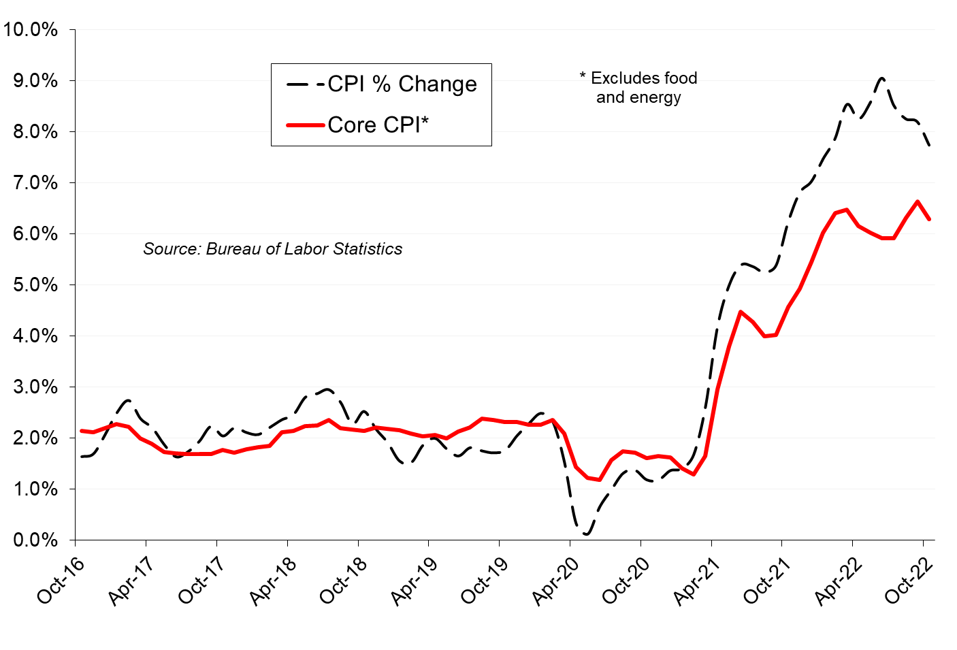
U.S. Inflation
Notes:
40-year high
Every time inflation exceeds 4%
And unemployment is below 5%
A recession ensues (Larry Summers)

Slide 4
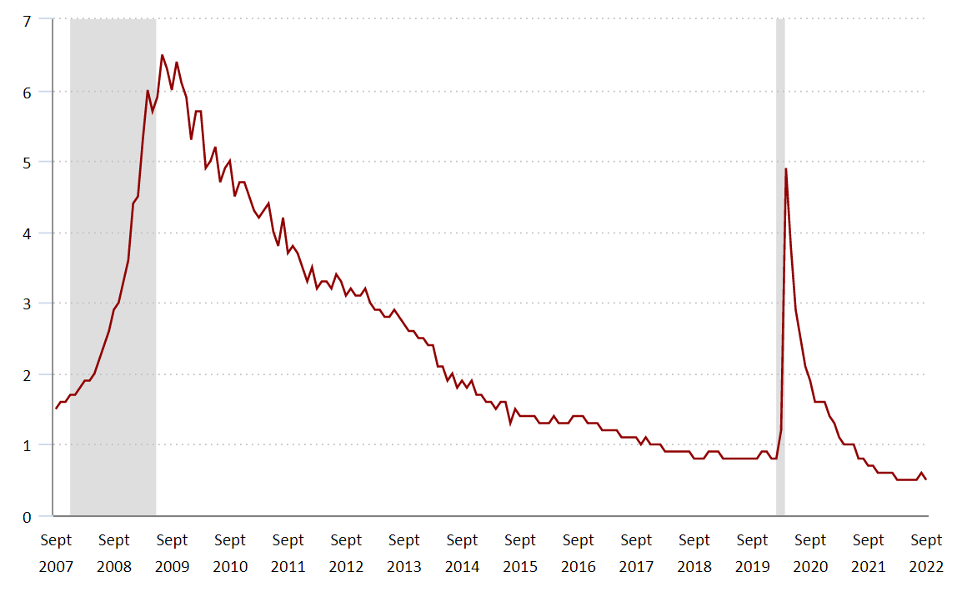
U.S. Unempl People per Job Opening
Source: BLS
Only 1 available worker for every 2 job openings
Notes:
This is a record low workers per job opening

Slide 5
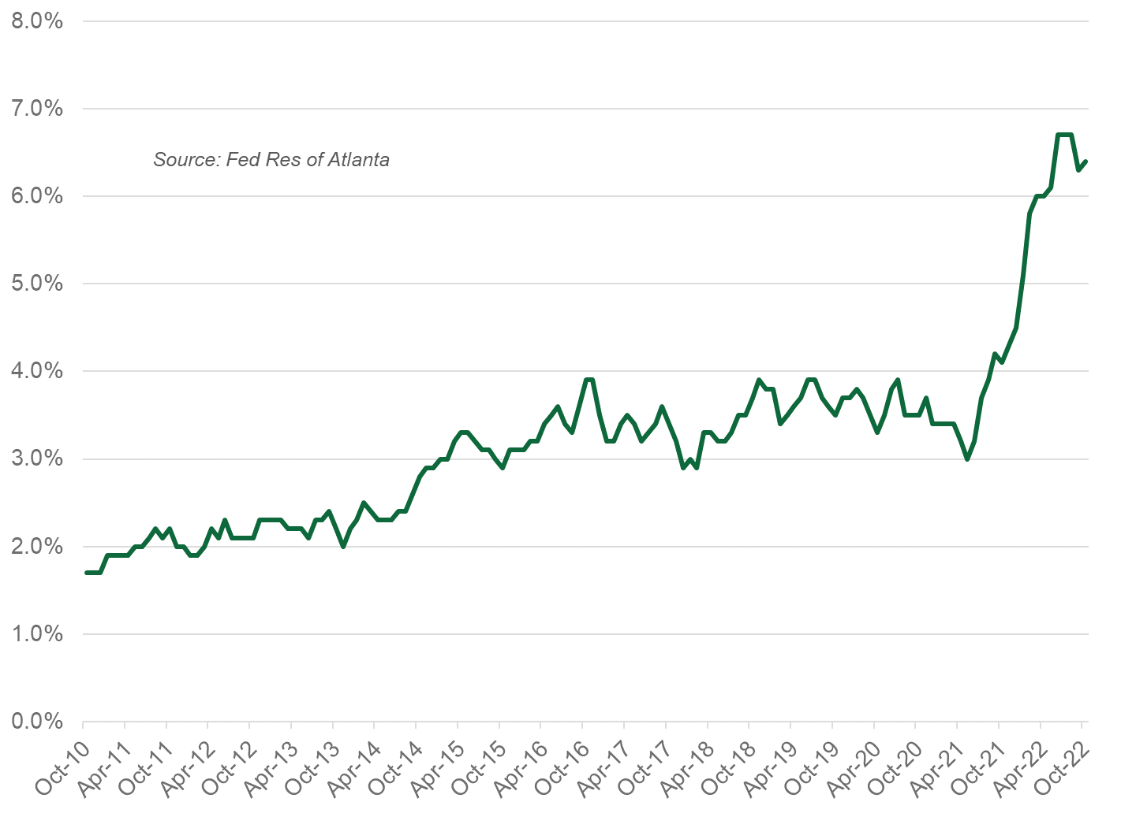
U.S. Wage Growth Tracker
Notes:
Tight labor market leads to higher wages
This contributes to inflation

Slide 6
Other Inflationary Factors
Cash stimulus
Low borrowing rates
Higher net worth
  Houses
  Stock Market
Strong consumer confidence
Supply-chain issues/low inventories
gone
gone
hanging on
gone
waning
still there

Slide 7
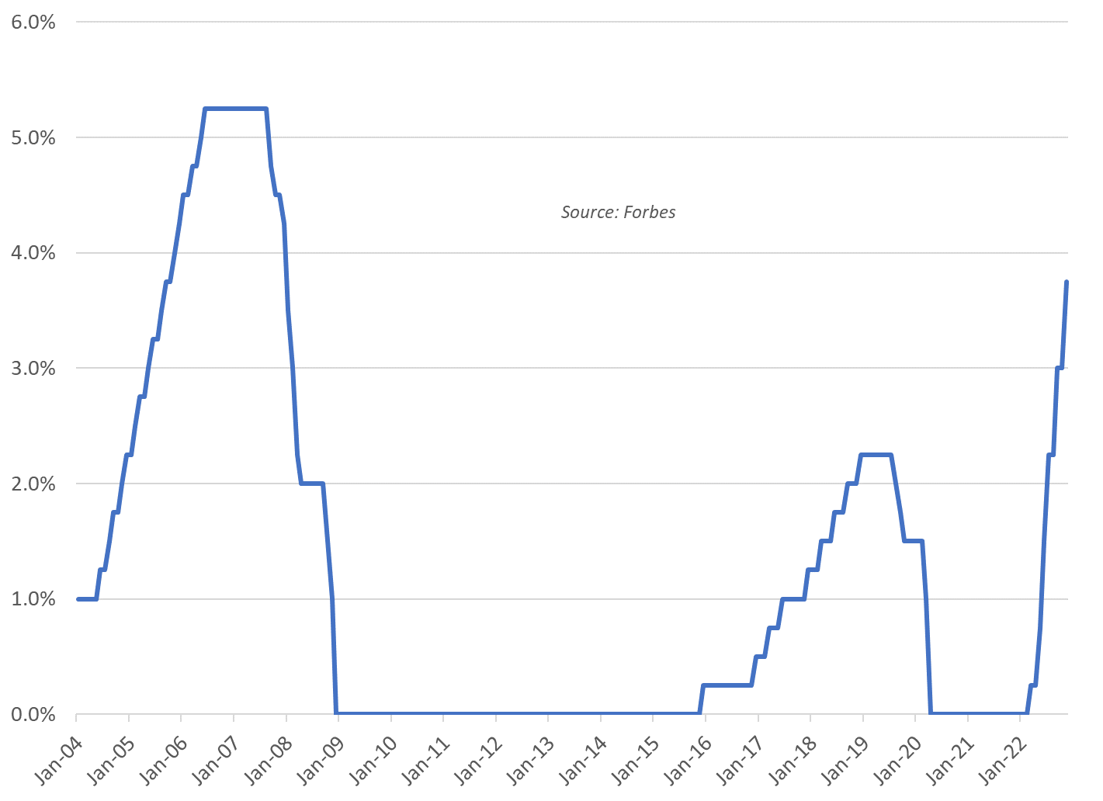

Federal Reserve Targeted Funds Rate
Covid
Great
Recession
Notes:
Here comes the FED!
A 50-basis pt increase in May
Two 75-basis pt increases in June/July
WSJ Survey = 3.5% by next summer

Slide 8
Mortgage Rates – 30 Year Fixed
Notes:
Everyone expected rates to rise from 3%
But … wow
5% isn’t bad historically, but recency bias …

Slide 9
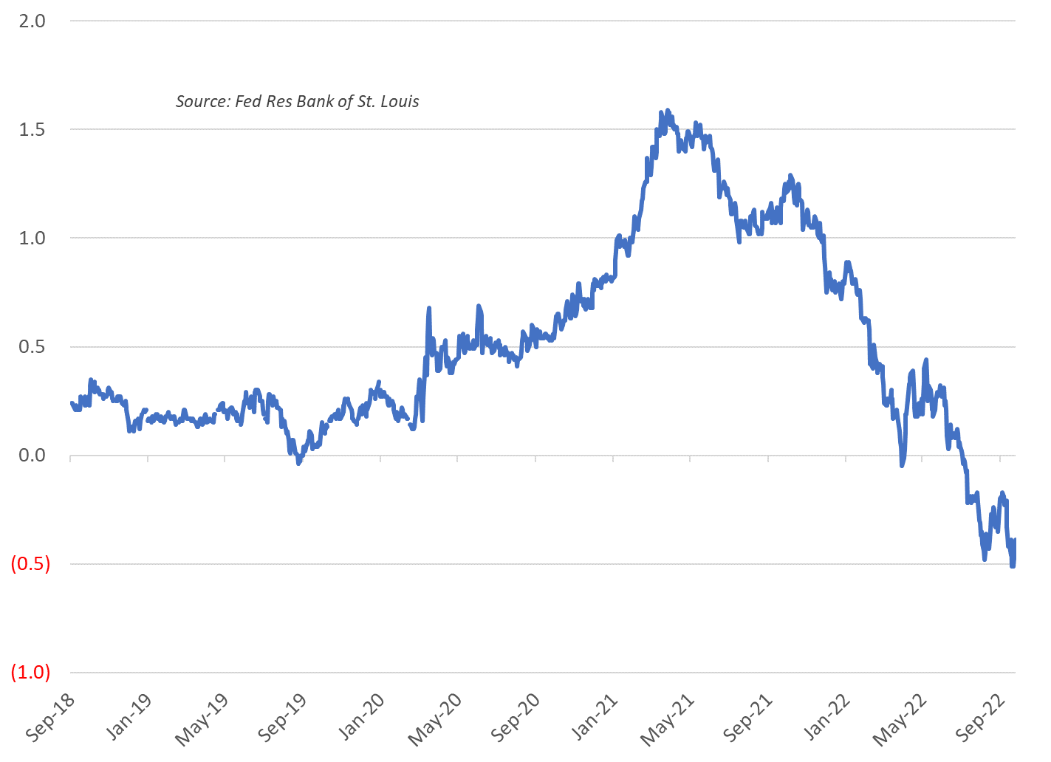

Yield Curve – 2 vs 10-Year Treasury
Notes:
Gray bar = recession
Yield curve signaling another slowdown

Slide 10

Work From Home Trends

Slide 11
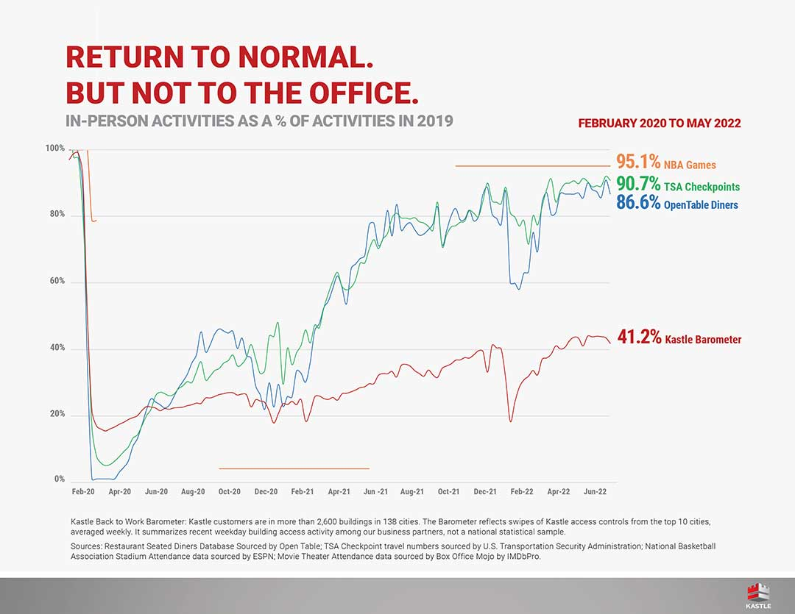
Recovery of In-Person Activities – U.S.
Source: Kastle Systems
Notes:
Red line is office attendance as measured by swipe cards
It is higher in Texas (no rail service), lower in DC
Certainly workers are able to return to office …

Slide 12
Work from Home
35% of employees have option to work from home full time
23% have option to work from home part time
42% - no work-from-home option
58% Choose to WFH 3+ Days/Week
Source: McKinsey

Slide 13
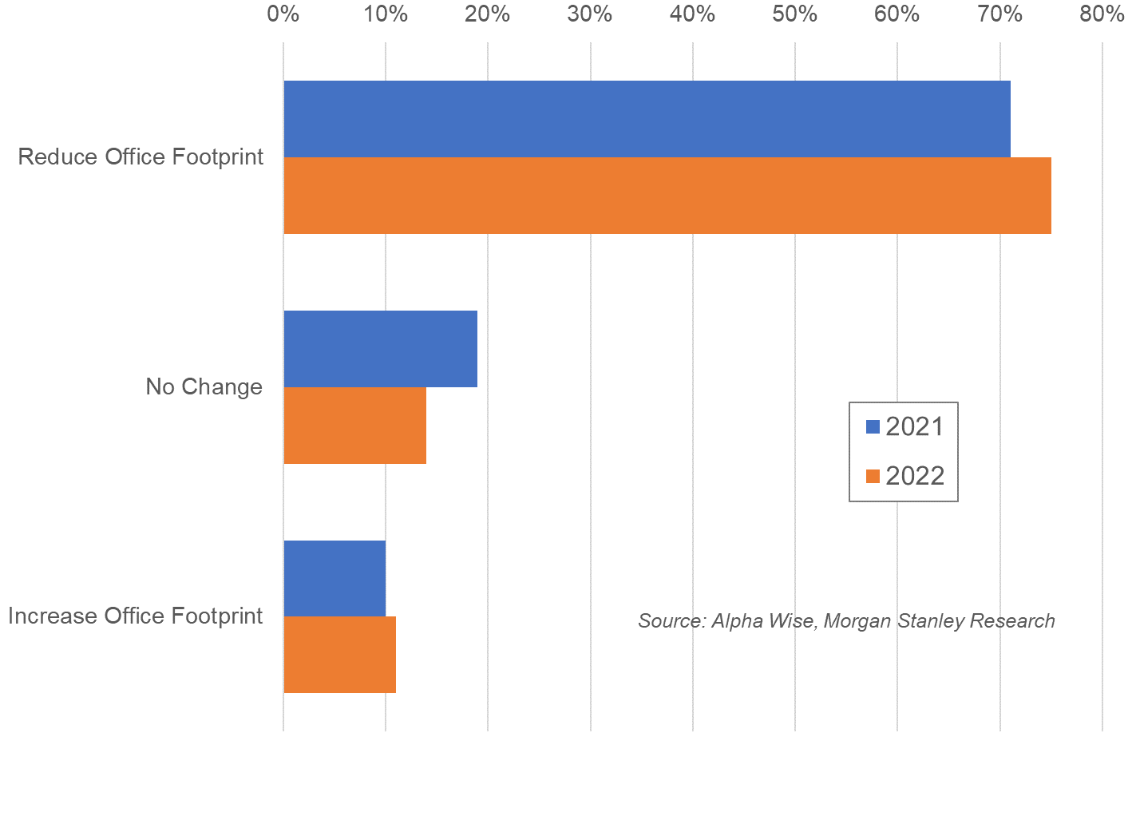
Expected Change in Office Footprint
Notes:
75% of businesses expect less office space
Work from home isn’t going anywhere
Major implications for housing

Slide 14
Housing Indicators

Slide 15
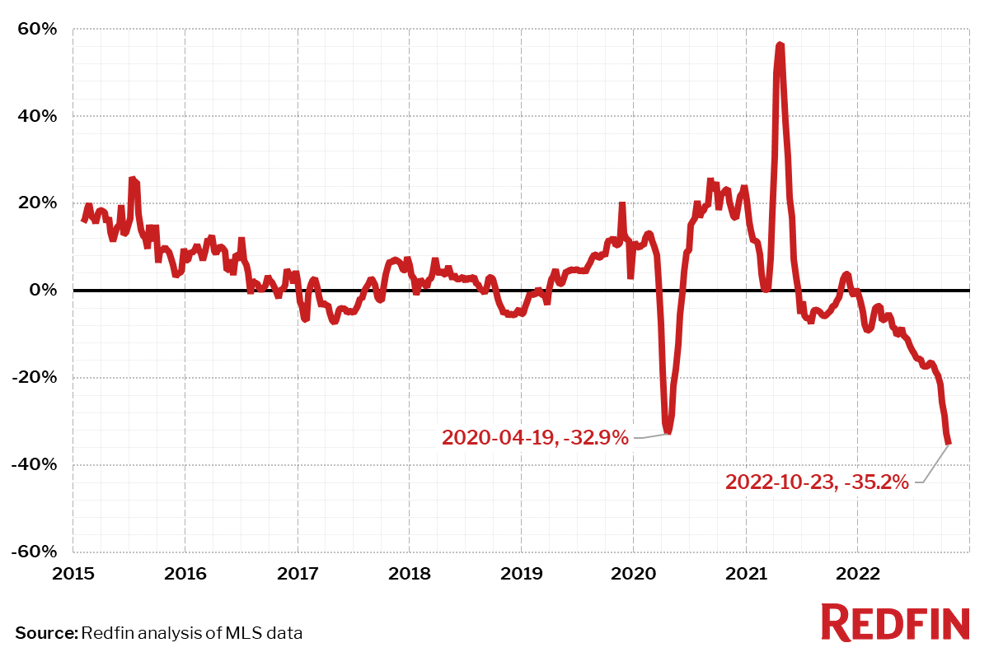
U.S. Yr-Ovr-Yr Change in Pending Sales
Notes:
Everyone expected rates to rise from 3%
But … wow
5% isn’t bad historically, but recency bias …

Slide 16
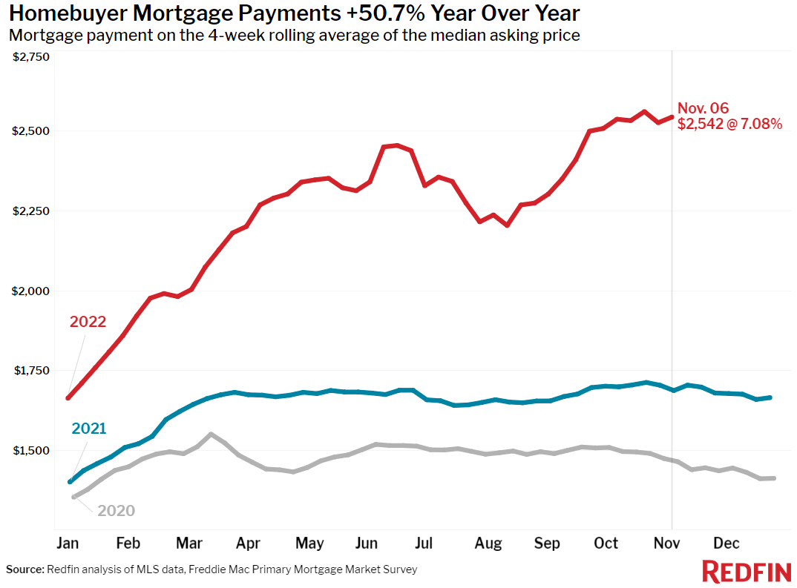
Mortgage Pymnt for Med List Price (U.S.)
+51% yr-ovr-yr
Notes:
Combined effect of higher home prices (up 16%)
And higher mortgage rates = 43% higher pmt
Rents, btw, are ALSO up 16% (rental mkt very strong)

Slide 17
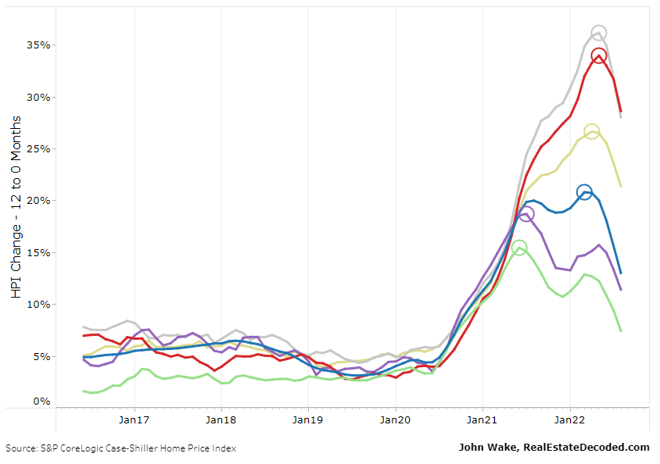
S&P Case Shiller Index Yr-Ovr-Yr Change
Miami
Tampa
Charlotte
United States
Boston
Wash DC
Notes:
Home prices have ballooned, less so in the Mid-Atl
Lags … only through March and a 3-mo moving avg
This will level off this year. Will prices crash?

Slide 18

Housing Crash?

Slide 19
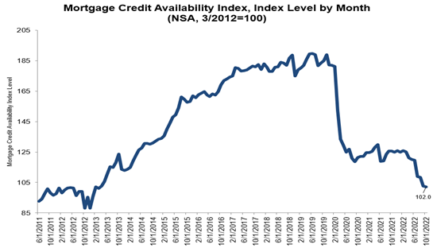
MBA Mortgage Credit Availability Index
Notes:
Mortgage underwiring now …
No comparison to mid 2000s

Slide 20
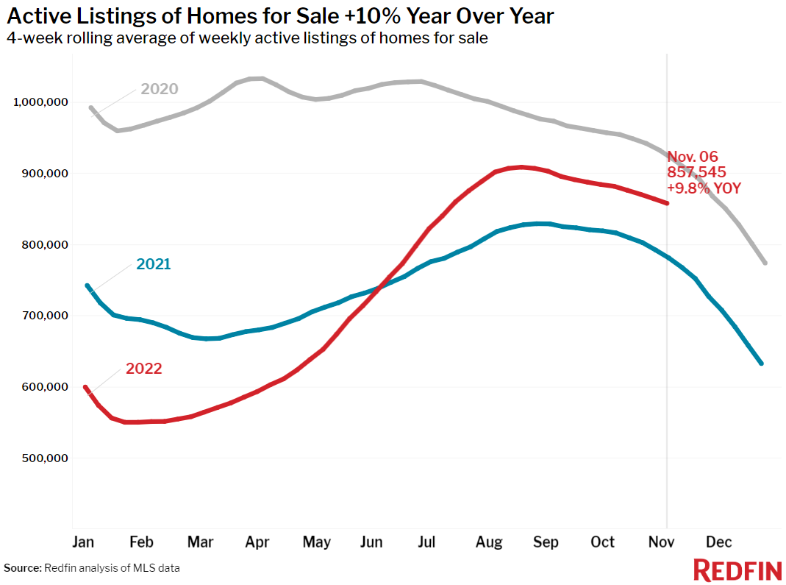
Active MLS Listings – U.S.
Notes:
How to address higher prices?
Earlier I mentioned possibility of alternative mortgage product
Motivated sellers may also meet the buyers part way

Slide 21





Need for More Housing
July 23, 2022
Notes:
General housing shortage across the country
3.8 mm units in 2020 according to Freddie Mac

Slide 22
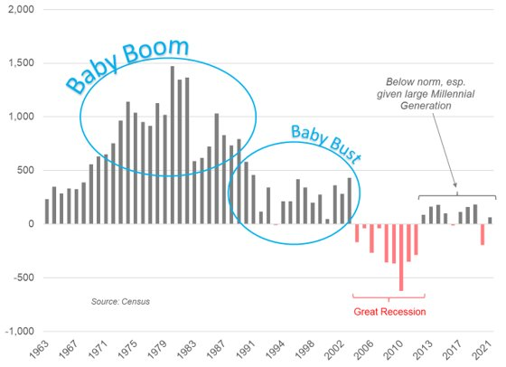
Household Formations – Under Age 45
Notes:
Where are the Millennial HH formations?
Appears to be lots of pent up demand

Slide 23
NoVA Resale Market

Slide 24
NoVA Annual Existing Home Sales
Notes:
Running annual total removes seasonality
Note the scale … sales are down
But only 10% yr-ovr-yr

Slide 25
NoVA Active Listings History
trendline
Notes:
The number of listings has hardly budged
So it remains very low
Why aren’t we seeing more sellers?

Slide 26
NoVA Months Supply of Listings
Notes:
Measured in months of supply
(accounts for falling sales rate)
Supply is still very low … ergo no price drop

Slide 27
Median Resale Price by County
Notes:
Bright MLS only updated through April
But price change by county shows largest
Increase in outer suburbs (Ch, Fred, Harf)

Slide 28
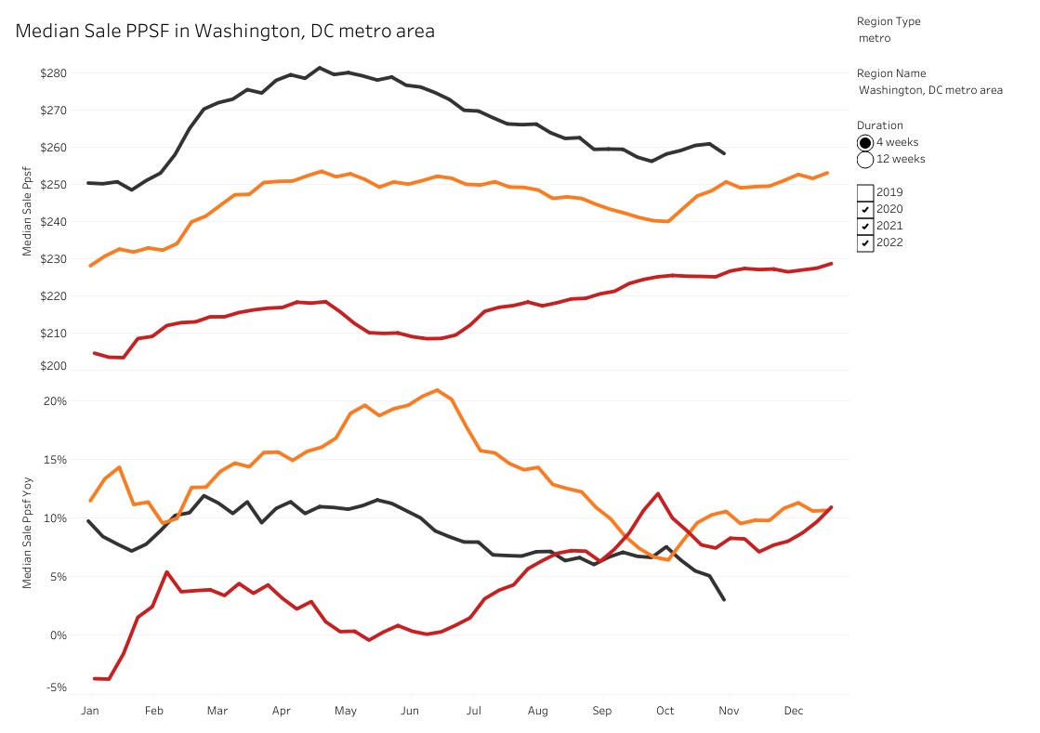
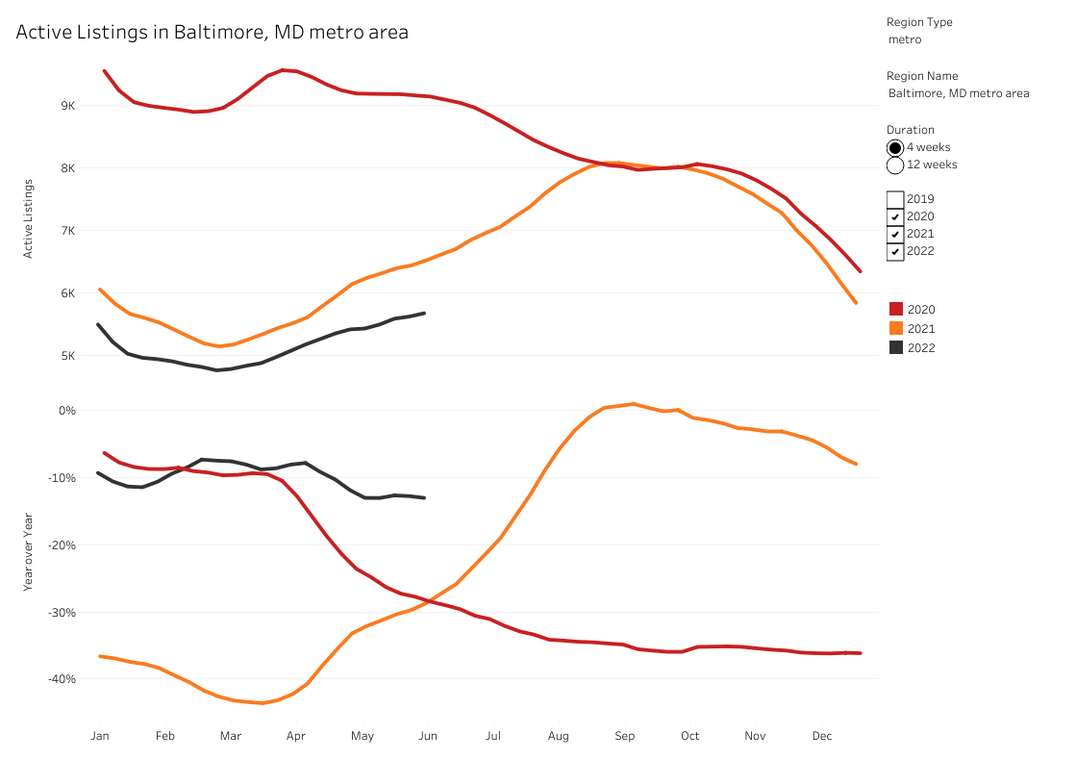
Wash DC Metro Med Sale $/SF*
+3% yr-ovr-yr
* 4-week average
Notes:
Are prices dropping?
Look at yr-ovr-yr to remove seasonality
+7% is similar to FHFA repeat sales index
It is lower than the “hot” metro areas

Slide 29
NoVA New-Home Market

Slide 30
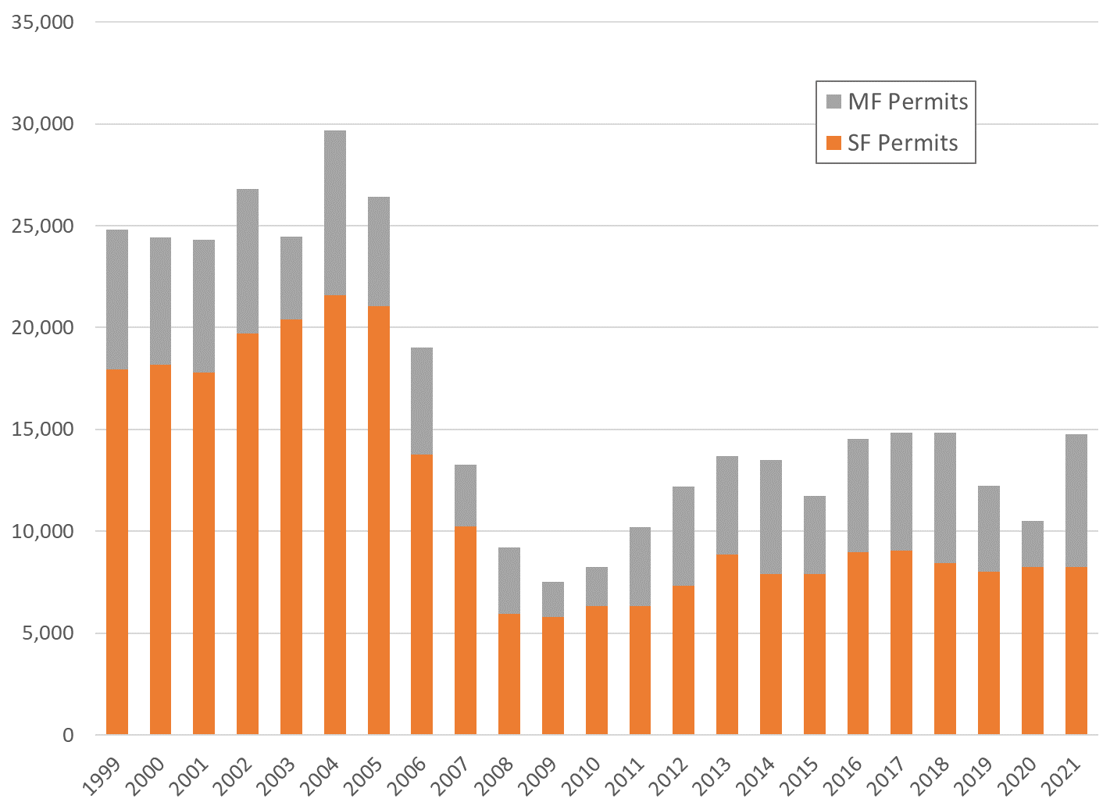
NoVA Single-Family Permits
Notes:
Not ALL of Maryland
11,000 units last year
’20-’21 doesn’t look like the strongest market in years

Slide 31
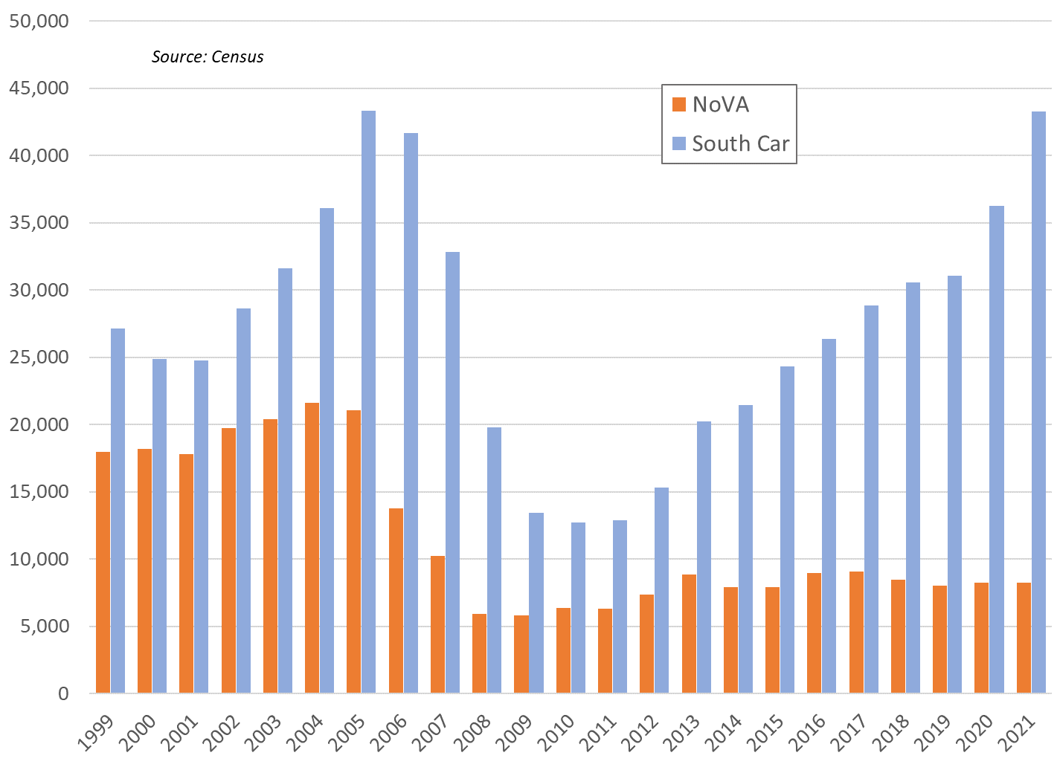
NoVA vs South Carolina SF Permits
Notes:
South Carolina’s population is 5 mm (vs MD 6 mm)
How were they able to get back to mid-2000 levels?
Economy … land supply

Slide 32
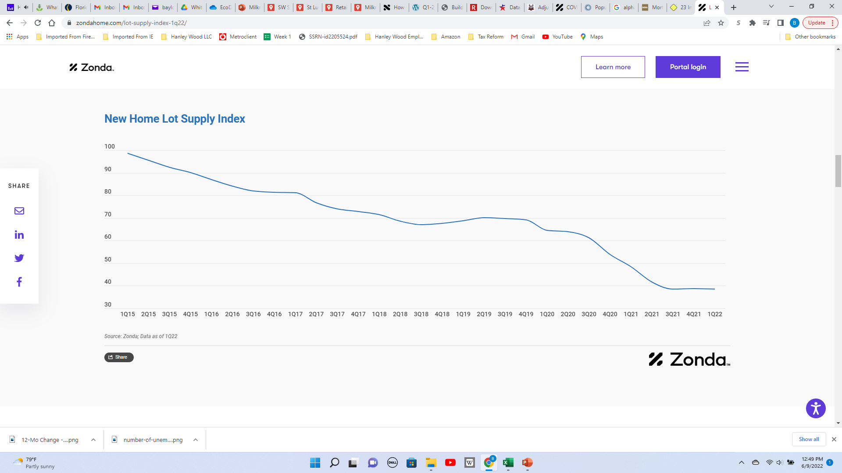
New Home Lot Supply Index – U.S.
Notes:
Overall picture of land supply
Zonda’s index

Slide 33
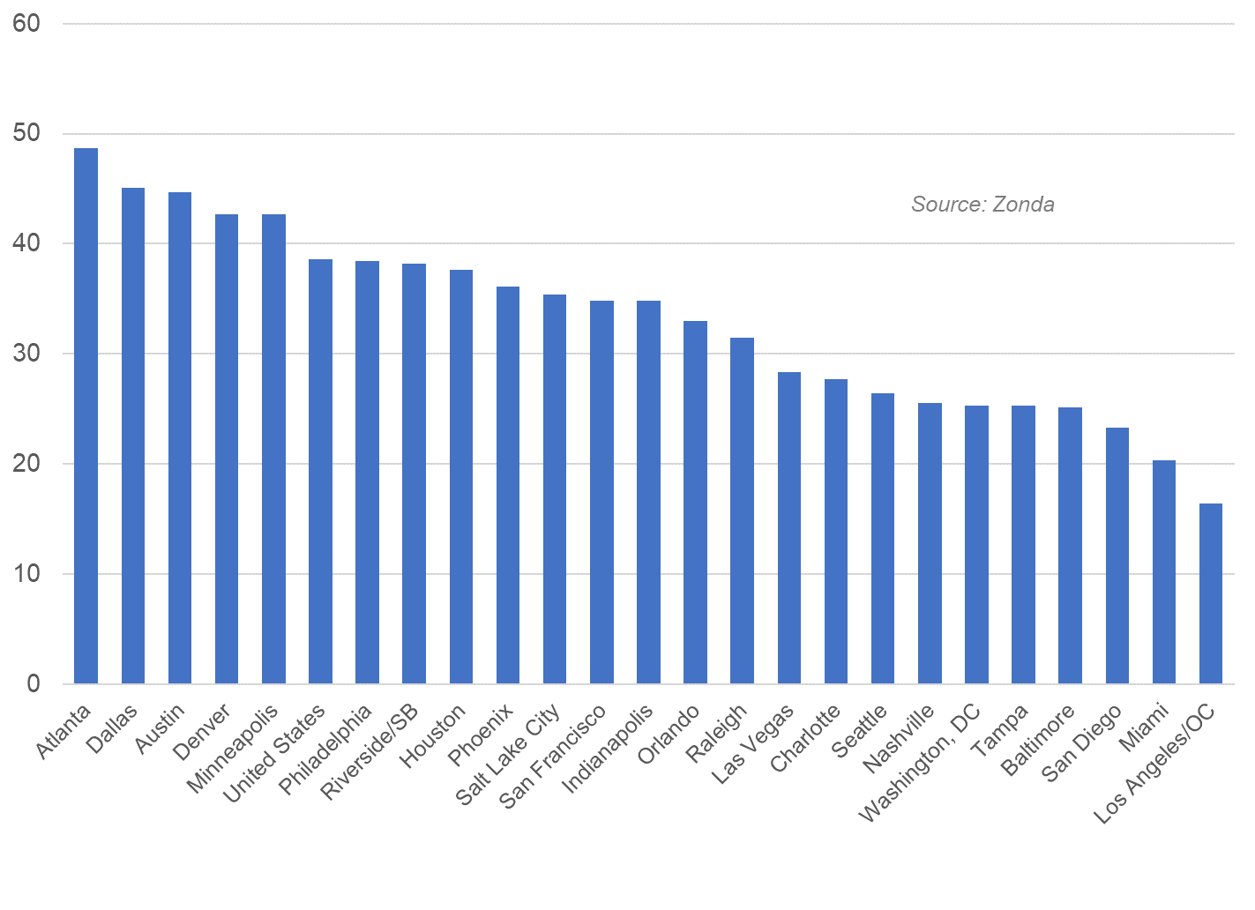
New Home Lot Supply Index by Metro
Notes:
And the problem is especially acute in the Mid-Atl
You see Nashville next to Wash DC,
But it takes less than a year to get a deal approved there

Slide 34
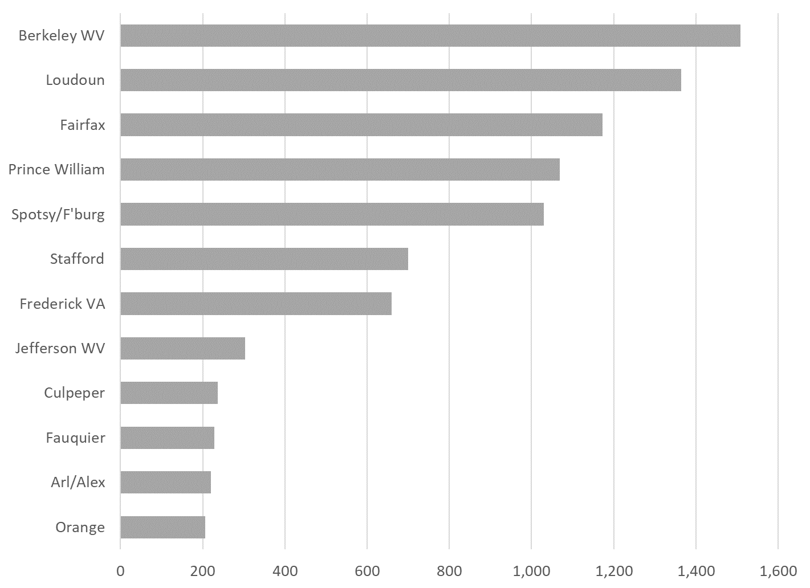
NoVA SF Permits* by Jurisdiction
* Preliminary
Notes:
And the problem is especially acute in the Mid-Atl
You see Nashville next to Wash DC,
But it takes less than a year to get a deal approved there

Slide 35
Panel

Slide 36




Jessica Francis
Drees Homes
Thomas Hyde
Miller & Smith
Tom Marable
Van Metre Homes
Sal Migliore
NVR

Slide 37
Ben Sage
571.306.0136
bsageanalytics@gmail.com

