Slide 1
Title Slide
HCCA - Defending Small Businesses Against a Recession Timm Johnson, Director, Mason SBDC
April 21, 2022

Slide 2
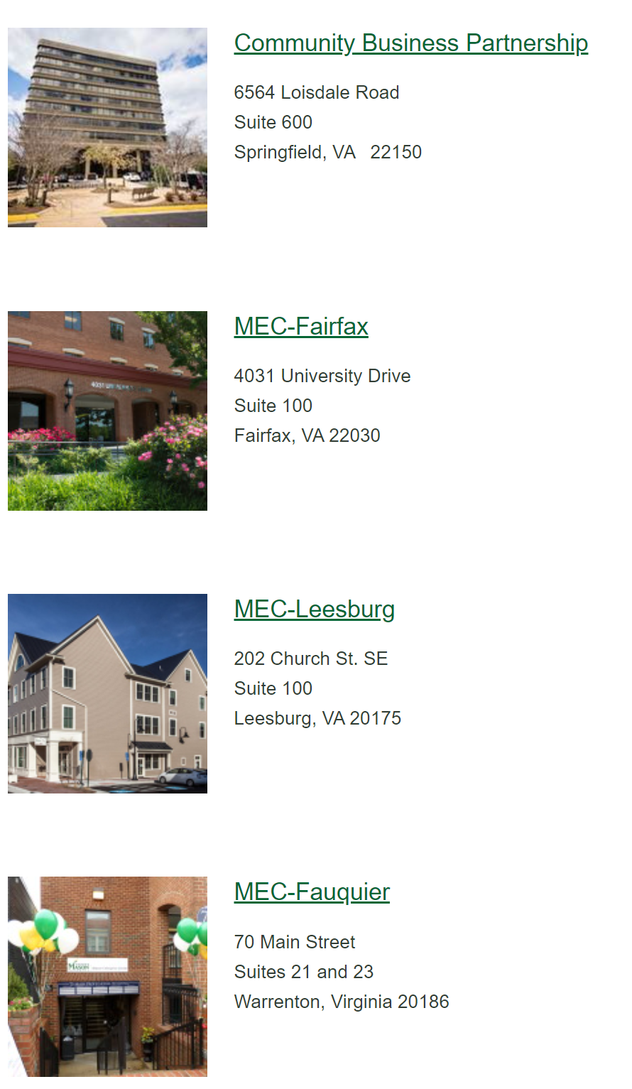
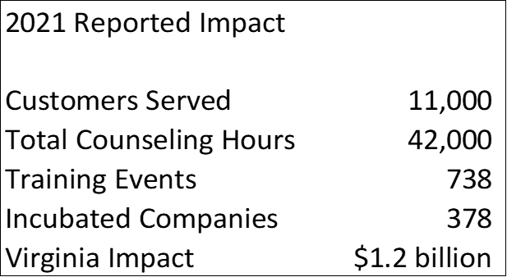
George Mason University Business Ecosystem – Mason Enterprise
Notes:
Key services of SBDC are counseling, training and information resources
60% of clients are existing firms—gradual shift in past 3 years
50% are women
14% are veterans
26% are minority firms
Areas of counseling and training – financing, marketing, business/strategic planning, start-up
Services (professional, IT, contractors), Retail
Track activities---numbers of companies assiste, but more importantly we ask clients to tell us the results of their SBDC engagement---Jobs created/retained, sales growth, new capital (Debt and equity) and for pre-ventures—did you start a business.

Slide 3
Business Expertise
Business Startup Administrative Steps
Financing and Financial Management
Marketing and Sales
Digital Marketing Presence
Value Proposition Design
Automation Tools & eCommerce
Lead Generation and Sales Process
Accounting, Human Resources and Back Office IT
Cybersecurity
Franchise, Business Acquisition and M&A

Slide 4
Upcoming Workshops
Live Webinars
10/20/2022 Start A Business (Legal & Administrative Steps)
10/26/2022 Building your Value Proposition Design (VPD)
11/02/2022 Financing Your Small Business
11/10/2022 Marketing 101
11/16/2022 Building your Performance Dashboard
12/14/2022 SEO And Social Selling
Register at Mason SBDC https://masonsbdc.org/workshop/
or at the Virginia SBDC Website https://clients.virginiasbdc.org/events.aspx

Slide 5
Cohort Series
Metropolitan Washington Airport Authority
9 week Executive Certification Cohort for 40 minority contractors looking to do business with MWAA
Department of Energy - 9 Week Business Technical Training Cohort
Complete GovCon business readiness training for contractors nationwide supporting DOE

Slide 6
Goldman Sachs 10,000 Small Businesses Survey
Recession in the next 6 months
62% yes
13% no
25% don’t know
Currently in a recession
43% yes
38% no
19% don’t know
Recession indicators experienced by small businesses
54% decline in customer demand
46% pause expansion
29% higher borrower cost or harder to get financing
16% hiring freeze

Slide 7
Construction Industry Concerns
14% decline in New Housing Permits
Prime Rate up to 6.25% - 3.25% a year ago
Commercial Office Vacancy Rates 12.3% from 9%
Commercial Retail Vacancy 15 year low (6.1%)
Commercial Warehouse Vacancy 4.1%
Infrastructure Bill - $500B in Construction Spending
Inflation Reduction Act – $384B
We are still feeling a tight job market and supply chain issues

Slide 8
Preparing for Slower times
Financial Forecast
Equipment and Labor Utilization
Labor Costs
Backlog and Pipeline Review
Pricing Review
Supply Chain Review
Overhead Review
Equipment Financing
Line of Credit Status

Slide 9
Preparing for Slower times
Marketing Review and Actions
Website Checkup – SEO, Content, Navigation
LinkedIn Profile
SBA Small Business Dynamic Search
Business Profile Backlinks
Networking Calendar
Matchmaking Events
Social Selling (Stalking Buyers)
Diversify – new capabilities, new markets

Slide 10
Contact
Mason SBDC 10306 Eaton Place, Suite 180 Fairfax, VA 22030
(703) 261-4105
timm@masonsbdc.org
help@masonsbdc.org
https://www.masonsbdc.org/

