Slide 1

NVBIA Outlook – Dinner Meeting
11/12/2021
  Ben Sage
  Senior Regional Director
  bsage@zondahome.com
  571.306.0136

Slide 2


Here to help
INSIGHTS AND ADVICE, ALL UNDER ONE ROOF
Our teams cover the entire spectrum of real estate, to help you grow your business and realize your goals.
60 advisors
500 researchers
50 technologists
Award winning Builder editorial team
Ali
Wolf
Chief Economist
Zonda Economics
Dan
Fulton
Senior VP
Zonda Advisory

Slide 3
National Headwinds/Tailwinds

Slide 4

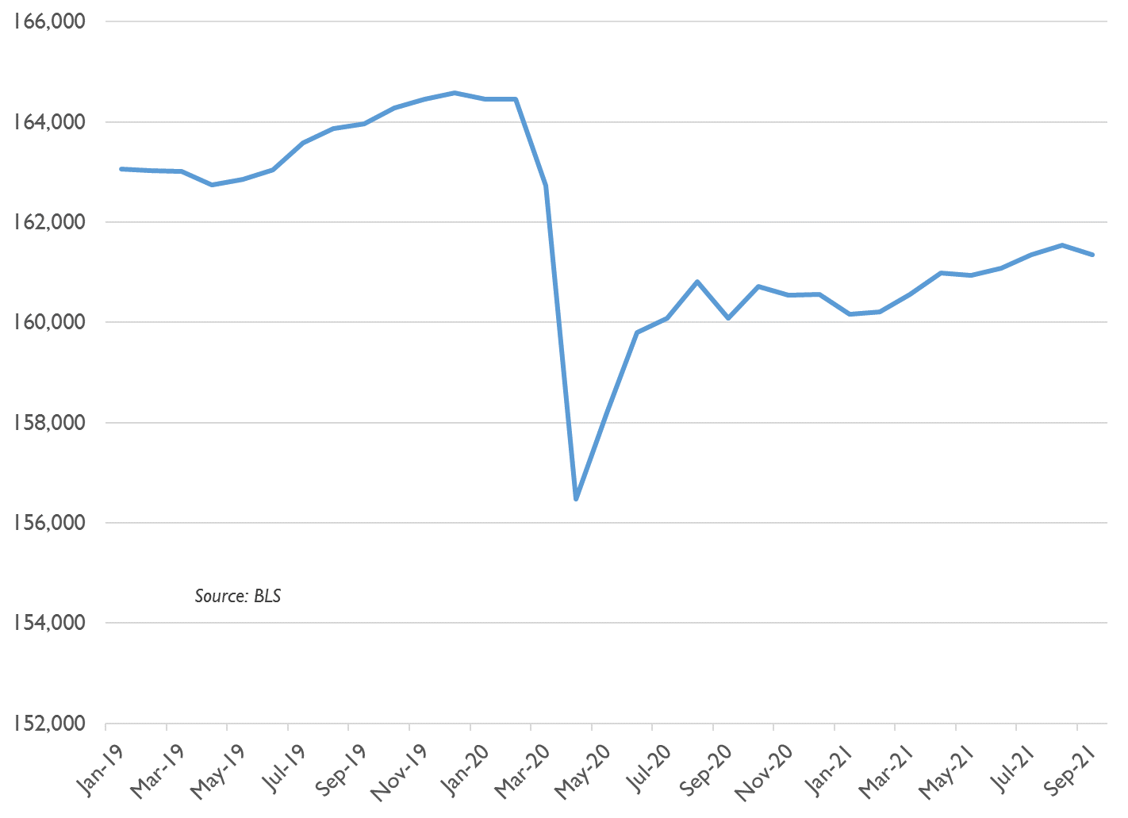
United States Labor Force (seas adj)
000’s
Labor force down
by 3 million (-2%)
Notes:
Labor Force has declined 2%
3 million fewer people either working
Or looking for work

Slide 5

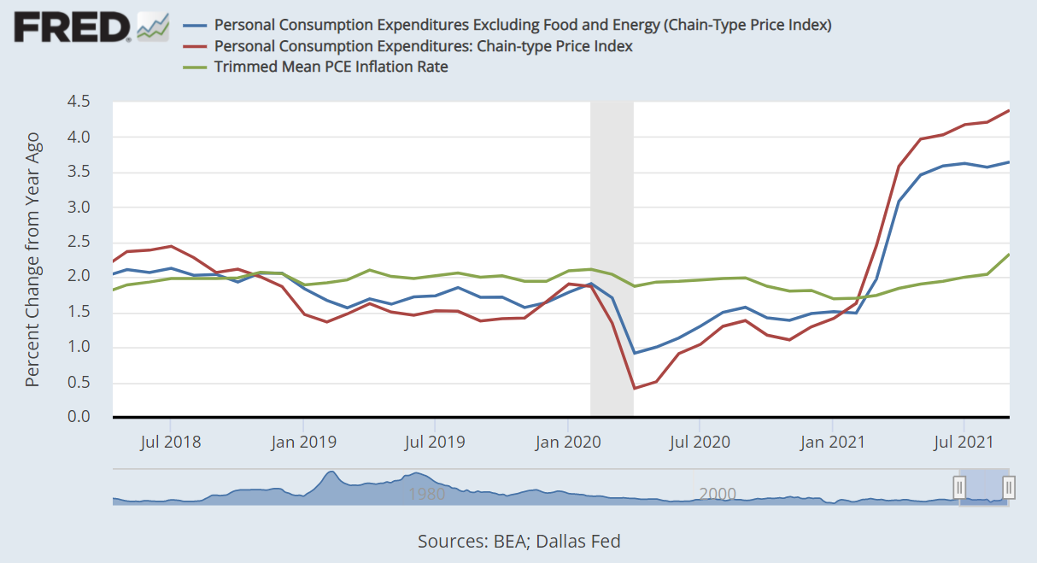
Perspectives on Inflation

Slide 6
Fannie Mae Housing Survey – “Good Time to Buy a Home”
One of the 6
components
Notes:
Here is one of the six components

Slide 7
30-Year Fixed Mortgage Rates
Notes:
What you expect to see in Hospitality (but -160k in May)
Retail has improved, now down only 6,600 (from -32k)
Healthcare -7% YoY, twice as bad as national

Slide 8
United States Personal Savings Rate
Stimulus checks

Slide 9
S&P 500 Index

Slide 10
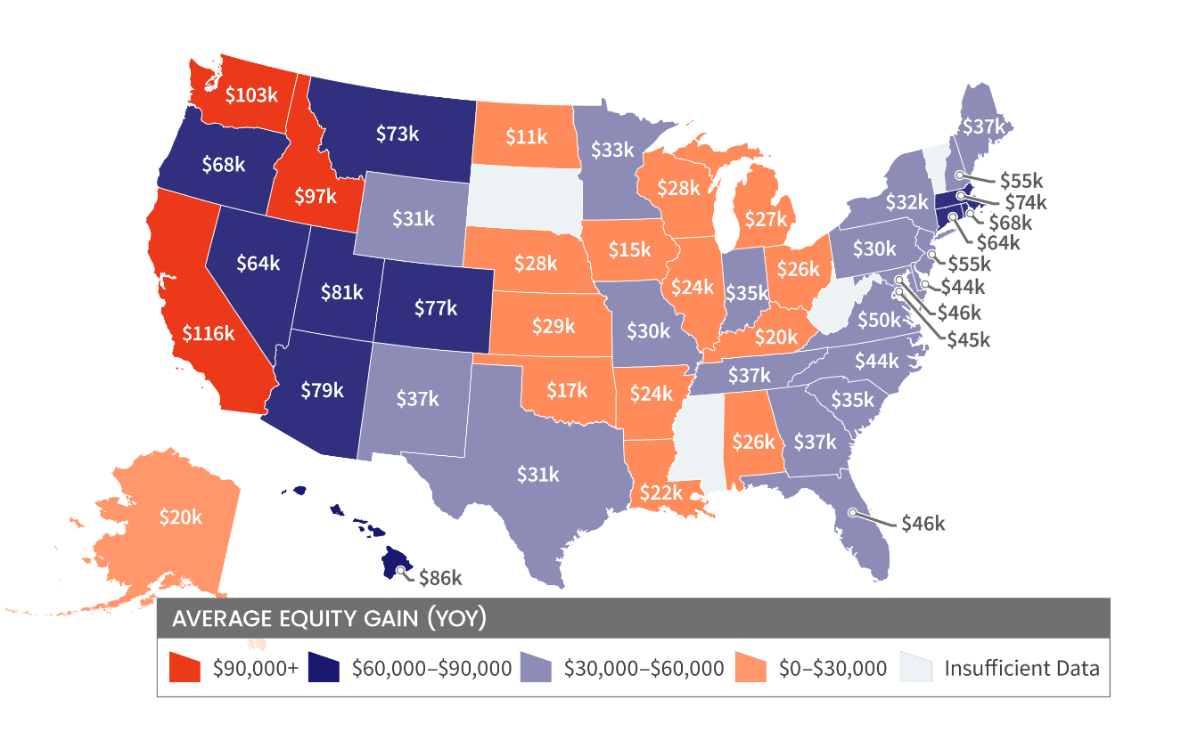
Homeowner One-Year Equity Increase
Mortgage rates, savings,
stock market, home equity …
Record wherewithal
to buy homes
Source: CoreLogic; Zonda
Notes:
Savings, stock market, home equity
Record wealth = record wherewithal to buy a home

Slide 11
United States Annual Residential Permits
Notes:
Not overbuilt like we were in mid 2000s

Slide 12

Are we in a housing bubble?

Slide 13
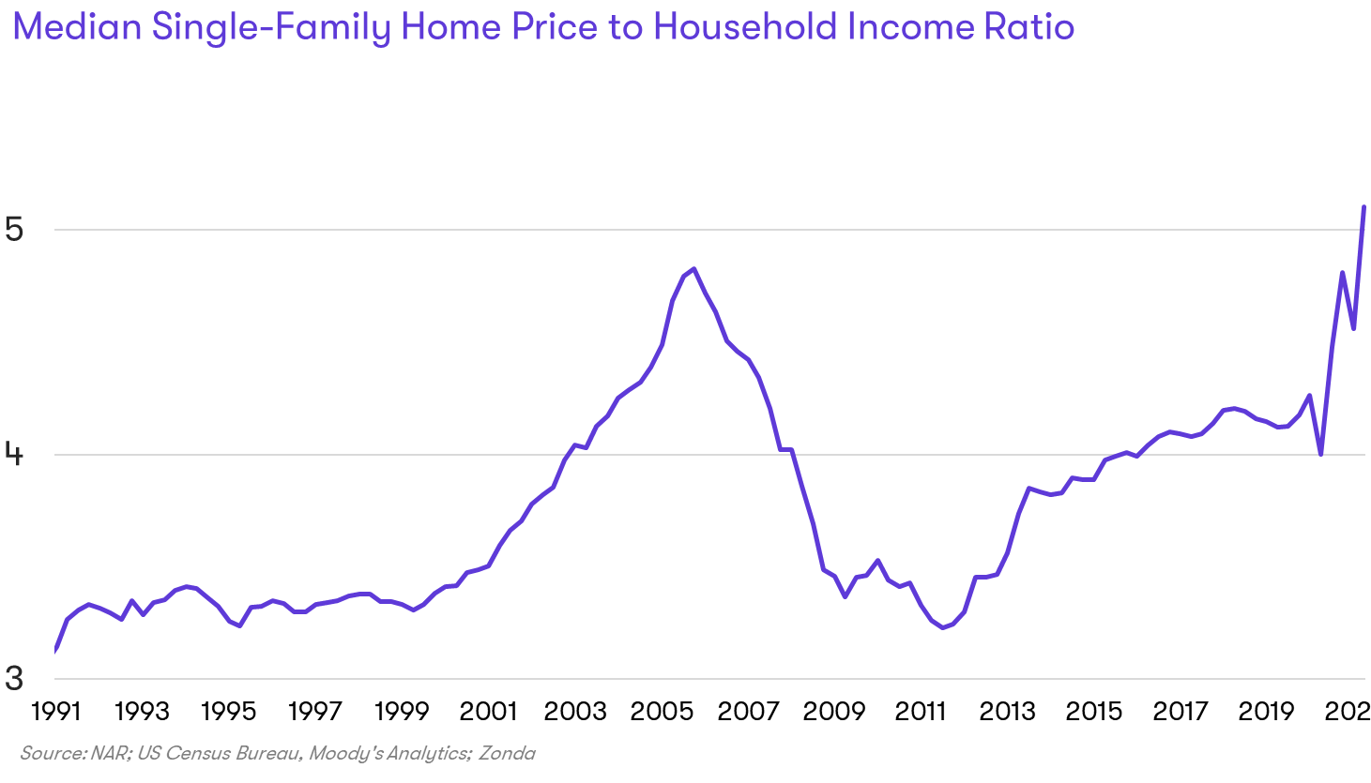
Home price to income levels are noteworthy
Notes:
Reveals risk exposure to higher rates

Slide 14
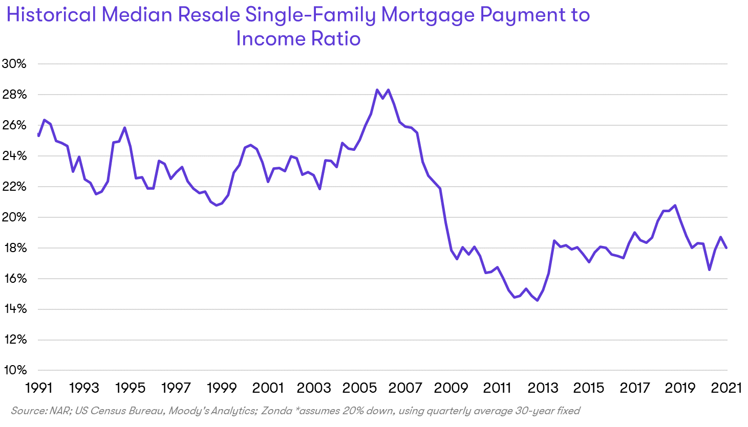
Impact of Low Mortgage Rates …

Slide 15
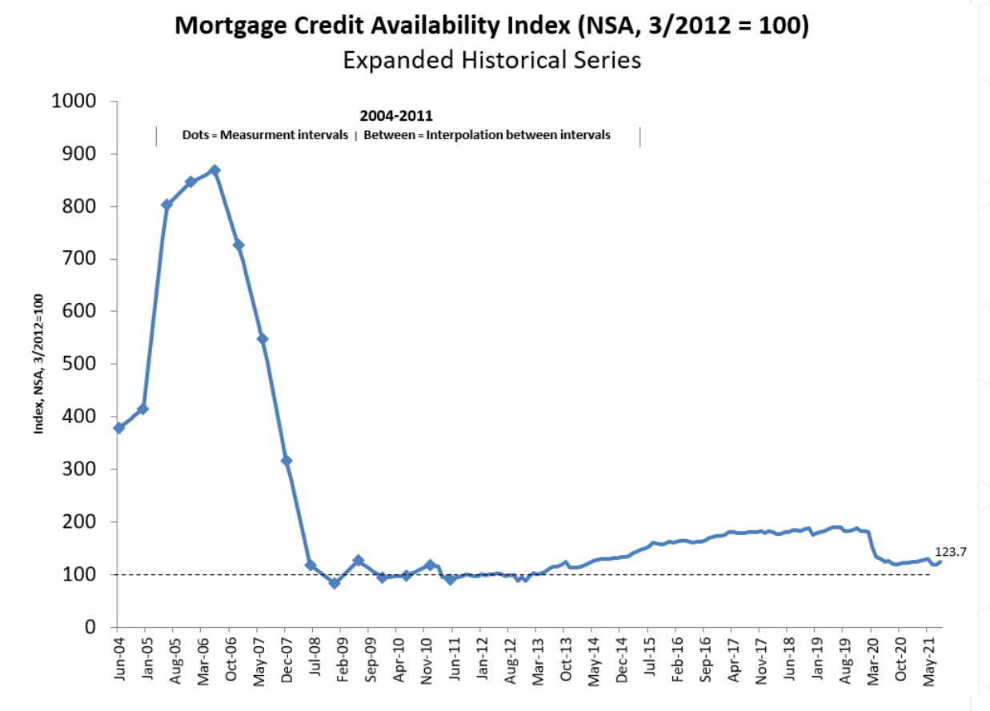
Safeguards following the GR

Slide 16
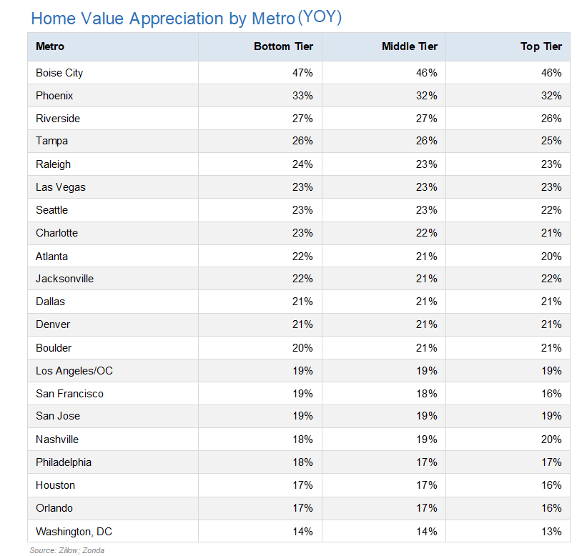
Some of the Appreciation is Justified, but It’s Not Sustainable
Return of Investors
Bidding wars
FOMO (starting to wane)
Easy monetary policy (ending soon?)
Extreme supply and demand mismatch
When do buyers get priced out?
Are some pandemic trends temporary?
Will households continue to relocate?
Have we pulled demand forward?

Slide 17

Employment
and Apartments
Planned Amazon HQ2 in National Landing

Slide 18
Northern VA Total Employment (Seas Adj)
+136,000 jobs
8 years
Recovered 74%
Notes:
Hopefully Delta variant won’t cause further setbacks
Lost only 12% of all jobs
183,000 jobs lost

Slide 19
Northern Virginia Apartment Market – Ann Absorption/Deliveries
Notes:
Nice bounceback in apt market
Suburban apts generally held steadier
During pandemic

Slide 20
Northern Virginia Apartment Market – Occupancy and Rent/Sq Ft
Notes:
There was not an “urban exodus” but
housing demand shifted to the suburbs
Signs that some are returning to
Apartments near work centers

Slide 21

Local Resale Market

Slide 22
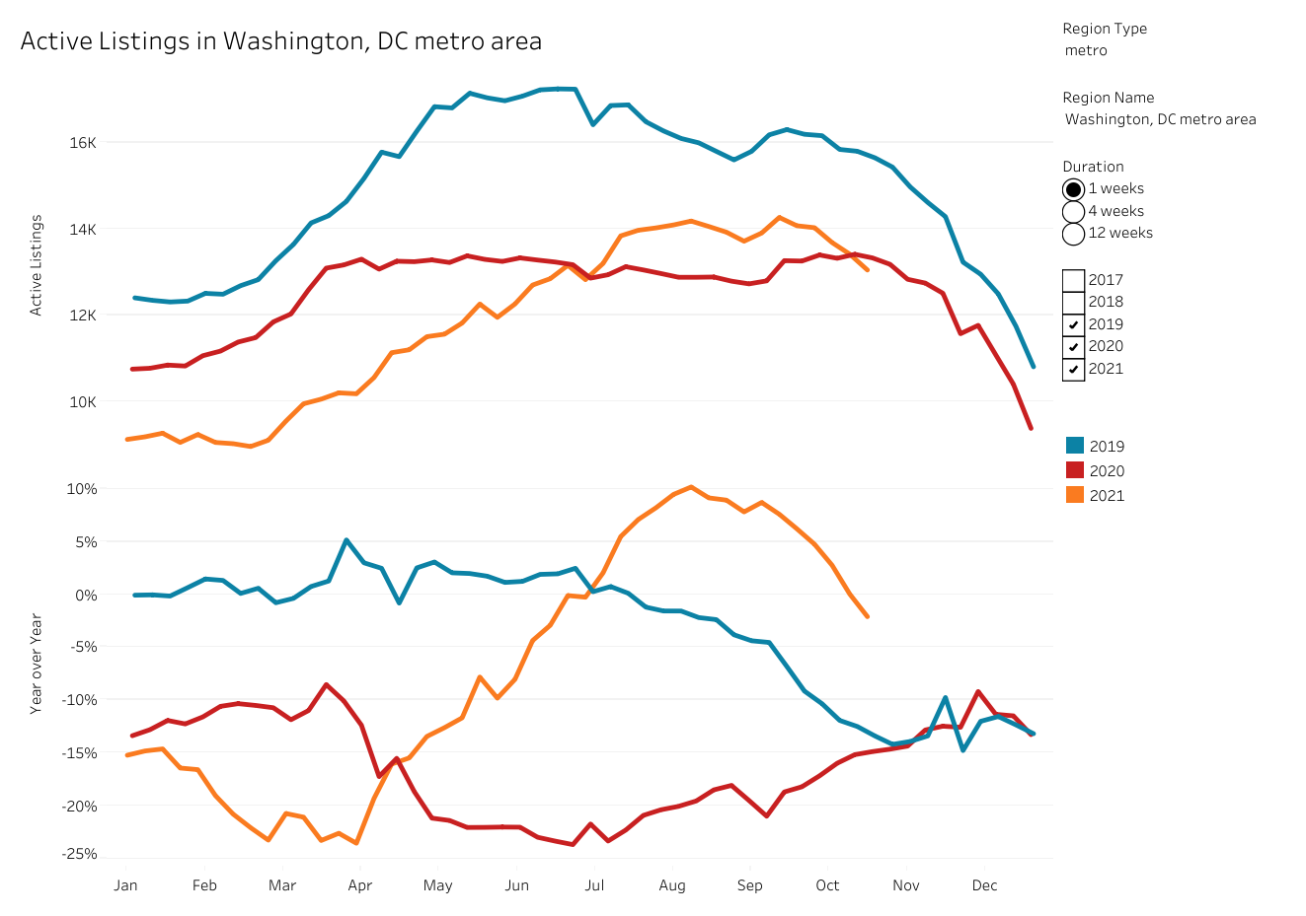
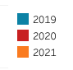
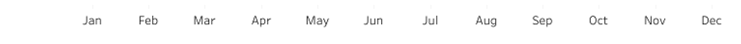
Washington DC Metro Total Resale Listings
Source: Redfin
Notes:
Steady increase in listings
Mostly seasonal, and …

Slide 23
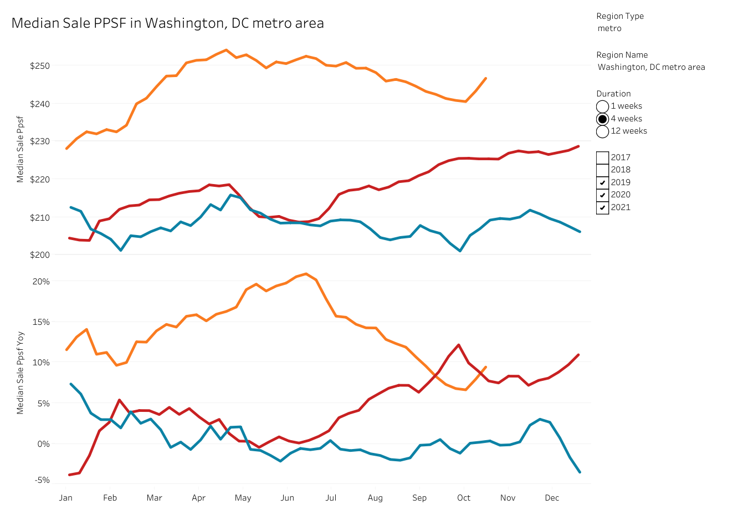
Washington DC Metro Median Resale Price/SqFt* of Homes Sold
* 4-week running total
Source: Redfin
Notes:
Prices are way up from one year ago,
But they are steadying
I expect this trend to continue as demand is
Strong but the “fever” has subsided

Slide 24
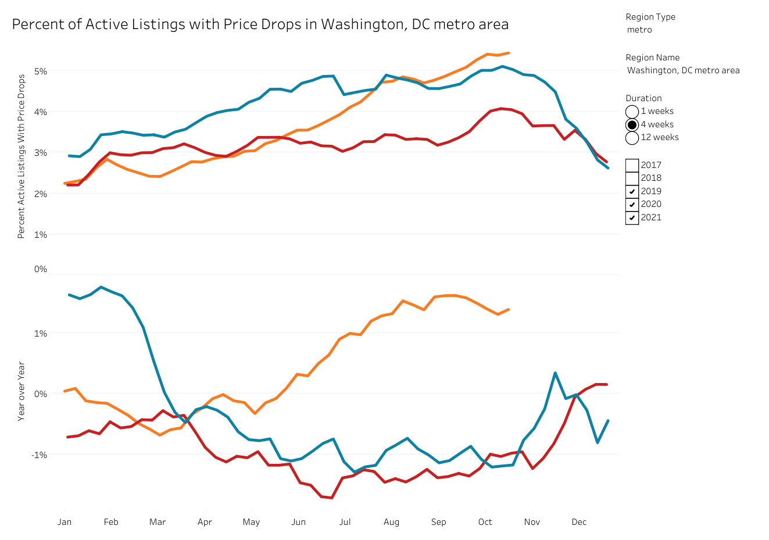
Washington DC Metro Percent of Active Listings with Price Drop
* 4-week running total
Source: Redfin
Notes:
Prices are way up from one year ago,
But they are steadying
I expect this trend to continue as demand is
Strong but the “fever” has subsided

Slide 25
Virginia Median Resale Price* Trend by County
* 3-month average
Notes:
Mentioned earlier that supply in the
Suburbs is lower, and this reinforces
That price increases are generally
Highest in the suburbs

Slide 26
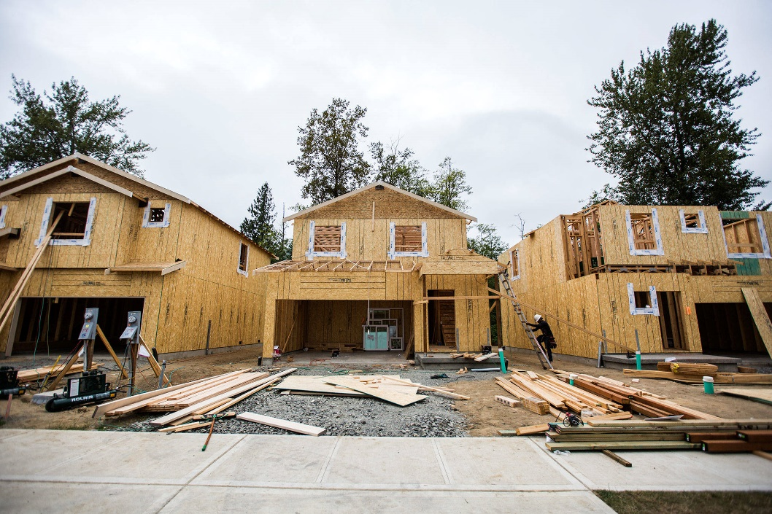
Local New-Home Market
Northern Virginia

Slide 27
NoVA Annual Starts and Closings
Source: Zonda
Notes:
Haven’t shown this in a while because
Sales were a better indication of demand
You do now see starts increasing
Though not (yet) past 2017 levels

Slide 28
NoVA Vacant Developed Lots & Months of Supply
Notes:
Set up this graph … another way to measure supply
Starts are generally steady
But VDL steadily declining since 2017
Months of supply much lower in Ffax, Loud, PW

Slide 29
NoVA Annual Starts and Lot Deliveries
Market: NoVa
Source: Zonda
Notes:
The problem is not absorption of lots (starts)
It is not enough lot deliveries
Deliveries have picked up recently
But still can’t keep up

Slide 30
NoVA Future Lots That Are Under Development
Notes:
Nor is there much hope that we will
Catch up with fewer and fewer lots
Coming online (2.5 yrs lost to “proffer reform”)

Slide 31
NoVA Recorded (but Undeveloped) Future Lots
Notes:
I asked NoVA presidents if there was any
Supply relief in sight. No, was the answer,
And this would back that up

Slide 32
Percent of Mid-Atl Builders Experiencing Gov’t Disruptions
Survey of local builders
Notes:
Government delays are a big part of the problem
This isn’t helping get supply on the ground

Slide 33
NoVA Annual Starts by County Yr-Ovr-Yr
Notes:
Fairfax is noteworthy (surpassed Loudoun)
Fairfax was at a very low point last year (condos)
SF / TH starts are up 18%
Condo starts are highest since mid 2000s (900 ann)

Slide 34
NoVA Communities Ranked by Annual Starts
Notes:
Fairfax is noteworthy (surpassed Loudoun)
Fairfax was at a very low point last year (condos)
SF / TH starts are up 18%
Condo starts are highest since mid 2000s (900 ann)

Slide 35
NoVA Total Contract Sales per Month
Notes:
Total contract sales not all that great
But builders are limiting sales due to supply

Slide 36
NoVA Production Builder Community Count
Notes:
Here is one way to measure supply contraints
Number of actively selling projects is way down
But at least it leveled off in 2Q (says an optimist)

Slide 37
What sales strategy do you use in light of capacity constraints?
Survey of local builders
Notes:
We asked builders how they are responding
To supply constraints …
So sales aren’t best indicator of demand

Slide 38
Mid-Atl Builders Experiencing Supply/Supplier Disruptions
Survey of local builders
Notes:
Starts would be much higher but
For supply constraints. Mostly, land
But also building material/appliances

Slide 39
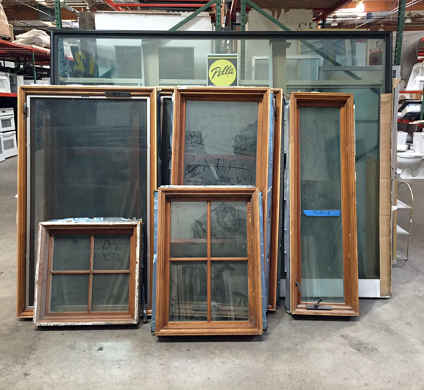
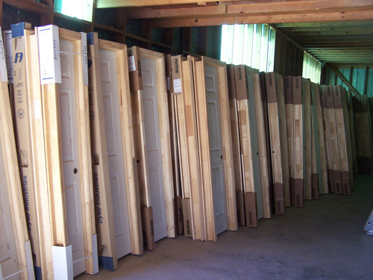
“Products for which there is a shortage (Sept)”
Notes:
What you expect to see in Hospitality (but -160k in May)
Retail has improved, now down only 6,600 (from -32k)
Healthcare -7% YoY, twice as bad as national

Slide 40
Mid-Atl Builders Experiencing Labor Disruptions
Survey of builders
Notes:
Again, though, starts would be stronger
But for supply constraints
Labor has been a bigger issue nationally,
Now starting to poke it’s head into the MidAtl

Slide 41

Builders Reporting Labor Disruptions by Geography
Notes:
What you expect to see in Hospitality (but -160k in May)
Retail has improved, now down only 6,600 (from -32k)
Healthcare -7% YoY, twice as bad as national

Slide 42
Conclusions

Slide 43

NoVA Builder Ranking – 3Q21 Annual Starts
Notes:
Haven’t shown this in a while
A few years ago we were top 4
DC Metro continues to get left in the dust
Not just on housing, but economy as well

Slide 44
“What are your biggest worries?”
October Survey of builders
Notes:
An update on what is most top of mind
To builders …

Slide 45

Conclusions
Local economic recovery is lagging
Resale market remains under-supplied, but it is less feverish and prices are steadying
Supply-chain problems are chronic, and they are expected to challenge homebuilders through 2022
New-home demand is normalizing, returning to seasonal patterns
Estimate 2021 – Starts +10% in NoVA
Forecast 2022 - Starts down 5% (supply driven)
Notes:
Generally, I’m bullish on housing long term
I don’t believe this is a fad

Slide 46

Panel

Slide 47
Ben Sage
  Senior Regional Director
  Mid-Atlantic
  bsage@zondahome.com
  571.306.0136

