Slide 1




NAPA EH&S Programs: Striving for EH&S Excellence
Protecting industry employees and the environment
Regulatory advocacy with Congress and Agencies
EH&S compliance assistance (e.g., SDS, Silica, SPCC, HoS)
Science-based classifications
Community (health) concerns
Online training programs
Diamond Achievement: self-assessing for improvement
Environ. Product Declaration
NAPA Care Benevolent Fund

Slide 2
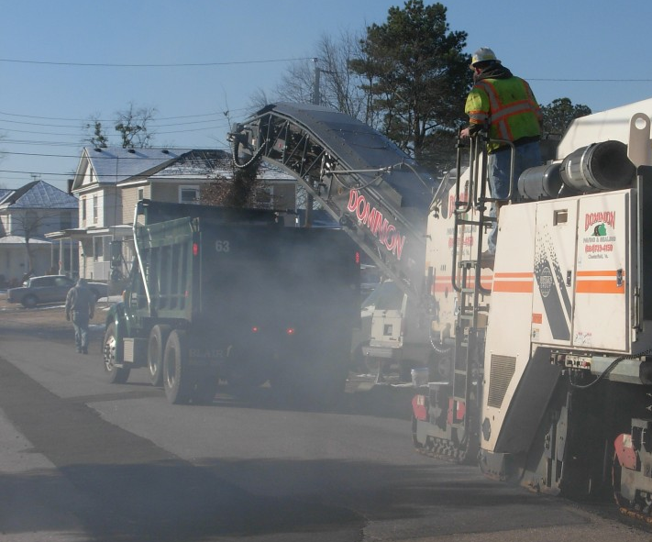
Compliance with OSHA’s Silica Rule
Known health hazard and top priority for U.S. OSHA
Construction Rule effective June 2017 (extended until Sept.); General Industry Rule effective June 2018
NAPA’s current guidance focuses on construction obligations
Reduces occupational Permissible Exposure Limit (PEL) to 50 “units” across all sectors
Gen’l ind. was “100” but construction was “250”
Use of “Table 1” controls reduce compliance obligations
Notes:
Now I’m going to provide a short 15 minute overview on OSHA’s new Silica Rule and what road construction contractors need to do now, and what asphalt plant operators will need to do by this summer.
First: OSHA spent decades finalizing the rule and set the Permissible Exposure Level to 50 micrograms per cubic meter (or units). This is a 5-fold decrease from what it used to be in the construction sector so it has been difficult to ensure exposures across the industry is controlled at that level.
Bottom line on the construction portion of the Rule: OSHA encourages the use of certain “approved” controls, identified in the Rule’s “Table 1”, and if those controls are used, there are just minimal compliance obligations that are needed. If Table 1 controls are not used, there are much more onerous compliance obligations that need to be adhered to.

Slide 3
Rule’s compliance obligations: big picture
Employers must ensure exposure below PEL for all activities
Basic premise of rule: specific engineering controls identified for many jobs/tasks/activities in “Table 1” – Construction only
Other major obligations (guidance @ www.asphaltpavement.org/silica)
  Document exposure if not following Table 1
  Designate a “Competent Person” (construction only)
  Develop a written Exposure Control Plan
  Update Hazard Communication
  Maintain all appropriate records
Notes:
Here are some of the basic compliance obligations under the rule:
Use Table 1 engineering controls on equipment
If not, document employee exposure
Designate your company’s “Competent Person”
Develop a written exposure control plan for all applicable road construction (and as of June 2018, asphalt plant) activities that can generate dust.
Update your company’s HazCom plan and maintain all appropriate records

Slide 4
Table 1 entries – Controls identified for Construction
Stationary masonry saws
Handheld power saws
Handheld power saws for fiber cement board
Walk-behind saws
Drivable saws
Rig-mounted core saws or drills
Handheld / stand-mounted drills
Dowel drilling rigs for concrete
Vehicle-mounted drilling rigs for rock and concrete
Jackhammers and handheld powered chipping tools
Handheld grinders for mortar removal (tuckpointing)
Handheld grinders for other than mortar removal
Walk-behind milling machines and floor grinders
Small drivable milling machines
Large drivable milling machines
Crushing machines
Heavy equipment and utility vehicles to abrade or fracture silica materials
Heavy equipment and utility vehicles for grading and excavating
Notes:
These are the activities identified on OSHA’s Table 1. Each activity has an approved control that is identified by OSHA. You can see some of the activities which abrade silica-containing materials, like mechanical action breaking aggregate, and OSHA has identified an approved control for each of these activities. I will review a few activities relevant to asphalt road construction work.

Slide 5
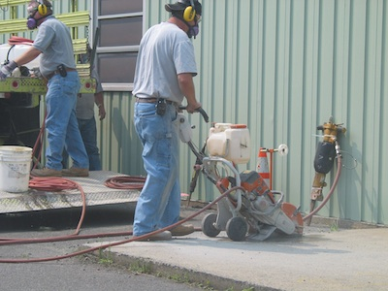
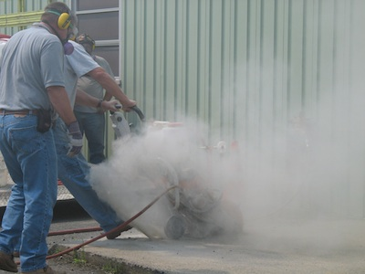
Table 1 controls vs. assessment
Table 1 controls generally involve equipment/activities with the following engineering controls:
  water suppression
  vacuum systems
  enclosed cabs with HEPA filters
If an employer chooses NOT to implement engineering controls:
  must measure exposure
  “Action Level” at ½ PEL
  restrict access/dedicated clothes
  medical monitoring / PPE / etc.
Notes:
The first premise of the Rule is that it is up to the employer whether or not they use an approved control. Here are two pictures of the same saw-cutting activity. In the top picture, a water suppression control is used and there is little to no silica dust generation. OSHA Table 1 controls usually include water suppression, vacuum systems, and if the equipment is required to have an enclosed cab, that there are other items required, like a HEPA filter.
However, an employer does not have to use an approved control on a piece of equipment or activity. If the control is not used, than the employer must measure the workplace exposure and there are a whole slew of other compliance obligations that go into effect including restricting access to the workplace. This is why NAPA recommends using approved controls identified for each road construction activity.

Slide 6
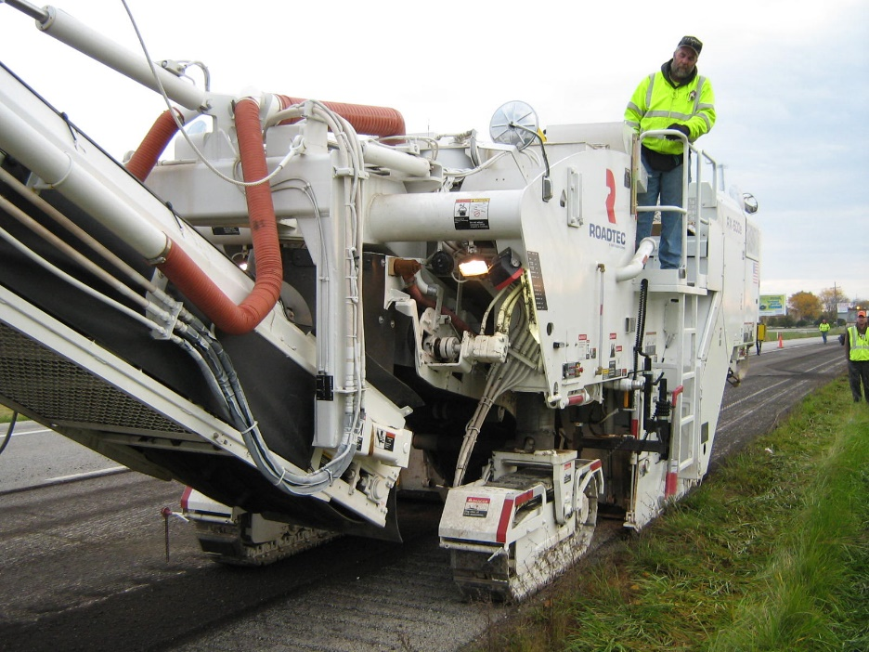
Milling operations and controls
All milling machines now have both “enhanced” water suppression AND vacuum controls; many since ~3 years ago
  Water-spray allows milling only to 4-inches any pavement
  Both controls allow milling to any depth in asphalt only
Reasonably priced retrofits available for many models
Some contractors now subbing-out full-depth milling
“enhanced” water (+/- surf.)
Small mills (skid-steer) require water suppression only + surfactant (detergent) [Table 1]
  Enclosed cab as best practice
Notes:
Milling operations have always been identified as a generator of airborne silica dust and NAPA’s Milling Machine Partnership worked, in a government-labor-industry partnership to develop easy-to-implement controls on large milling machines. All new equipment comes with both an enhanced internal water suppression and vacuum system; and retrofits are available for older machines. Depending on the type of control you might retrofit on an older mill will determine to what depth you are allowed to mill.
Small mills, like on a skid steer, are only required to have a water suppression system which includes the use of a surfactant. Although surfactants are commercially available, many companies use a couple ounces of liquid detergent per 100 gallons water .. Which do a much better job of reducing dust than using water alone. Although not required, an enclosed cab on a skid steer mill would be considered as a best practice.

Slide 7
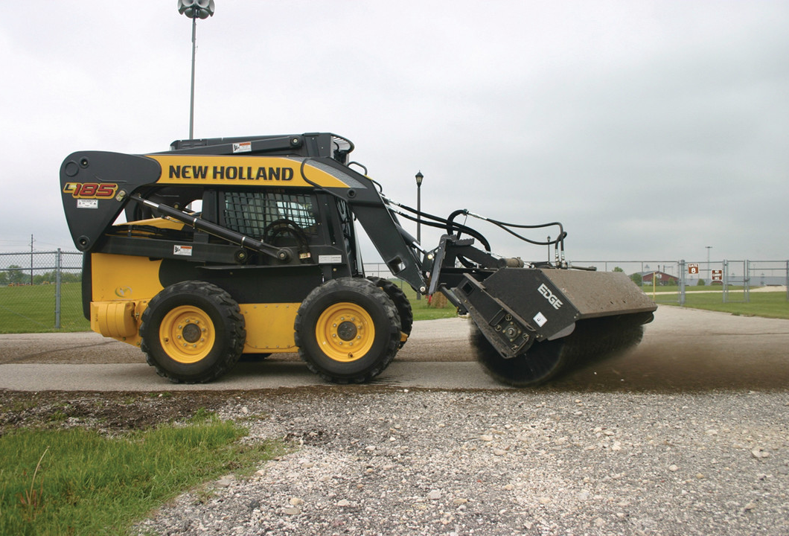
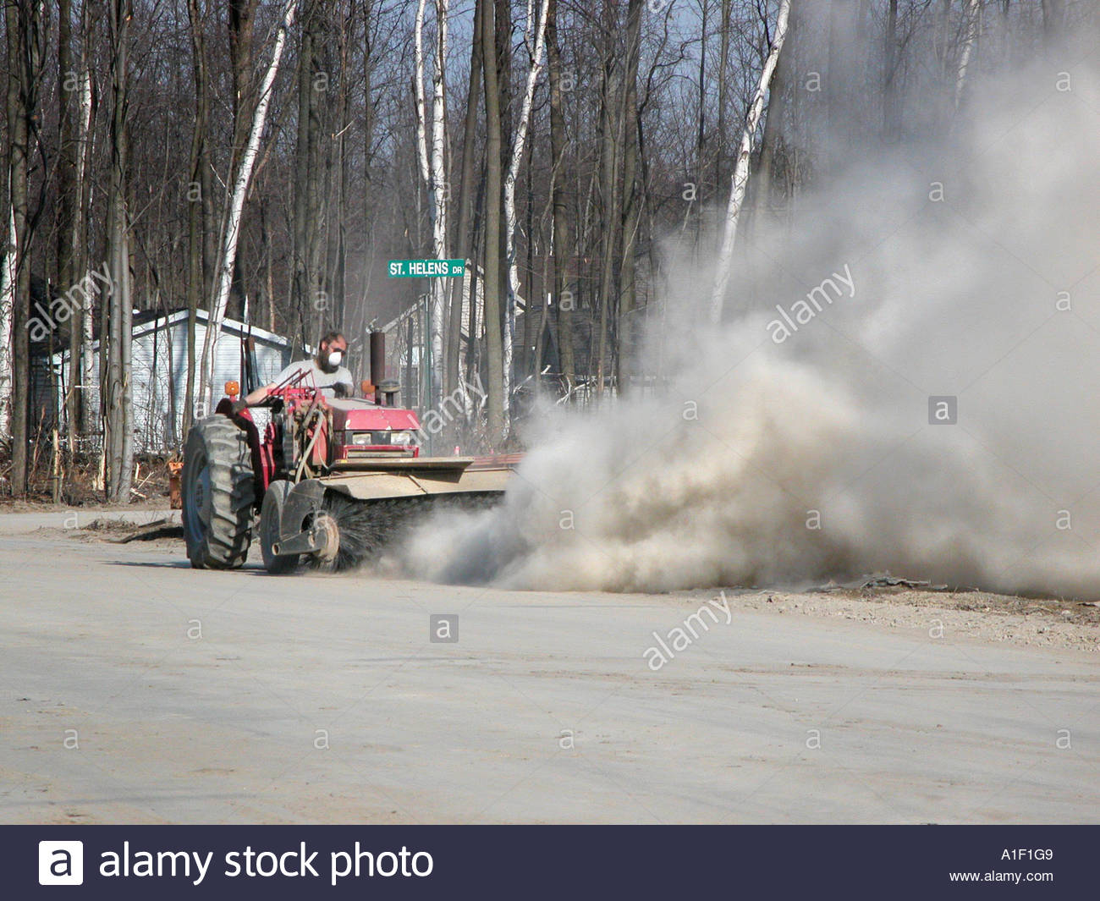
Brooming & sweeping controls
Not as straight-forward
Table 1: heavy equipment and utility vehicles that …..
  abrade or fracture silica-containing material …
  do NOT abrade or fracture
If abrading: enclosed cab + water suppression (if grounds-crew present)
If not abrading: water suppression *OR* enclosed cab when operator is only one engaged in activity
https://www.youtube.com/watch?v=SY49tv-WC5M
Notes:
Some activities like power brooming are not explicitly identified in Table 1. However, IF they are defined as a utility vehicle or heavy equipment and utilize a water suppression system, than they might be covered under Table 1.
NAPA has collected data generated by some member companies that make the case that water suppression on a power broom is protective and we will be submitting this data to OSHA soon.
But please be aware that these types of machines and activities are in a gray area with regards to whether or not a water suppression system is considered an “approved” control. NAPA provides further information on our website or please don’t hesitater to speak to me later today.

Slide 8
Notes:
I want to spend a bit more attention on the power broom issue and how they might fall under Table 1 controls. There are two table entries that are relevant for power brooms and other pieces of equipment that has not been explicitly identified. On the screen is some text from OSHA’s guidance document. Specifically if a piece of equipment abrades or fractures silica-containing materials, like aggregate, then the equipment must have an enclosed cab and if there are grounds crew, a water suppression system must be employed. Some of the examples OSHA identifies include3 hoe-ramming and rock ripping equipment.

Slide 9
Notes:
Here is OSHA’s guidance for the Table 1 entry for equipment that does NOT abrade silica-containing materials. Again, OSHA provides only some examples like earthmoving, grading, and excavating. One could argue that power brooms, which have predominantly nylon rotating bristles, do NOT abrade silica and would fall under this table entry. If so, than the piece of equipment would only need a water suppression system for both an operator and grounds crew. However, an enclosed cab would be acceptable as well. As I mentioned before, once OSHA required an enclosed cab, then there are a bunch of housekeeping and other requirements that go along with the enclosed cab. So, if you have equipment with an enclosed cab, which is required, please be aware of those requirements.

Slide 10
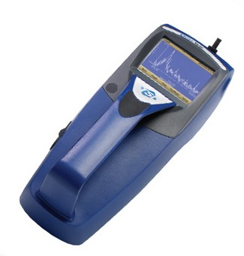
Exposure assessment: all activities
OSHA requires exposure assessment when using non-controlled equipment or when activity not Table 1 specified
  (short duration) brooming, flaggers, truck drivers
Employer must understand employee 8-hr TWA exposure
  low PEL still allows elevated exposure for short durations
Measuring airborne silica requires an IH and results lag
OSHA allows alternative methods of exposure assessment
Use of “real-time” dust monitor and silica content
Aggregate silica content varies but dust exposures can be large and PEL low
Rule of thumb: ~ 10% airborne silica
https://eco-rentalsolutions.com/product/equipment-rental/tsi-8534-handheld-dusttrak-drx/

Slide 11
Exposure example: uncontrolled brooming
Relevant if brooming not considered Table 1
Short duration, uncontrolled, or non-specified activities
  Dry saw cutting, truck drivers, drilling
RCS should remain below Action Level of 25 µg/m³
Direct-read dust monitors can be helpful in understanding potential exposures over short durations
  10% airborne silica content is good rule-of-thumb
Should be part of Exposure Control Plan and reviewed by Competent Person
Some type of exposure assessment required ... but
Can rely on “obj. data”/survey

Slide 12
Competent Person; HazCom; Recordkeeping
Designate a Competent Person who “can identify existing and foreseeable respirable … silica hazards; is authorized to promptly eliminate or minimize silica hazards; [and] has the knowledge and ability to implement the written exposure control plan”
CP duties include regular job site/equipment inspections;
CP doesn’t need to remain on jobsite but does need authority to take prompt corrective action; recommend a crew chief, foreprsn
Comply with OSHA’s HazCom Standard: train workers on activities/tasks resulting in exposure, workplace protections, etc.
Maintain records for 30 + years per Standard (29 CFR 1910.1200)
  Air monitoring & objective data, medical records, MSDS, etc.
  Procedures used to restrict access, when necessary to limit exposures (employee rotation/scheduling, signage)
Notes:
Here are the last few Silica Rule requirements:
Designate a “competent person”. Each company must do this. A foreperson or supervisor type is recommended. These folks are the primary contact for any OSHA or company questions associated with silica exposure on the jobsite.
Update your company’s HazCom program to include silica
Make sure you retain all the appropriate records for 30 years after each workers employment. This includes maintaining all MSDSs for the raw materials used during manufacture or application of pavement mix.

Slide 13
Develop a Written Exposure Control Plan
Employer must develop an exposure control plan that can be implemented by the Competent Person
  can be generic (not project-specific)
Plan must contain the following information:
  Description of tasks involving exposure to respirable silica
  Engineering controls, work practices, and respiratory protection for each task (e.g., water spray while brooming)
  Housekeeping measures used to limit exposure
  Procedures used to restrict access, when necessary to limit exposures (employee rotation/scheduling, signage)
NAPA guidance/examples at www.asphaltpavement.org/silica
Notes:
I’m almost done reviewing compliance obligations associated with the Silica Rule, but this is probably the most important item to comply with the Silica Rule. Employers must develop a written exposure control plan, implemented by the Competent Person, that provides the following information:
Description of dust-generating tasks and the engineering controls used to reduce exposure; and how you are limiting exposure on the worksite. NAPA provides some examples on our website about how to develop these control plans. Each activity MUST have these control plans. They are not difficult to generate, but they MUST be done.

Slide 16
“Construction” Silica Rule Summary
Compliance for construction activities are now enforceable
Compliance activities are the employer’s responsibility; rely on common sense; understand/oversee role of consultant
Requires employer identification of job-task exposure
Milling Partnership successful: eliminated need for respirators
  Mills will require controls (new or retrofit @ ~ $12-15k)
  Small mills (skid-steer) only require water suppression
Power brooms will likely need water suppression/enclosed cab
  If Table 1 applicable or exposure assessed
  NAPA working to provide control information to OSHA
Identify company’s “competent person(s)” … crew foreperson
Develop an Exposure Control Plan for all activities
Notes:
Here is the last slide on the construction portion of the rule, which you can read just as well as I can. But I do want to read it because this sums up the Rule’s compliance obligations in one slide:
Compliance for construction activities are NOW
Bottom line: compliance activities are employer responsibility; rely on common sense; understand/oversee role of consultant
Requires employer identification of job-task exposure
Milling Partnership successful: eliminated need for respirators
Mills will require controls (new or retrofit @ ~ $12-15k)
Small mills (skid-steer) only require water suppression
Power brooms will likely need water suppression/enclosed cab
If Table 1 applicable or exposure assessed
NAPA working to provide control information to OSHA
Identify your company’s “competent person(s)” … crew foreprs
Develop an Exposure Control Plan for all activities
Contact NAPA for additional information

Slide 17
General Industry Silica Rule
Compliance for asphalt plants by June 2018
Requirements identical to Construction Rule except:
  No “Table 1” for industrial activities
Requires employer identification of job-task exposure
  Exposure assessment and documentation of control
  Chipping drum flights, baghouse maintenance, crushing / moving aggregate and RAP, QA lab aggregate screening, cleaning plant equip, sweeping/brooming, haul roads
NAPA will solicit industry for task-specific exposure info
  Individual facilities can still rely on “objective data” / survey
Use of real-time dust monitors will be helpful
Notes:
Lastly on the silica rule, and effective in June 2018, will be compliance obligations for general industry which will include asphalt plants. Compliance requirements are identical to the construction rule with the exception that there is no “Table 1” approved controls for industrial activities. Unfortunately, this means that employers will need to identify job or task-specific exposures and ensure they are below the PEL.
Some plant activities that might generate silica dust are highlighted in the red box and include general maintenance activities on drum flights or other pieces of equipment where you are generating dust; obviously anything to do with baghouse maintenance, and also some activities that may occur in a QA lab. Although I didn’t go into detail earlier about how to conduct exposure assessments, because the construction portion of the standard allows the use of certain approved controls in lieu of documenting exposure …. compliance with the general industry provisions will require employer and industry knowledge of exposure. Similar to the information that we generated on power brooms, NAPA will likely help industry test various silica generating activities to understand best practices to control, and we will try and package those exposure assessments so that the entire industry can access and use them. The will hopefully ease the amount of resources expended by individual companies by documenting standard activity exposure levels. OSHA’s rule allows industry-wide exposure surveys specifically to easy some of the burden. You might recall the slide on real-time dust monitors: I’d suggest each plant seriously consider renting one of these for a day or two, to see where or what your problematic activities might be. I will be communicating further guidance on these industry-wide exposure assessment activities fairly soon.
So that wraps-it-up for compliance with the silica rule. And unless there are pressing questions, I now want to spend another 10 minutes on some of the other EH&S regulations that are or will be impacting the industry.

Slide 18
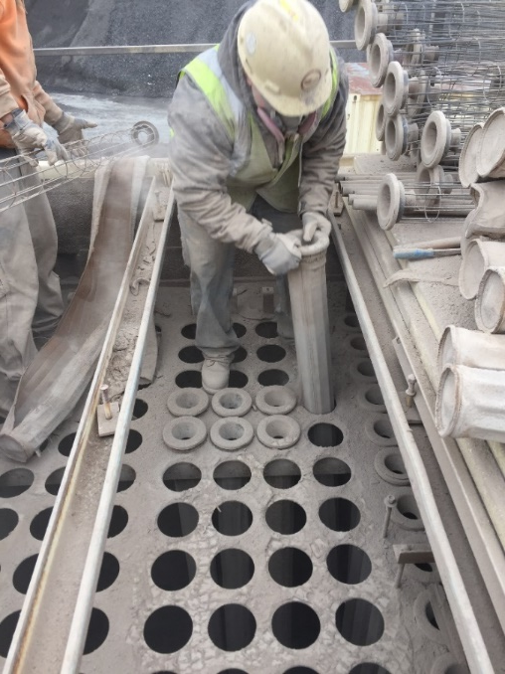
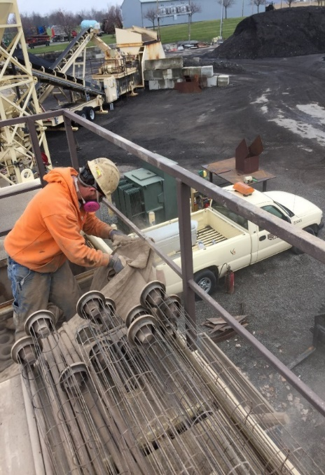
Asphalt Plant - Baghouse Maintenance
Task: Team members pulled / replaced baghouse bags.
Results: Median: 422.6 µg/M3
Additional Information:
  Approx. 96 bags were pulled.
  Only natural ventilation used during this test.

Slide 19
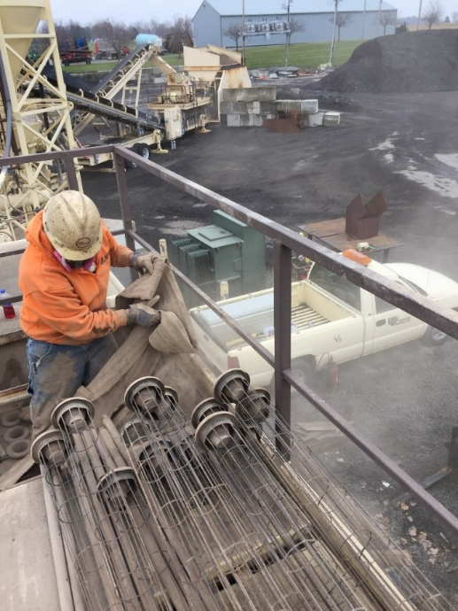
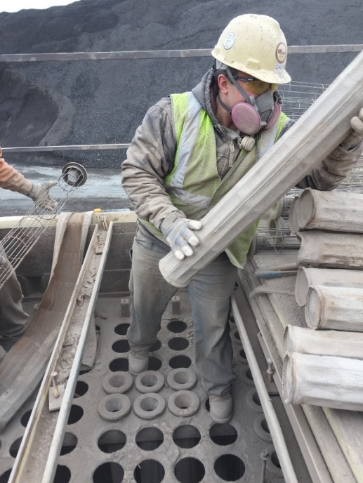
Asphalt Plant - Baghouse Maintenance
Task: Team members pulled / replaced baghouse bags.
Results: Median: 20.1 µg/M3
Additional Information:
  Approx. 90 bags were pulled / replaced.
  The baghouse exhaust fan was turned on low for duration of work.
Notes:
Baghouse variable speed fan was turned on low to create a downdraft while pulling bags.

Slide 20
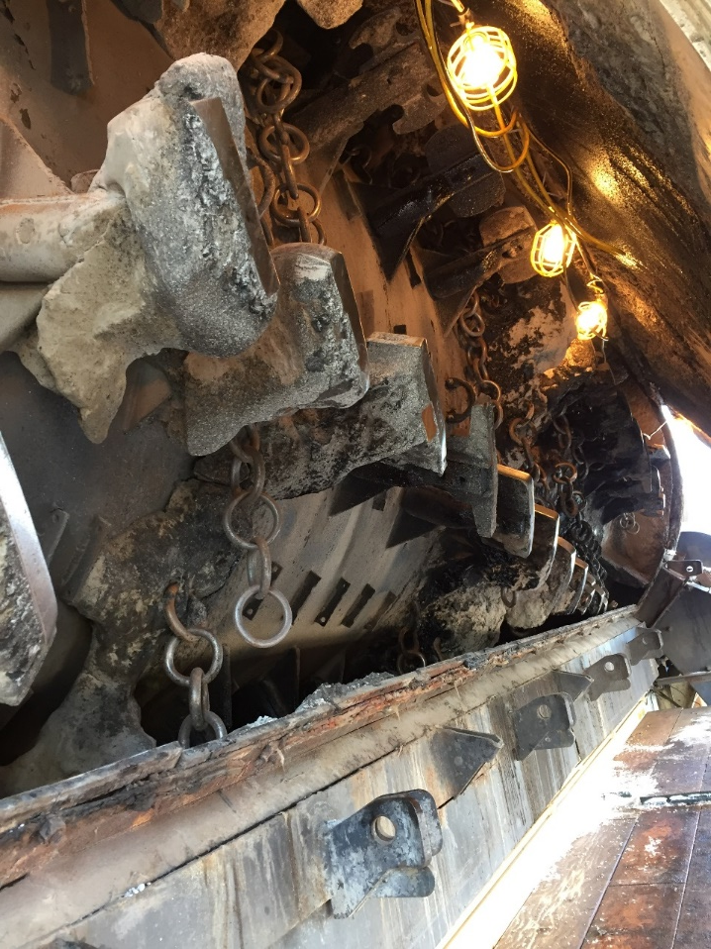
Asphalt Plant - Chipping In Drum
Scenario 1
Task: Team members chipping material buildup from asphalt drum.
Results: Median: 679 µg/m³
Additional Information:
  Team members working from ladders.
  Utilizing pneumatic chipping hammers w/out source capture controls.
Notes:
Chipping away build up on the tips, shanks and shaggy dogs.

Slide 21
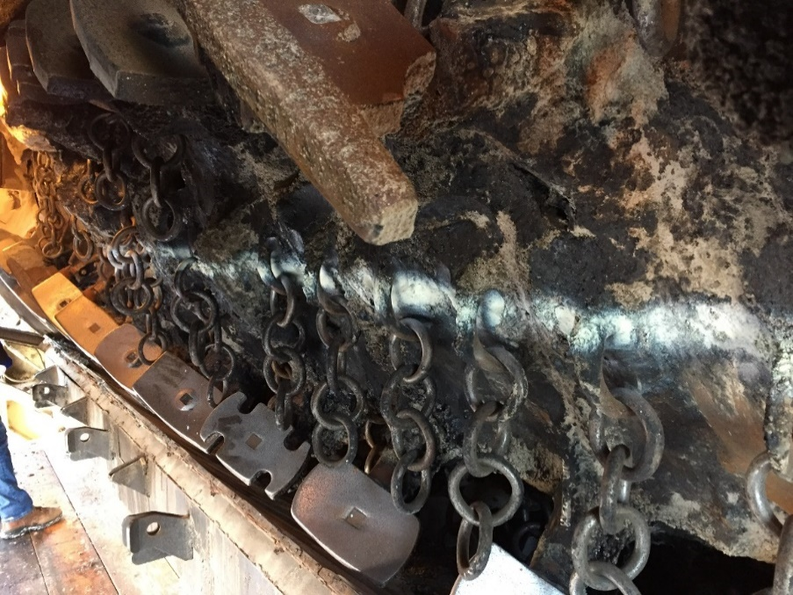
Asphalt Plant - Chipping In Drum
Scenario 2
Task: Team members chipping material buildup from asphalt drum.
Results: Median: 135.95 µg/M3
Additional Information:
  Team members working from elevated platform.
  Utilizing pneumatic chipping hammers w/out source capture controls.
Notes:
Note: During this test we wanted to see if body positioning would have any effect on what the team member’s RCS exposure. As you can see from the results the body positioning help to substantially decrease the exposure but still almost 3x the PEL.

Slide 22
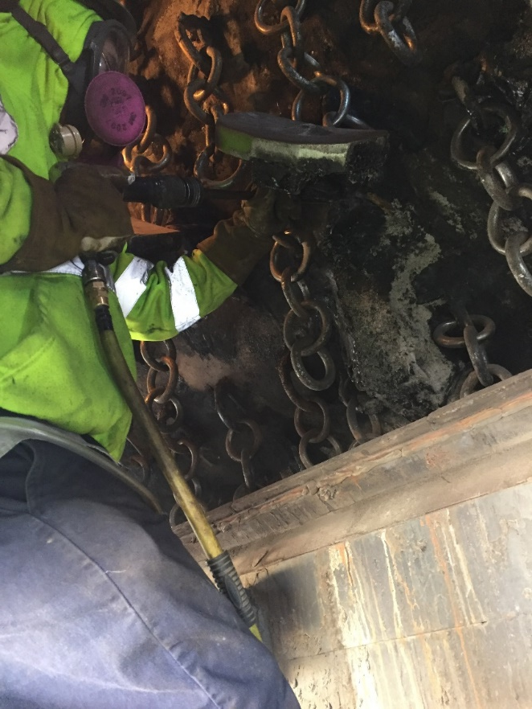
Asphalt Plant - Chipping In Drum
Scenario 3
Task: Team members chipping material buildup from asphalt drum.
Results: Median: 85.1 µg/M3
Additional Information:
  Team members working from elevated platform.
  Exhaust fan on low pulling air into the drum and baghouse.
  Utilizing pneumatic chipping hammers w/out source capture controls.

Slide 23
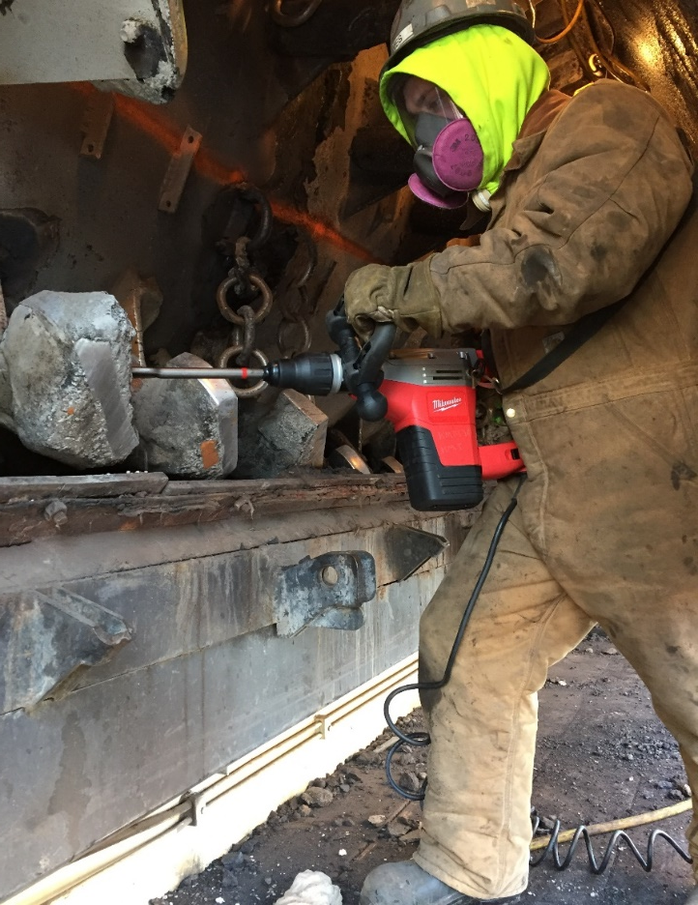
Asphalt Plant - Chipping In Drum
Scenario 4
Task: Team members chipping material buildup from asphalt drum.
Results: 48.4 – 400.8 µg/M3
Additional Information:
  Team members working from elevated platform.
  Exhaust fan on low pulling air into the drum and baghouse.
  Utilizing electric chipping hammer and pneumatic chipping w/out source capture controls.
Notes:
Without performing additional sampling it was unknown why there was a substantial range while using the two different types of hammers during this test.

Slide 24
OSHA’s Electronic Reporting of Injury Logs
Requires electronic submittal of injury logs for certain sized (25 / 250) and risk-classified “establishments”
  “High Risk” includes construction and manufacturing (NAICS)
  2016 data collection site closed on Dec. 31
Determining allocation of employees to “establishment” is key
Notes:
I wanted to take a minute to review this

Slide 25
AC Tank Inspection Standards
EPA revised SPCC Rule in 2009; required tank inspection program
NAPA published general SPCC guidance in 2011 and industry-specific tank inspection guidance in 2014 based on AC tank risk
In 2016, EPA “asked” NAPA to participate with Steel Tanks Institute (STI) in developing a “consensus-based” standard
STI’s SP-001 “Thermoplastics” appendix published Jan 2018
  Provides relief vs. NAPA guidance
  But requires a “certified” inspector
Inspection frequency based on containment type and tank size
If CRDM - periodic inspection only
If not, periodic for small tanks
> 30,000 gal: “external” inspection by certified inspector @ 35 yrs
Terminal tanks @ 5 / 10 yrs

Slide 26
AC Tank Inspection Standards
EPA revised SPCC Rule in 2009; required tank inspection program
NAPA published general SPCC guidance in 2011 and industry-specific tank inspection guidance in 2014 based on AC tank risk

Slide 27
AC Tank Inspection Standards
EPA revised SPCC Rule in 2009; required tank inspection program
NAPA published general SPCC guidance in 2011 and industry-specific tank inspection guidance in 2014 based on AC tank risk
In 2016, EPA “asked” NAPA to participate with Steel Tanks Institute (STI) in developing a “consensus-based” standard
STI’s SP-001 “Thermoplastics” appendix: final stages of approval w/ anticipated publication in Feb 2018
  Provides relief vs. NAPA guidance
  But requires a “certified” inspector

Slide 28
AC Tank Inspection Standards
EPA revised SPCC Rule in 2009; required tank inspection program
NAPA published general SPCC guidance in 2011 and industry-specific tank inspection guidance in 2014 based on AC tank risk
In 2016, EPA “asked” NAPA to participate with Steel Tanks Institute (STI) in developing a “consensus-based” standard
STI’s SP-001 “Thermoplastics” appendix: final stages of approval w/ anticipated publication in Feb 2018
  Provides relief vs. NAPA guidance
  But requires a “certified” inspector
Inspection frequency based on containment type and tank size
Small tanks: “periodic” inspection
> 30,000 gal: “external” inspection by certified inspector @ 35 yrs
Terminal tanks @ 5 / 10 yrs

Slide 29
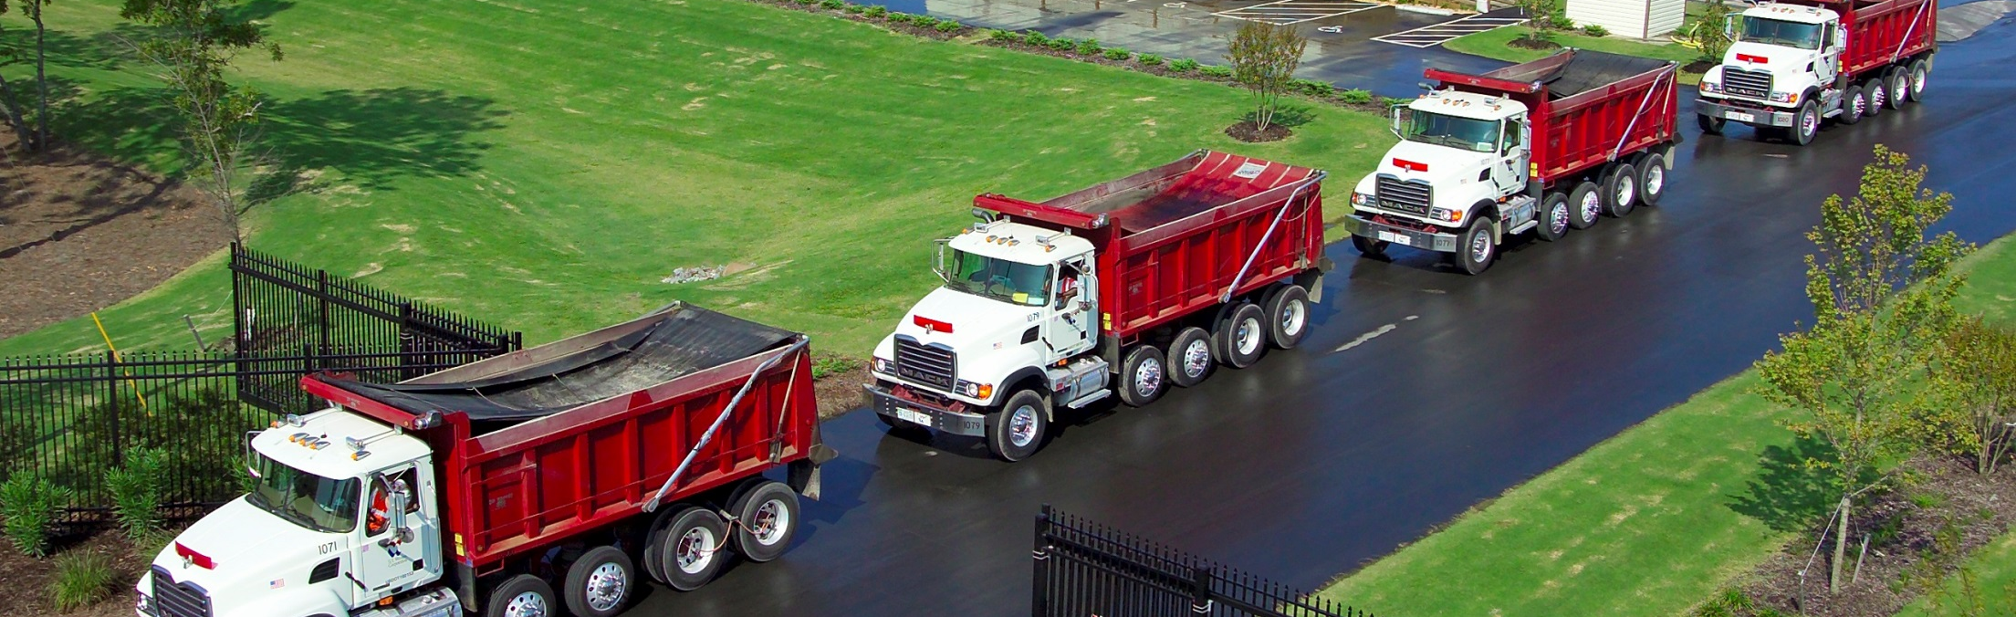
Trucking “Hours of Service” (HOS)
inTERstate vs. inTRAstate
NAPA petition for relief granted by FMCSA on Jan 26
  Transportation of asphalt and related materials
  E.g., dump trucks, equip haulers, water/distributor trucks
  30-min break NOT required; short-haul on-duty ext. to 14 hrs
Electronic logging required Dec. 18; excluded under short-haul
  If driver NOT required to keep written RODS, no need for ELD
Understand/review other exemptions for HoS requirements
Notes:
Some of you in that are associated with the trucking part of the industry may have heard about this issue.
The Federal Motor Carriers Safety Admin of FMCSA is the DOT agency responsible for regulating the trucking industry.

Slide 30
Trucking “Hours of Service” Guidance
http://www.asphaltpavement.org/PDFs/EH&S/SR-216v2-Cutting_Through_HoS_Confustion.pdf

Slide 31
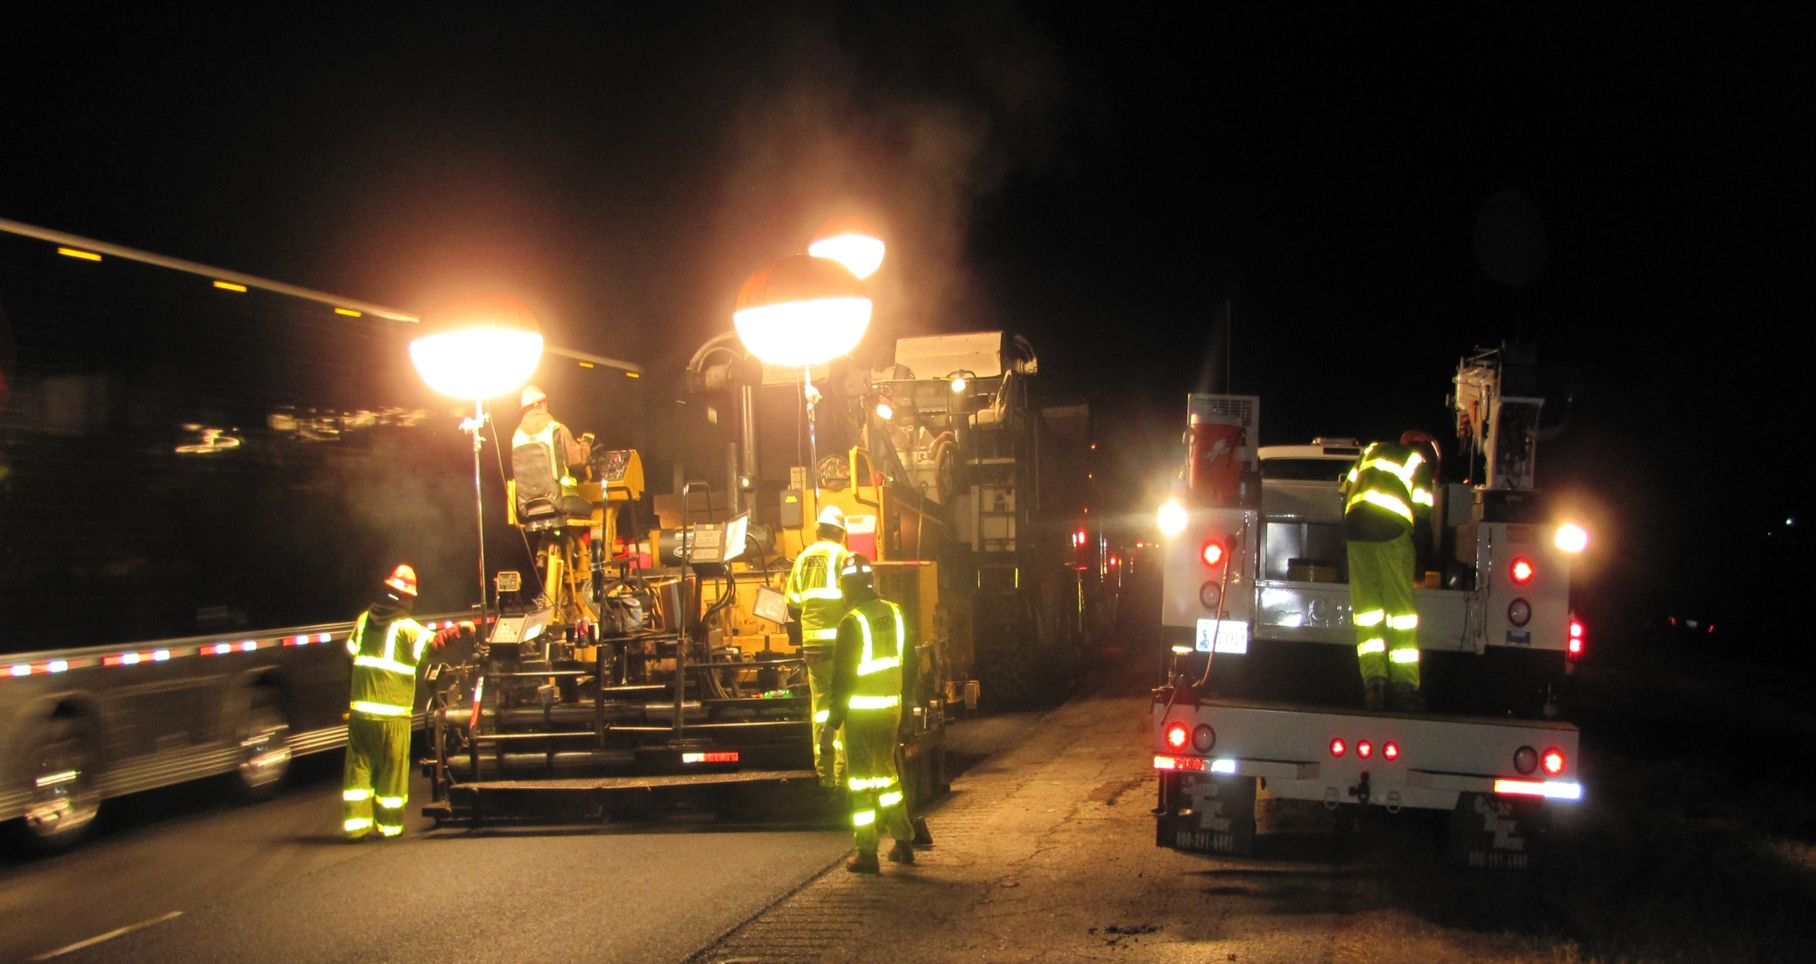
WZS: Programs and Projects
NAPA extensively partnering with ARTBA on WZS issues
PSA-type WZS impact video debuts at NAPA’s Annual Meeting
Launching contractor online training at WoA “Safety Pavilion”
Working with stakeholders / DOTs to identify best practices
Continue to advocate DOT project “safety contingency funds”
NAPA Care Benevolent Fund
Notes:
I want to spend a moment on this subject.
Road construction activities … esp road paving is a dangerous occupation
You see the statistics above.
Although I’ve lumped all WZ injuries and fatalities together, we are seeing an increase in third party WZ intrusions from e.g., distracted drivers.
Part of the problem . . . The solution isn’t necessarily all that practical with the driving public nor with road agencies.
Many people will say … concrete barriers . . . Easy to say , but difficult in practice
Bid process up to states now with some FHWA language . . . Some states are looking at true innovative practices.
NAPA Care program . . . Want to mention .. A benevolent program established by the Associate Member Council that reaches out to families within 24 hours of a worker fatality at a plant or jobsite to help with immediate financial obligations.
Just want to want to point out that there will be a silent auction to help raise funds for this program at our 2018 Annual Mtg

Slide 32

Thank-you / Questions?
www.asphaltpavement.org HMarks@asphaltpavement.org

