Slide 1
Know What’s Below
June 15, 2021

Slide 2
Agenda
History of Damage Prevention in Virginia
Common Ground Alliance
Next Practices Initiative
Virginia 811 Resources

Slide 3
GOLD!
Notes:
Sutter’s Mill, California, start of the California Gold Rush

Slide 4
Wisconsin
Notes:
30 state of the Union

Slide 5
Washington Monument
Notes:
Construction began but delayed for 23 years due to funding issues and the Civil War. Finally completed in 1884 and dedicated in 1885.

Slide 6
Washington Gas Light Company
Chartered by Congress
Became the first of the District of Columbia’s present-day utilities
Notes:
This happened a few days after the cornerstone of the Washington Monument was laid on July 4, 1848.
Columbia Gas of Virginia has a similar origin in time although not in Northern Virginia.

Slide 7
Fast Forward…

Slide 9
Call Centers
Centers were established in certain areas in the US
Regional centers
Houston example
Idea was for excavators to make one call as opposed to calling each utility for information
Notes:
Centers were established due to an increase in catastrophic damages that resulted from excavation activity. Incidents in Pennsylvania, Georgia, and Minnesota, all saw multiple deaths and others injured, not to mention the costs in property damaged.
Houston – the hottest little number in town.

Slide 10
Miss Utility
1971 - Started for parts of Northern Virginia and Maryland
“To miss the utilities, call Miss Utility before you dig”
4 utilities in Northern Virginia were the original participants
Service provided by C&P Telephone
Collect call!

Slide 11
More History
1975 – Miss Utility of Tidewater formed
1976 – Richmond area center opened
1977 – Committee formed to study and prepare proposed legislation
Call was voluntary
Utility membership was voluntary
Notes:
Accidents continued, and it was recognized that guidelines were needed in addition to calling for utility marks. Annandale explosion, 1972, killed a mother and 2 young children. In 1977, a 34,000 volt electric cable was hit in the Richmond area. The backhoe operator was slightly burned but another worker suffered severe burns and was hospitalized. Over 2,100 area homes and businesses lost power.

Slide 12
Damage Prevention Act
1979 – Became law
1995 – Amended to include
Enforcement
Positive Response System
3 Hour Notice tickets
Establishment of Advisory Committee
2002 – Amended to include
Change in timing for waiting period
Designer and Special Project tickets
Installed lines must be locateable
Utility Depth Requirements
Notes:
2010 – legislation passed to address marking of sewer laterals in certain situations

Slide 13
Rules of Enforcement
Detail standards and requirements that help enforce the Damage Prevention Act
Definition of “clear evidence”
General marking requirements
Requirements for trenchless excavation
Delineating specific location
Additional Rules of Certification of Notification Center
Notes:
Marking Standards released in 2003, first of its kind anywhere.
Latest issues include “over-notification” and “scheduling tickets”

Slide 14
How Have We Done?
Notes:
Factors – enforcement, education, development of better practices, cooperation and partnership amongst stakeholders, greater awareness of requirements.

Slide 15
Latest Damage Data

Slide 16
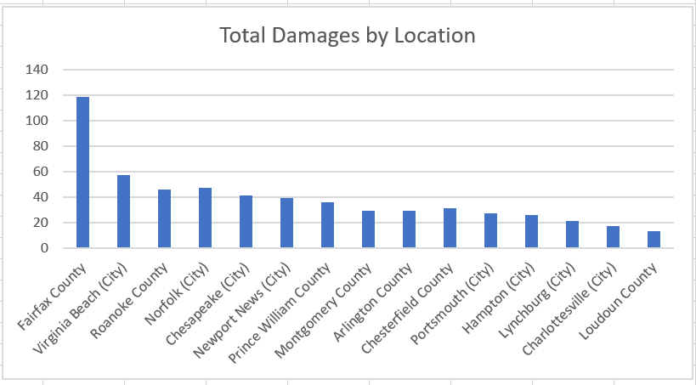

Slide 17
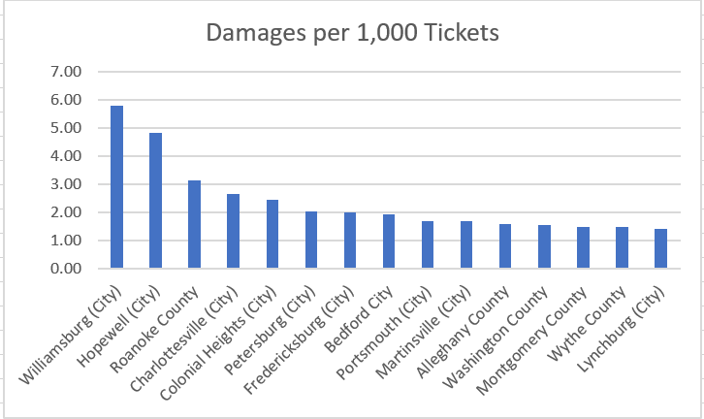

Slide 18
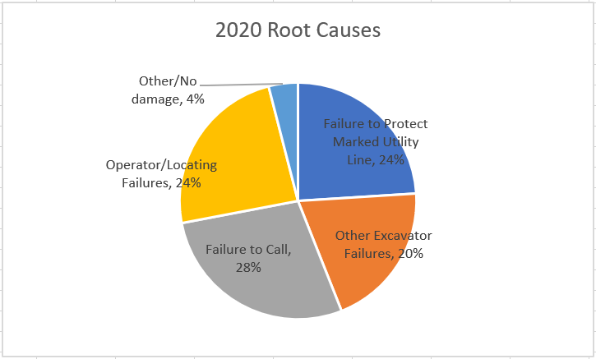

Slide 19
Virginia 811
Established as Virginia Utility Protection Service
July 2002 - Began Operations
July 2003 – Single notification center in Virginia
Added Northern Virginia and Eastern Shore
501 (c) (6) organization
Notification Center
We do not mark utilities!
HCCA member since 2006
Notes:
In addition to processing tickets and maintaining positive response system, we have a mandate to conduct “an effective public awareness program”. We do that in part by partnering with stakeholders throughout Virginia.

Slide 21
Common Ground Alliance

Slide 22
Common Ground Alliance (CGA)
Created as a result of the Common Ground Study
1998 – study authorized by Congress to examine damage prevention laws and practices
Study conducted by US Department of Transportation
Stakeholders came to consensus on best practices
Incorporated in 2000
Member driven organization dedicated to help prevent damages to underground utilities

Slide 23
Notes:
Stakeholder driven, consensus based

Slide 24
Notes:
Initiated in 2007

Slide 25
CGA Next Practices
Notes:
Research, industry surveys, and CGA DIRT report were the resources

Slide 26
Background
Launched in 2020, the goal of Next Practices Initiative is to address the most critical challenges facing the damage prevention industry.
The Next Practices Initiative seeks to encourage the industry to develop and adopt a new generation of innovative solutions to issues that the industry has struggled to address.
Guided by the Next Practices Advisory Committee, the Initiative uses industry data, quantitative surveys and stakeholder input to focus the industry on the advancement of the most effective solutions to address critical damage prevention challenges.

Slide 27
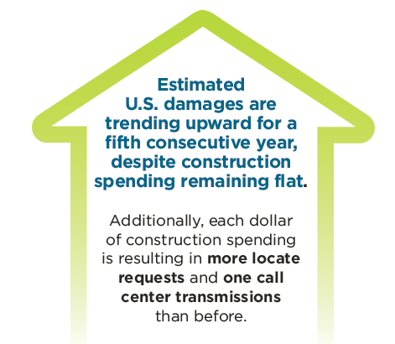
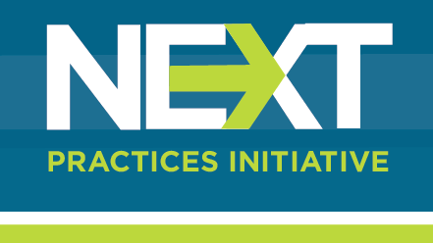
Future of Damage Prevention
Reversing trend will require innovation in all areas of damage prevention.
The Next Practices Initiative will:
Encourage innovation and new practices to address the most critical damage prevention challenges.
Document and share case studies and data supporting new and effective practices; and
Incentivize damage prevention stakeholders to develop and support innovative solutions.

Slide 28
Vision & Strategy
VISION - A damage prevention system that:
Works for all stakeholders every time.
Ensures effective, efficient and safe excavation around buried facilities.
Results in zero damages.
STRATEGY - A three-pronged approach to success:
Double down on proven practices.
Advance innovative solutions.
Eliminate inefficiencies in the system (no band-aid solutions).

Slide 29
Key Findings: Critical Issues
Facilities not marked accurately and on time
Excavator errors in the field
Effective and consistent use of 811
Notes:
3 includes no ticket and over-notification

Slide 30
CGA Technology Report
Developed by CGA’s Technology Committee
Idealized excavation project in 2030

Slide 31
2030
Excavator enters an electronic one call ticket using electronic white-lining.
Facility operators/locators mark the site on time and provide Electronic Positive Response (EPR).
EPR contains a file that can be uploaded into the excavating machine cab. Hardware/software on the bucket use the data and warn the equipment operator when they are within a certain distance of the buried utility.

Slide 32
2030
(continued) Critical facilities have sensors installed that could automatically shut down the machine or freeze controls if needed (equipment gets too close).

Slide 33
2030
Software geofences the perimeter of the work site as defined by the one call ticket. Alerts machine operator if they move beyond that scope and can alert to facilities outside of that scope.
Software is compatible with an inexpensive drone. EPR file uploaded to it allows monitoring of the machine operation (even remotely).

Slide 34
2030
If any unmarked, mismarked, or abandoned facilities are found during the project, the drone maps them via integrated GPR and/or takes photos. Those photos are provided back to the utility operator who can verify it and update files as needed.
Ideally, all utility operators participate in EPR.

Slide 35
All of the technology described exists NOW!
CHALLENGE: Getting all stakeholders to adapt and utilize

Slide 36
Virginia 811 Resources

Slide 37
Computer Based Training

Slide 38
Web Ticket Entry

Slide 39
Web Ticket Entry

Slide 40
Single Address Tickets

Slide 41
Ticket Revision Express
Allows callers to process Update/Remark tickets quickly online

Slide 42
Location Enhanced Ticket Search
lets.va811.com
Allows anyone to search by:
GPS location
Phone number
Ticket number

Slide 43
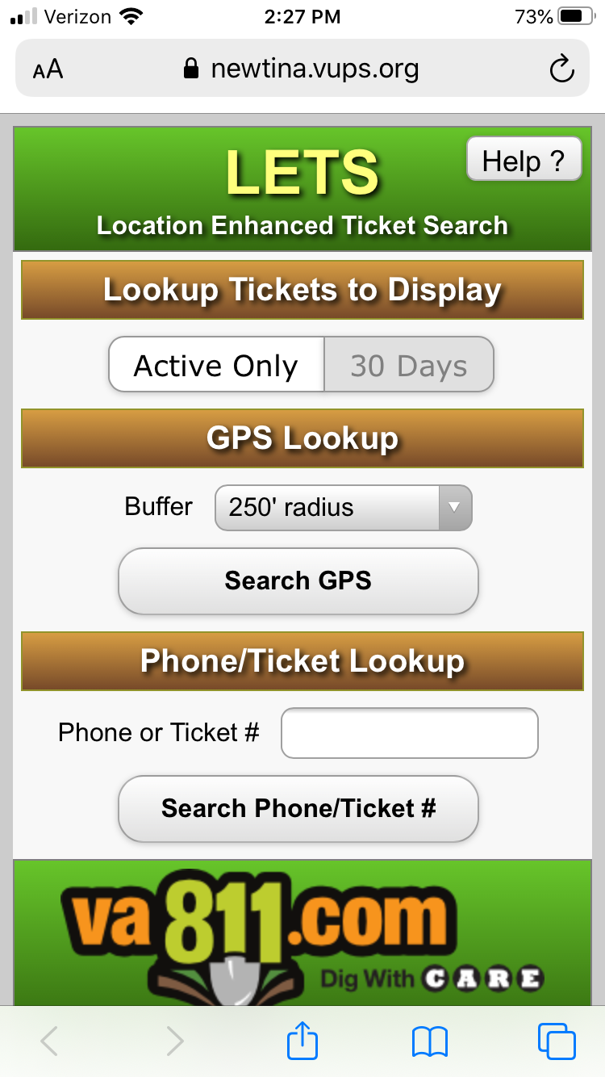
Location Enhanced Ticket Search
Requires location services to be turned on for GPS search
Search for active tickets or from last 30 days

Slide 44
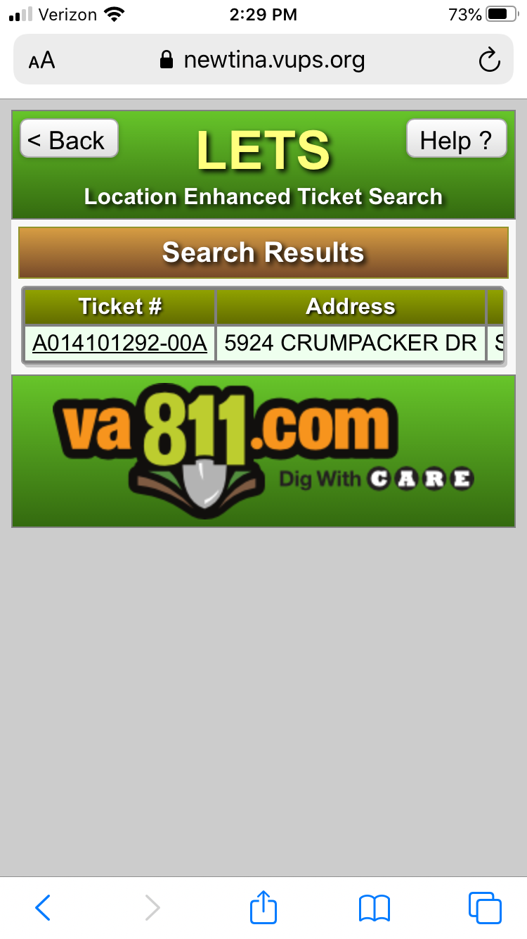
List of tickets based on GPS search
Expired tickets if present are shown in red
All members utilities have responded for tickets shown in green

Slide 45
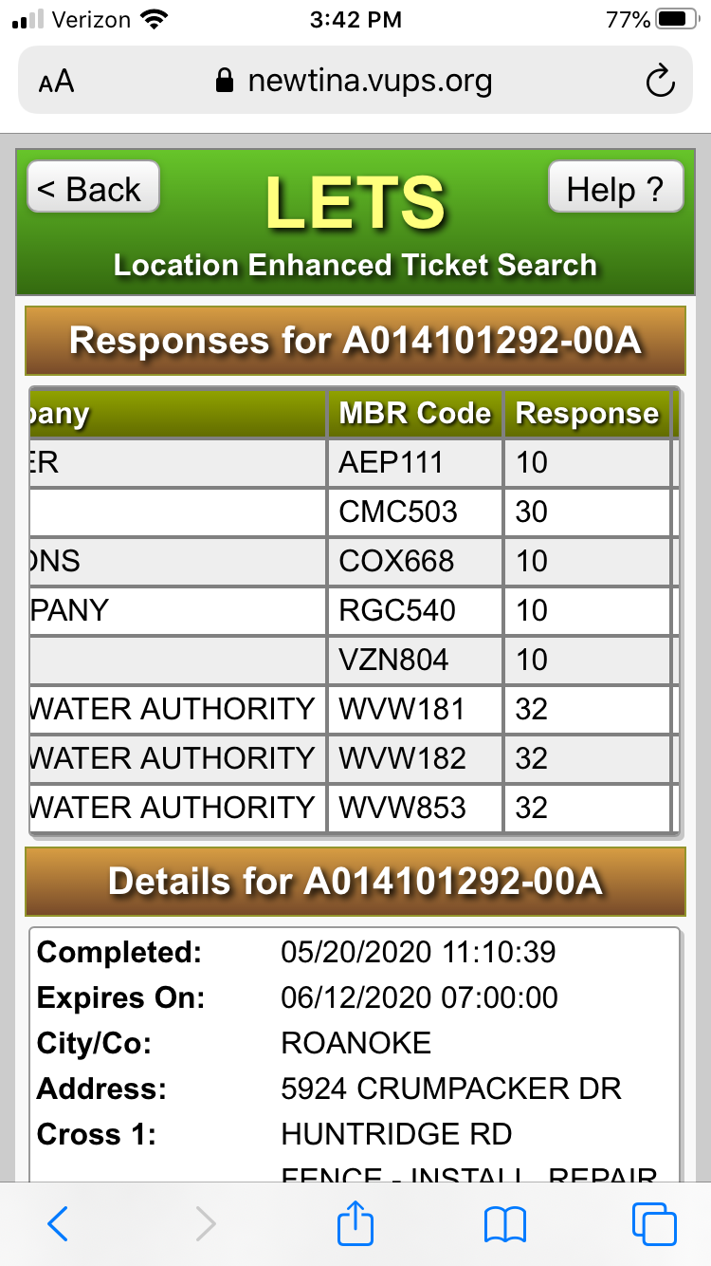

Slide 46
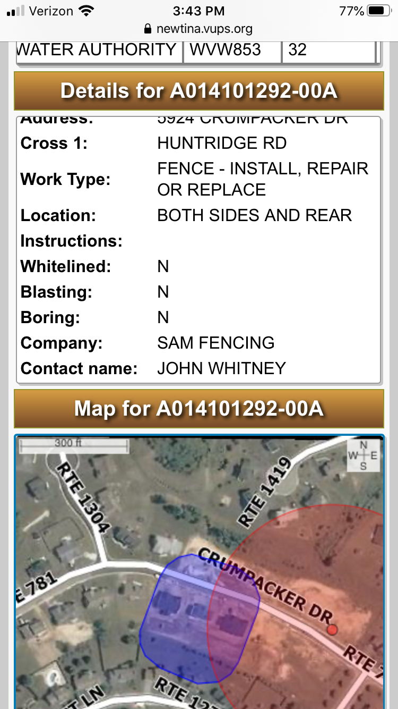
LETS
Map
1,000 ft buffer is shown in red
Notification polygon is shown in blue

Slide 47
Why LETS?
Ability to confirm:
Is there a valid ticket?
Who should be working in an area?
Is the excavator working within the dig site polygon?
What are the Positive Response codes on ticket?
Has the ticket cleared?

Slide 48
Academy
Online resource for training and tips on Web Ticket Entry
Visit www.va811.com and click on the Academy logo

Slide 49
Contact Information
Steve Light
Email – slight@va811.com
Cell – 540-761-9655
www.va811.com

