Slide 1
Leadership and
The Importance of Service
Ken Falke

Slide 2
Leadership Defined
A Leader is some one who helps get people to a place they couldn’t get on their own.
A Follower has two key needs:
they want to contribute
they want to grow.
Get to know your people (FORD)
  Family
  Occupation
  Recreation
  Dreams
Service – and Leadership Matter to Mental Health + Suicide

Slide 4
Lead Yourself First
Attributes of a Great Leader
IQ
Technical Ability
Emotional Intelligence
  Self awareness
  Self regulation
  Motivation
  Empathy
  Social skill

Slide 5

What we know about Life

Slide 6
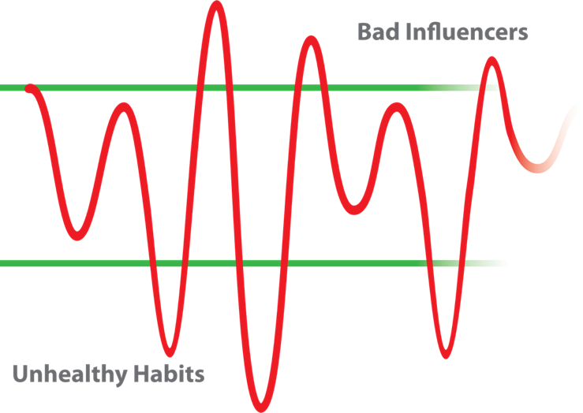
A tough to manage Life

Slide 7
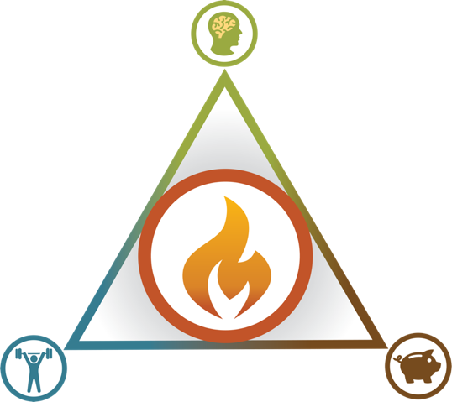
Measuring Yourself
1-5
1-5
1-5
1-5

Slide 8
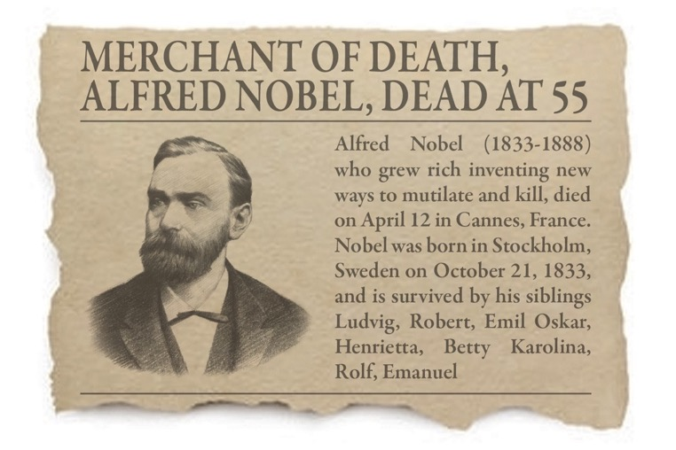
How Will You Be Remembered?

Slide 9
Ken’s 10

Slide 10
1) Set and clearly communicate your Vision. Speak it, Write it, Draw it. Everyone must know where they are going and why.
2) Setting and Achieving Goals. - Results oriented. Meet your people where they are and challenge them to stretch.
3) Listen. Be present and listen to what is being said. – Communicate clearly! Make decisions and don’t waffle around.
4) Be Kind. No one likes a screamer. – Be passionate. Kindness and passion are contagious.
5) Work Hard. Measured in output, not time worked.

Slide 11
6) Hire Quality People. Partner with Quality Customers. – Team Builder.
7) Create a culture of Loyalty and Satisfaction, with both employees and customers by building relationships. Connection not Control.
8) Empower your team and ensure you hold them Accountable. Teach them to ask “WHY?” and not “WHY ME?”.
9) Take Calculated Risks.
10) Give Back. – Must have character. Volunteering and sharing profits.

Slide 12
Developing High Performing Teams
Select the right people
Clearly define the objectives
Do your basics well…to perfection
Pursue Excellence

Slide 13
Measuring Success

Slide 14
Measuring Success
  Don’t measure what we do, by what we do, but instead measure in terms of results.
    Customer satisfaction, loyalty, commitment and ownership behavior
    Employee satisfaction, loyalty, commitment and ownership behavior
    Profit
    Growth
    Innovation
    Good News sticks to employees
    Bad News sticks to Company
“Measuring service experience, the end is more important than the beginning”

Slide 15
Employee and Customer Success

Slide 16
Our Mission
To Create a Life Worth Living!

Slide 17
How Will You Be Remembered?

Slide 18
Questions
Email:
ken@strugglewell.com
Cell:
  571.919.9062

