Slide 1
September 24, 2020
Covid-19 AND Used Equipment Market
Ed Sullivan Jr
Territory Manager
Northern VA & Southwest MD
703-963-9113
esullivan@ritchiebros.com
Notes:
Thank everyone being here today
Special thank you to HCCA, Ken Garison and Ashley Hutson
Goal todays presentation to answer most common question
“How is used equipment market” What are we seeing” “How has COVID impacted our business”
We will also discuss why we are seeing what we are seeing
My hope is that you can take overview and apply I to your fleet decision making and budgeting as we approach the new year

Slide 2
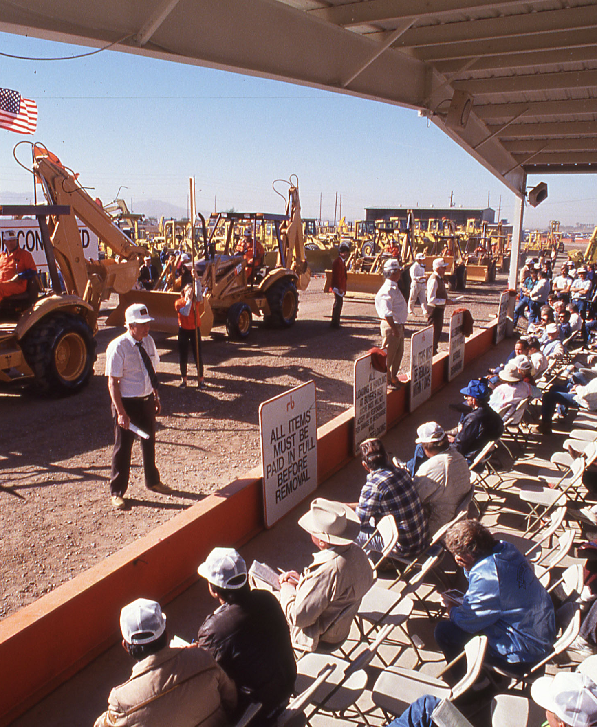
Agenda
Introduction to your Territory Manager
Ritchie Bros. Background/History
Market Conditions Overview
Auction Trends
Case Studies
Auction Demand
Questions
Question for the Group
Notes:
Intro about myself new to group, new to Ritchie Bros and new to this area
Quick background and brief history of Ritchie Bros to better understand the size an scope of our organization and the data we provide
Quick overview of current economic conditions
Review of Ritchie Bros and IP auctions trends
Case studies to review to draw comparison of market trends to actual equipment that has sold here locally.
Test during this section, 3 questions pop up. For those of you that are able please answer questions prizes will be awarded after presentation
Current auction demand
Questions time permitting

Slide 3
Pennsylvania – Philadelphia Suburbs
UMBC - EMT, Law Enforcement
Fleetway Capital Corp. – King of Prussia, PA
Equipment Financing/Leasing 9+ Years
Account Executive, Underwriting, Asset Management

Slide 5
- About -

Slide 6
ALWAYS INNOVATING WITH OUR CUSTOMERS IN MIND

Slide 7
ALWAYS INNOVATING WITH OUR CUSTOMERS IN MIND
Notes:
https://www.cbc.ca/news/business/ritchie-bros-auctioneers-anniversary-fuelled-1.4753067
$2000 bank note due for the family furniture store, so the 3 Ritchie Bros. decided to have a furniture auction
Event was a success, so the decided to look at other industries and settled on heavy equipment.
First auction held in 1963
By 2017 the company was selling over 4.5B in used equipment
2017 RBA acquired the IP platform
In 2019 RBA/IP sold over 5.1B in Used equipment
Selling points 1 min (need to add response to COVID 19)

Slide 8
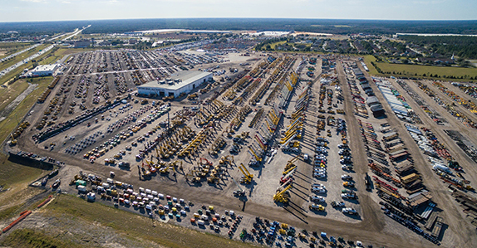

Slide 9
Current Market Conditions

Slide 10
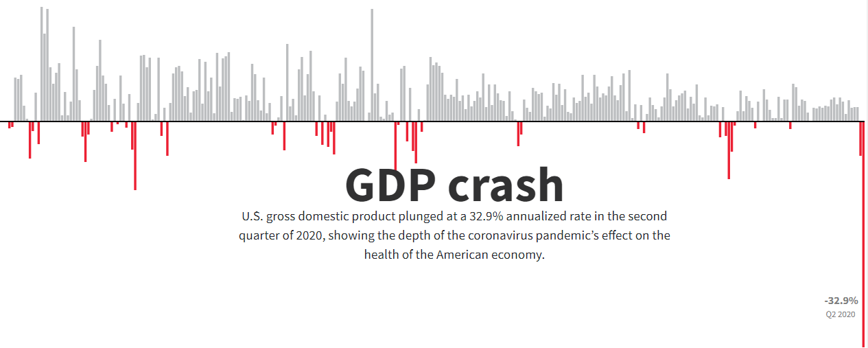
COVID-19 AND US ECONOMY
Notes:
GDP fell at a 32.9% annualized rate, the deepest decline since records began back in 1947.
The COVID-19 pandemic has caused the biggest blow to the US economy since the Great Depression.

Slide 11
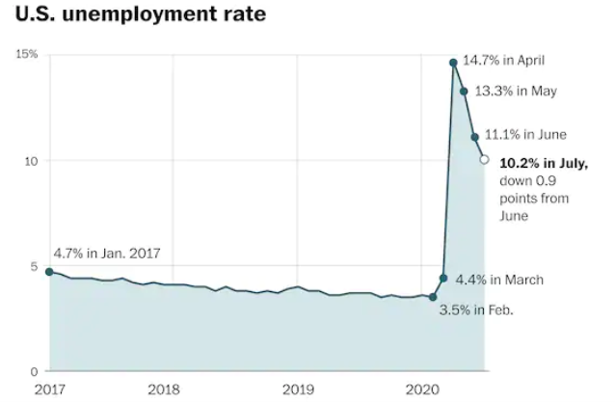
COVID-19 AND US ECONOMY
Notes:
2008 recession — Unemployment hit 20% unemployment
2020 COVID Pandemic — unemployment hit 16.6%
Projection: economy will recover quickly once the pandemic has subsided.

Slide 12
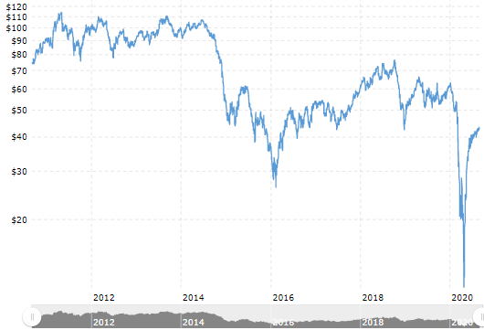
CRUDE OIL PRICES
Notes:
http
s://www.cnbc.com/2020/08/04/oil-markets-fuel-demand-coronavirus-in-focus.html
Crude Price as of 8/31
U.S. West Texas Intermediate (WTI) crude futures fell 30 cents, or 0.7% to $40.71 a barrel.
Brent crude futures fell 37 cents, or 0.8% to $43.78 a barrel.
Slide comes after WTI rose 1.8% and Brent climbed 1.5% after increase in manufacturing
Decrease due to:
Increase in Covid Cases & Lockdowns
Inventory remains high
https://www.rbauction.com/blog/ritchie-bros-is-the-go-to-solution-for-buying-and-selling-oil-gas-equipment

Slide 13
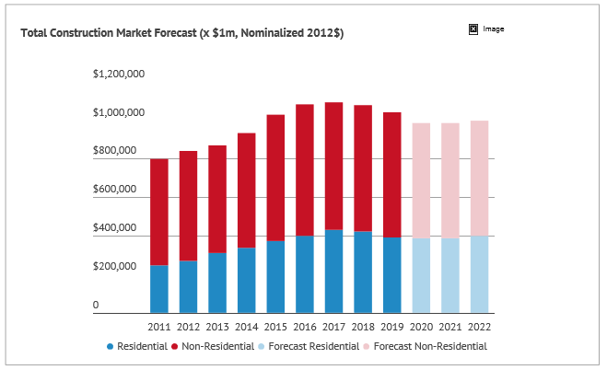
COVID-19 AND US ECONOMY
Notes:
http
s://www.cnbc.com/2020/08/04/oil-markets-fuel-demand-coronavirus-in-focus.html
Crude Price as of 8/31
U.S. West Texas Intermediate (WTI) crude futures fell 30 cents, or 0.7% to $40.71 a barrel.
Brent crude futures fell 37 cents, or 0.8% to $43.78 a barrel.
Slide comes after WTI rose 1.8% and Brent climbed 1.5% after increase in manufacturing
Decrease due to:
Increase in Covid Cases & Lockdowns
Inventory remains high

Slide 14
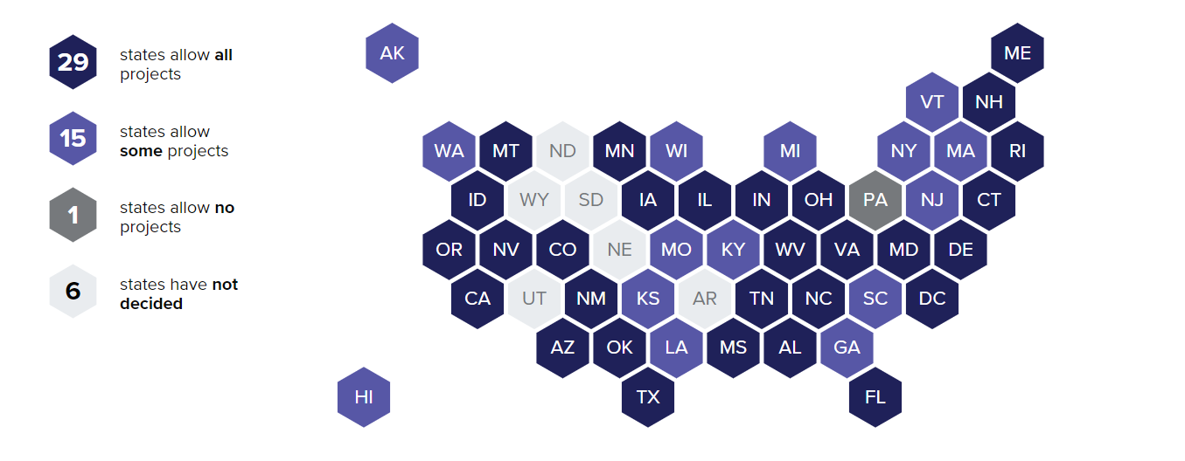
Mapping the coronavirus impact on US construction
Notes:
https://www.constructiondive.com/news/mapping-high-impact-construction-across-the-us/551042/

Slide 15
COVID-19 & EQUIPMENT MANAGER SENTIMENT
Mid-Year Fleet size Trends
Mid-Year Rental Usage
Mid-Year Revenue Report
(% responding, vs, 2019)
Two-thirds of equipment managers have put expansions on hold for 2020 About one in five say their fleet.
(% responding, vs, 2019)
Rental usage is straying the course, according to respondents. Some 15 percent have increased rental usage this year.
(% responding, vs, 2019)
Revenue has decreased for nearly two-thirds of respondents’ organizations, and none report revenue growth. Performance is trailing expectations due to the coronavirus pandemic.
Notes:
Source of article and size of survey

Slide 16
Equipment Trends

Slide 17
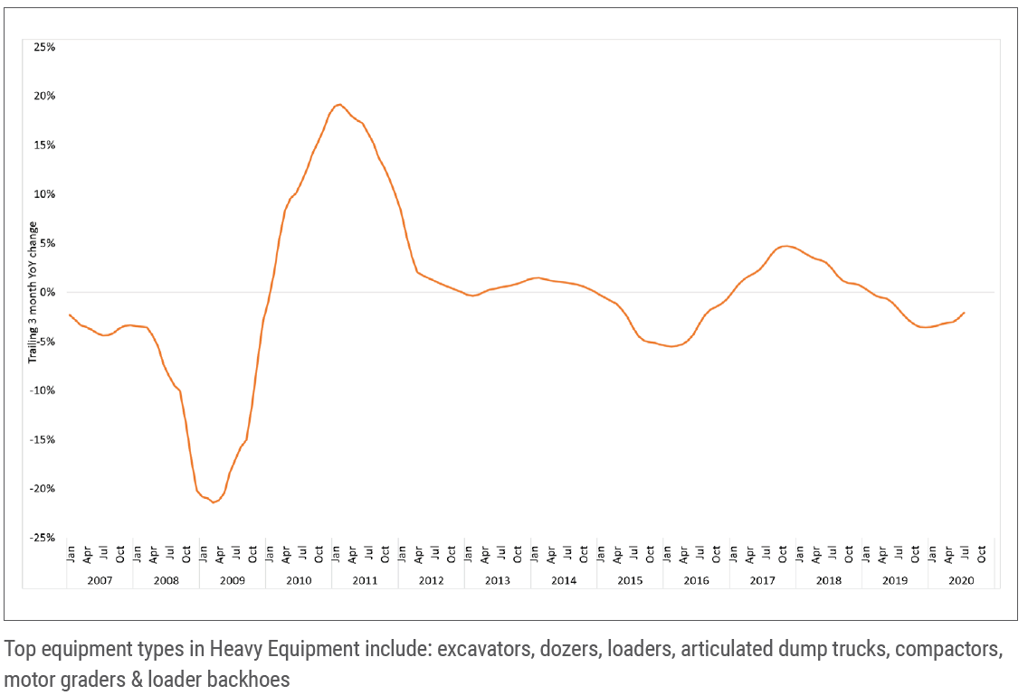
USED EQUIPMENT PRICE INDICES
Heavy equipment
In our estimation, for the 3 months ending July, prices for used heavy equipment declined ~2% (± 1.5%) compared to the same time frame last year.
Notes:
Competitors reporting 6-10% decrease in value
CAT 6% Competitor 5-10%
https://www.equipmentworld.com/should-you-buy-used-construction-equipment-in-2020-how-to-navigate-the-market-amid-a-pandemic/

Slide 18
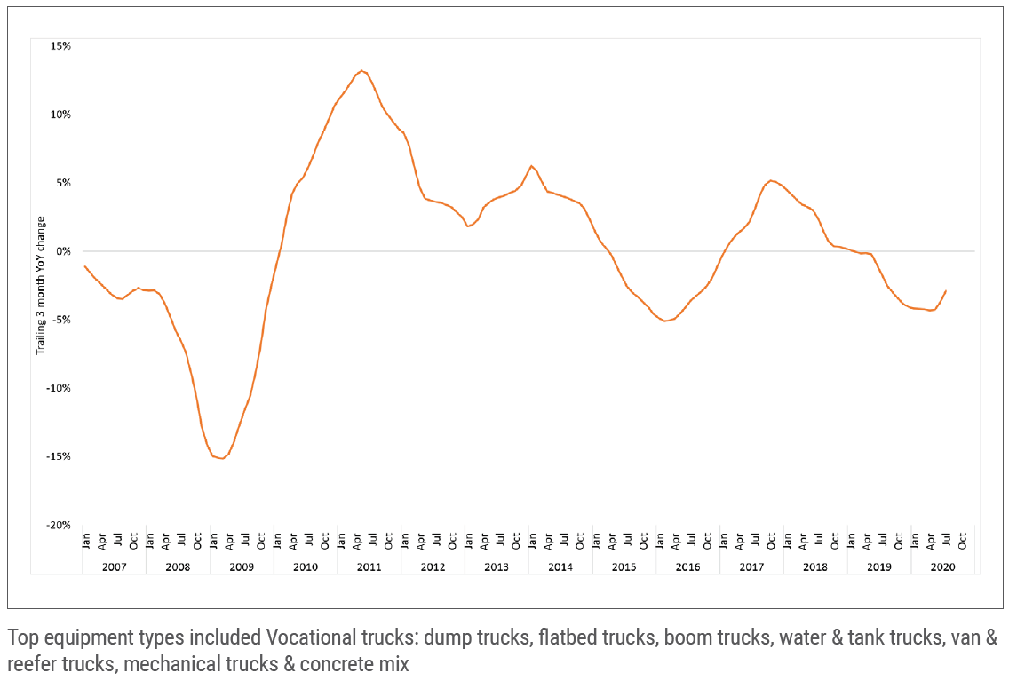
USED EQUIPMENT PRICE INDICES
Vocational trucks
In our estimation, for the 3 months ending July, prices for used vocational trucks declined ~3% (± 1.5%) compared to the same time frame last year.
Notes:
Can we compare these to regional results. VA to NY, PA

Slide 19
MARKET TRENDS BY TYPE OF EQUIPMENT – HYDRAULIC EXCAVATORS
Notes:
US brands leading used equipment excavator market

Slide 20
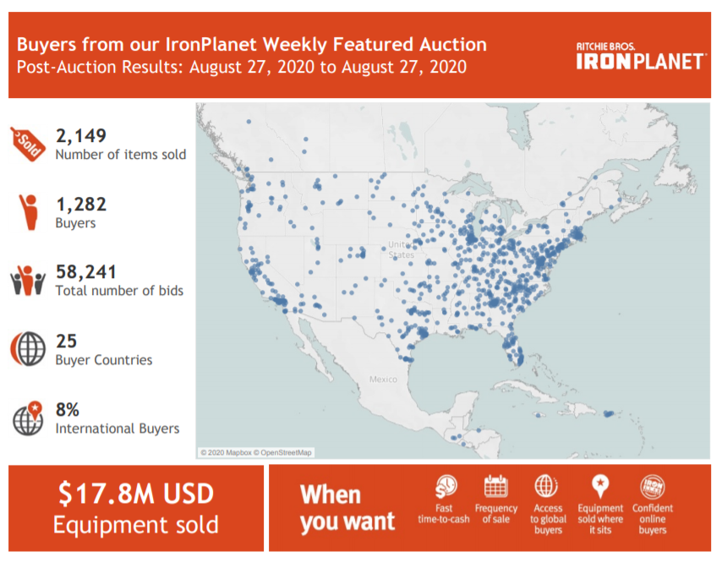
IRONPLANET SNAPSHOT

Slide 21
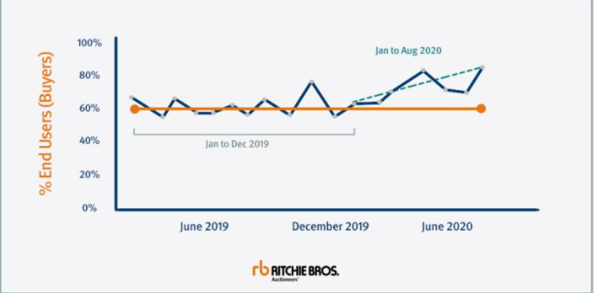
End User Participation
Notes:
ore and more of our customers are the ones putting the equipment to work. End users participation at our live online auctions on rbauction.com has increased to 78% - up 10% from 2019! More end users buying from us and not dealers

Slide 22
Used Heavy Equipment Market Recap
Heavy Equipment Pricing Stable
now is a good time to sell
01
02
03
Recent Iron Planet exceeding expectations
8% International Buyers
End User Participation is up 10%
Uncertainty moving into next year…will the market change?

Slide 23
OTHER PRICING FACTORS
Lead time on new equipment
Late and Low – limited supply in market and limit availability of new machines
Many OEMs have reported increases in lead time for new machines, and it’s primarily due to the lower demand in the past three months as well as oil and gas prices going down,
-Nick Yates, CAT
Used equipment pricing tends to lead any significant changes in the market…Coming out of a downturn, there will be a recovery in used prices before they appear in new equipment, she says. With unavoidable availability issues stemming from supply chain disruptions, expect increased demand for quality used equipment that can go right to work.
-Tara Stryker, director of remarketing, Volvo Construction Equipment

Slide 24
CASE STUDIES

Slide 25
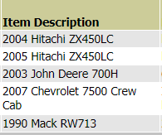
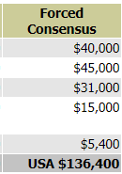
Case Study #1
Total Projected $136,400
TOTAL SOLD $151,270

Slide 26
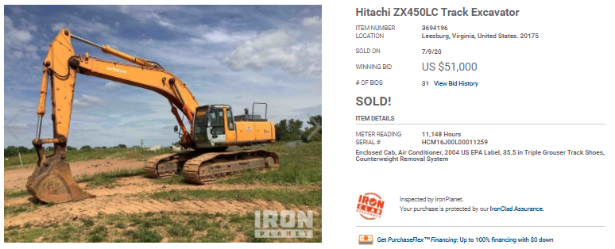
WHAT YOU SEE…

Slide 27
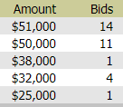
WHAT YOU DON’T SEE…
Australia
Vietnam
Mexico
Netherlands
China
Projected $45k
623 Hits
Sold $51k
31 Bids

Slide 28
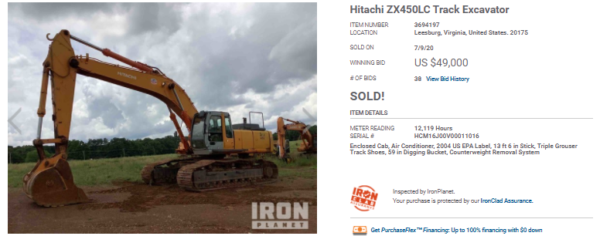
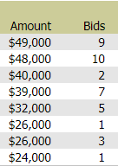
Second Excavator

Slide 29
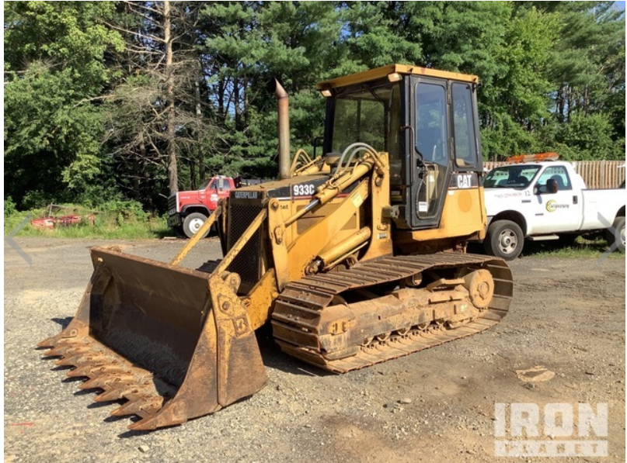
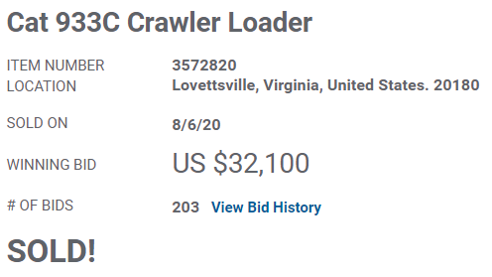
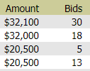
Case Study #2

Slide 30
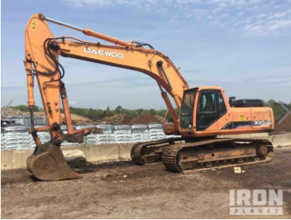
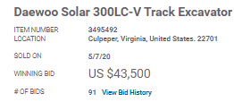
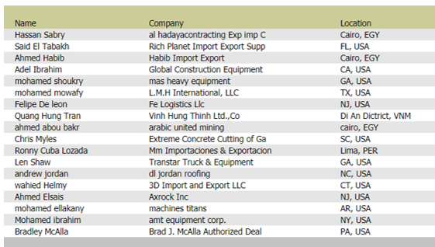
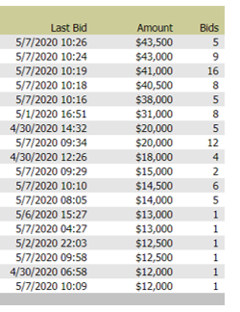
Case Study #3

Slide 31
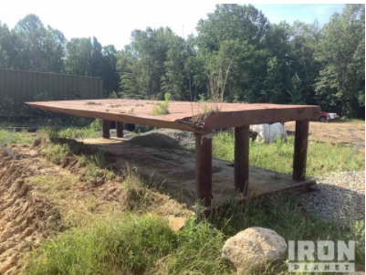
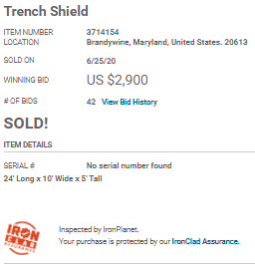
Case Study #4

Slide 32
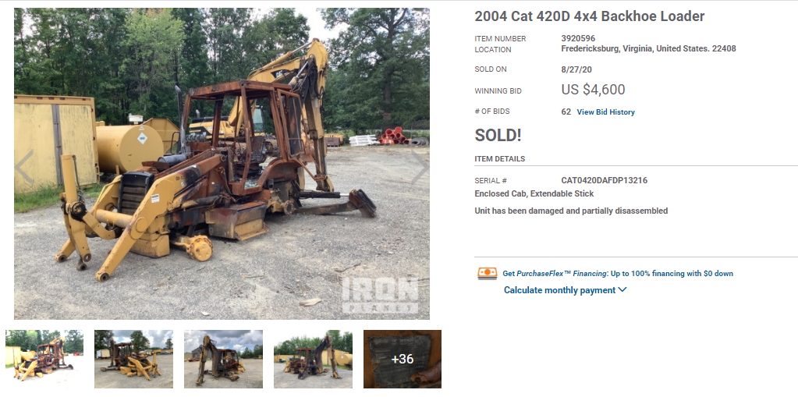
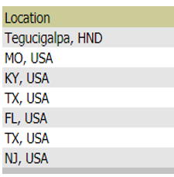
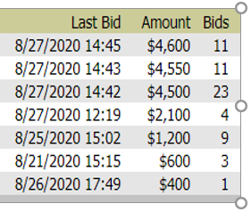
Case Study #5

Slide 33
WHAT IS YOUR MARKET KNOWLEDGE?
QUIZ
01
What was the final selling price of this unit?
02
How many bids did it receive?
03
How many bidders were bidding on this unit?

Slide 34
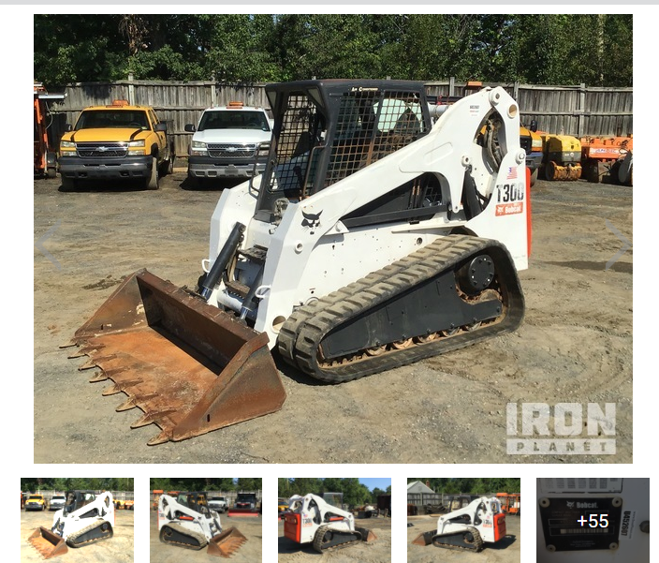
What's it worth?
2006 Bobcat T300 Skid Steer 5,663 Hours Enclosed Cab (Door missing), Air Conditioner, High-Flow Auxiliary Hydraulics, 7 Pin Electric Kit, Manual Coupler, Bucket

Slide 35
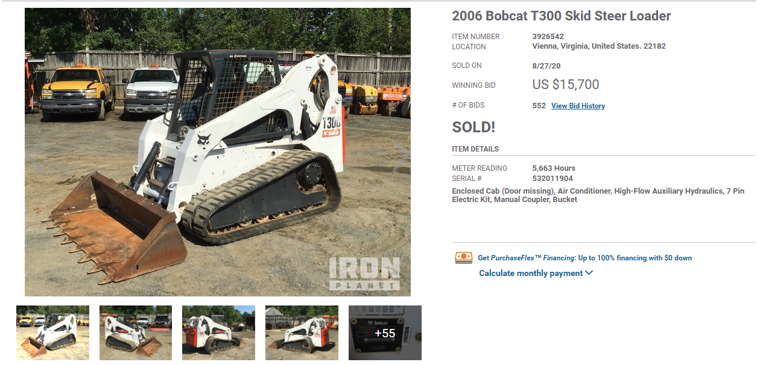
Results

Slide 36
SOLD $15,700
2603 Hits
161 Bidders
552 bids
4 Countries

Slide 37
Auction Demand

Slide 38
AUCTION DEMAND
Today, during these unprecedented times sellers have come to rely on Ritchie Bros., now more than ever, to reach buyers with our industry-leading online platforms.
During this pandemic we haven’t missed a beat for our customers.
Here’s some of the numbers from Q1 2020:
34.7M
8.2M
135,000+
$590M
Visits to our websites
Searches on our mobile app
Assets sold on behalf of sellers from 80+ countries
In pre-approved financing for buyers
2.1M
$55B
1.5M
160
Bids received on items selling
In approved online bidding limits
Followers on social media
Countries reached with active bidders

Slide 39
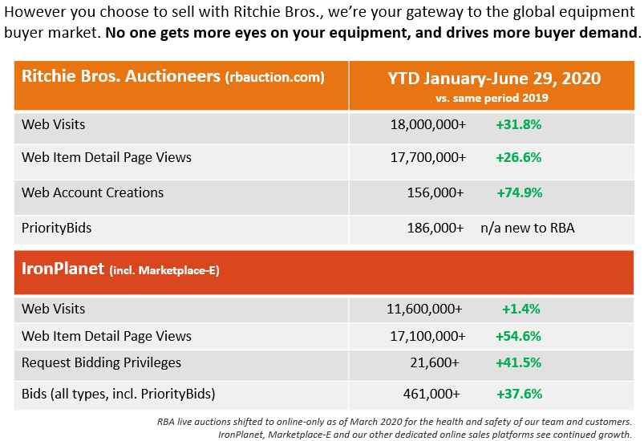
AUCTION DEMAND

Slide 40
- Thank you -
Sign up for Monthly Market Trends Reports from Ritchie Bros.

Slide 41
CONNECT WITH ME ON LINKEDIN
Ed Sullivan Jr
Territory Manager
Northern VA & Southwest MD
703-963-9113
esullivan@ritchiebros.com

