Slide 2
Ditch Diggers Dialogue, Vol. 2 Heavy Construction Contractors Association July 29, 2020
Presented by: Monica Backmon, Executive Director, Northern Virginia Transportation Authority

Slide 3
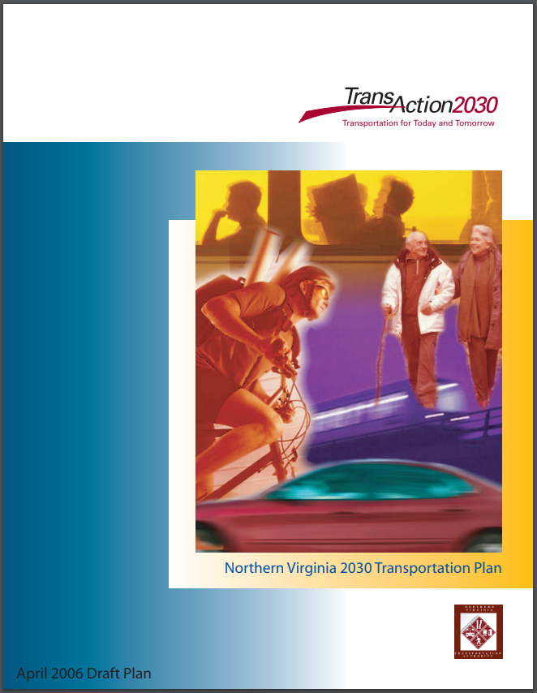
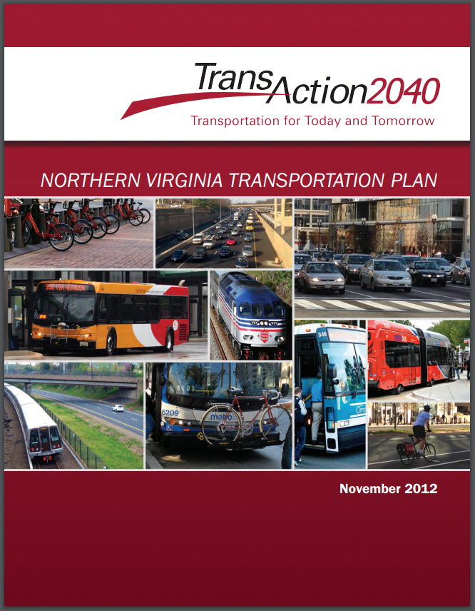
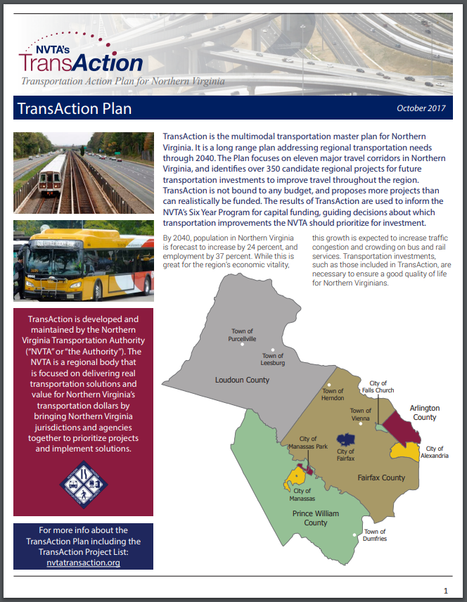
Two Primary Responsibilities
Develop and update the long-range, multimodal Transportation Plan for Northern Virginia → TransAction (updated every five years, last adopted October 2017)
Prioritize and fund regional transportation projects → Six Year Program (updated every two years)

Slide 4
FY2020-2025 Six Year Program Planning & Prioritizing for the Region
**Six Year Program Update Adopted, July 9, 2020**
Authority’s 5th Funding Program – Most competitive to date
$539 Million in Authority regional revenues programmed
on 21 multimodal transportation projects
$1.44 Billion in regional revenue funds was requested by 13 Northern Virginia jurisdictions and agencies for 41 projects
To date, the Authority is advancing 106 regional multimodal transportation projects, totaling $2.5 billion, for congestion reduction throughout the region

Slide 5
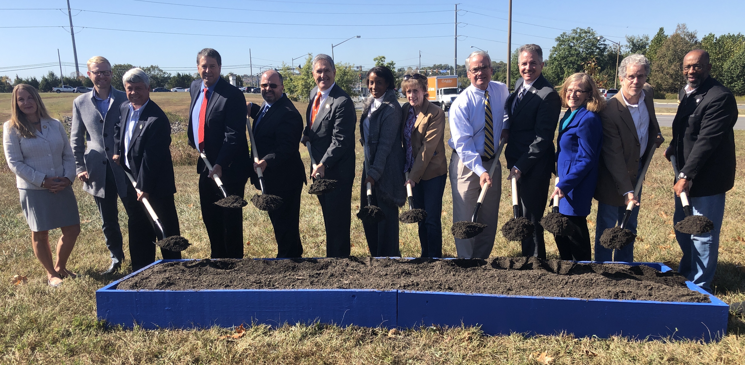
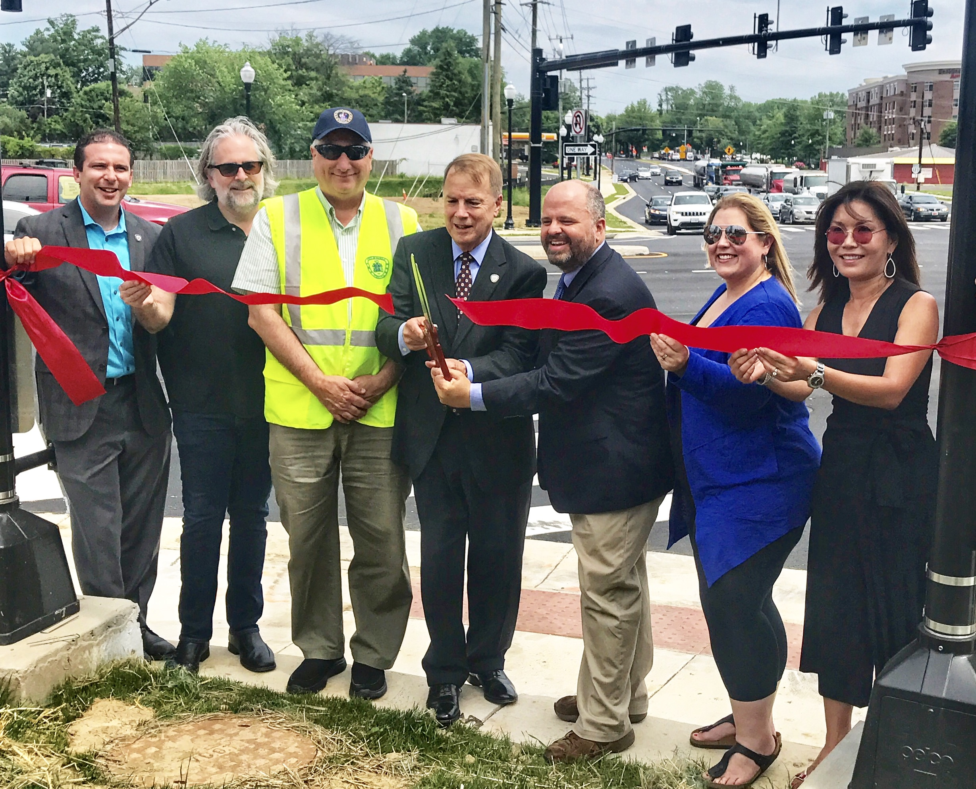
Spotlight on NVTA Funded Investments by Corridor
Corridor | NVTA Funding
Rt. 7/Dulles Toll Road/Silver Line | $528 Million
Loudoun County Parkway/Bi-County Parkway/Rt. 234 | $461 Million
Route 28 | $350 Million
Prince William Parkway | $263 Million
Fairfax County Parkway | $205 Million
I-66/US 29/US 50/Orange-Silver Line/VRE Manassas | $324 Million
I-495 | $102 Million
I-95/I-395/US 1/VRE Fredericksburg/Blue‑Yellow Line | $1 Billion
US 15 | $139 Million
Columbia Pike/Braddock Road/VRE Manassas | $53 Million
US 50 | $117 Million
**Total will not match the total NVTA funds since projects overlap corridors.
Notes:
Notes:

Slide 6
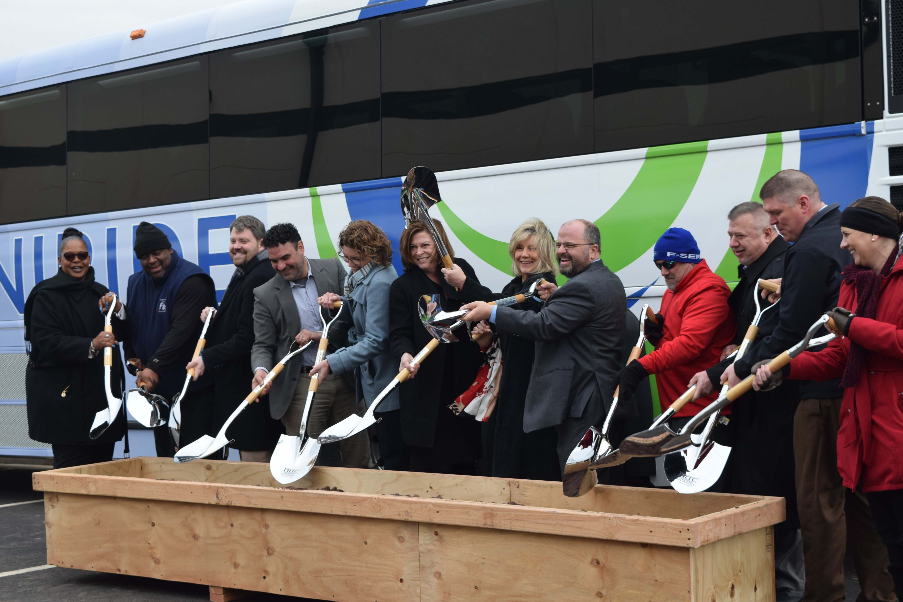
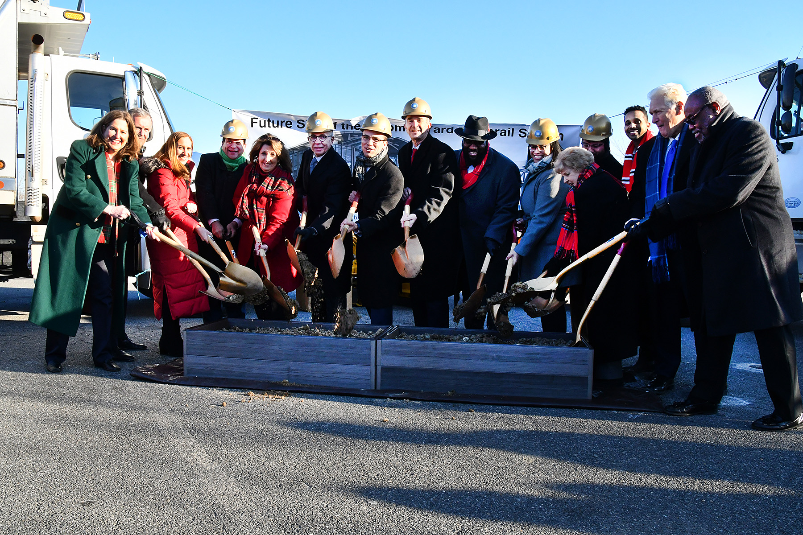
Spotlight on NVTA-Funded Transit Investments
Bus Rapid Transit--$371 Million
Including Route 1/Richmond Highway ($250 Million) and Duke Street
Transitway ($87 Million)
Metro Projects--$184 Million
Including Potomac Yard Metro Station ($69.5 Million)
Virginia Railway Express--$44.2 Million
Including VRE Crystal City Improvements Project recently adopted ($15.8 Million)
DRPT--$22.9 Million
Franconia-Springfield Passenger Rail Bypass recently adopted
Other--$170+ Million
Includes New Bus Purchases, Maintenance & Storage Facilities, and Pedestrian Access to Transit
Notes:
Notes:

Slide 7
NVTA Investments in National Landing
 | Project | NVTA 70% Funds
 | In National Landing Location
 | Arlington
 | 1. ART Operations and Maintenance Facilities | $39,027,000
 | 2. CC2DCA Intermodal Connector: From Crystal City to Ronald Reagan Washington National Airport 3. Pentagon City Multimodal Connections and Transitway Extension | $18,000,000 $28,850,000
 | 4. Crystal City Streets: 12th Street Transitway, Clark/Bell Realignment & Intersection Improvements | $11,600,000
 | 5. Intelligent Transportation System Improvements | $10,000,000
 | 6. Crystal City Metrorail Station East Entrance and Intermodal Connections | $5,000,000
 | 7. Boundary Channel Drive Interchange | $4,335,000
 | 8. Crystal City Multimodal Center | $1,500,000
 | 9. Blue Silver Mitigation – Bus purchase | $1,000,000
 | Alexandria
 | 10. Potomac Yard Metrorail Station | $69,500,000
 | 11. Traffic Signal Upgrades/TSP - Route 1 and Duke St | $850,000
 | WMATA
 | 12. 8-Car Train Traction Power Upgrades – Blue Line | $17,443,951
 | VRE
 | 13. VRE Crystal City Station Improvements and Platform Extension | $20,200,000
 |  | $227,305,951
 | VRE System-wide
 | 14. Gainesville to Haymarket Extension/ Broad Run Expansion | $1,500,000
 | 15. Manassas Park Station Parking | $2,500,000
 | 16. Franconia-Springfield Platform Expansion | $13,000,000
 | 17. Slaters Lane Crossover | $7,000,000
 | 18. Franconia-Springfield Passenger Rail Bypass (*DRPT received funding on this project) | $22,958,821
 |  | $46,958,821
 | TOTAL: 18 Projects | $274,264,772
Notes:
Notes:

Slide 8
2020 Virginia General Assembly Legislation
Omnibus Transportation Bill (HB 1414)/(SB 890)
When fully implemented, the Bill will provide $50 million in new revenues to the Authority to partially restore the $102 million in funding diverted to Metro in 2018, when Virginia dedicated funding to Metro State of Good Repair needs.
Amended due to revenue implications resulting from COVID-19.
Amendments on transportation funding will delay some funding provisions to the Authority but not all.
$30 million in Grantors delayed until May 2021.
$240 Million+ in Reduction in Revenues (FY20-23; due to COVID-19 and I-81)
Despite COVID-19 impacts on revenue, the Authority is able to preserve all project funding programs.

Slide 9
COVID-19 Impacts on Transportation
NVTA recently partnered with AECOM to conduct analysis of change in travel behavior due to COVID-19
GOAL: Explore impacts to operating conditions and future transportation project investment considerations
SCENARIOS & IMPACTS: Analyze plausible possible future scenarios, not intended to predict the future or imply any preferences
Scenarios
Scenarios developed based on policies, travel choices, and behaviors
Transportation Impacts
Potential impacts assessed using TransAction model and MobiliticsTM
Results Use
Inform potential short-term policies and future TransAction analysis

Slide 10
COVID-19 Impacts on Transportation Analysis
National Trends: Working from Home
Q: Thinking of your job before the coronavirus outbreak, how often were you able to work from home?
Q: Are you currently working from home?
Never before
No
(47%)
Yes
(53%)
Before only less than 25% of the time
Before between 26-50% of the time
Before more than 50% of the time
Source: Heart+Mind May 27th Roundtable

Slide 11
COVID-19 Impacts on Transportation Analysis

Slide 12
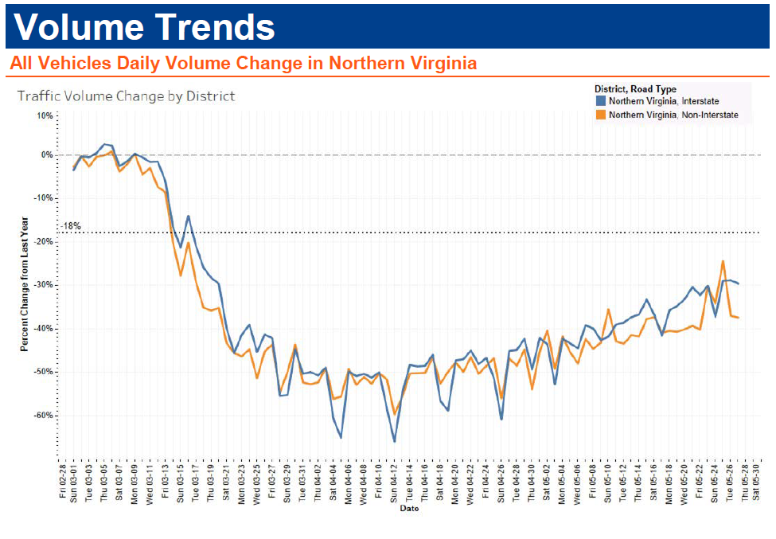
COVID-19 Impacts on Transportation Analysis
Regional Trends: VDOT Volume Trends
Mid-April shows the lowest daily volume at -55% compared to 2019 levels
Source: VDOT data presented at the Commonwealth Transportation Board June 17th Meeting

Slide 13
COVID-19 Impacts on Transportation Analysis
Regional Trends: WMATA Ridership
Source: WMATA Finance & Capital Committee Meeting May 14, 2020

Slide 14
COVID-19 Impacts on Transportation Initial Findings
Analysis Conclusion:
Short-Term - The majority of changes occur within the first 18 months and level off around June 2021
"New Normal"
Teleworking and economic impacts result in:
Traffic volumes and transit ridership that don't fully recover to pre-COVID levels
Significant reductions in time spent traveling and time lost in congestion
While congestion reduction impacts are positive, transit ridership reduction may be challenging to the financial stability of some transit agencies
Implications for NVTA’s Planning & Programming
Findings will be taken into consideration through upcoming long-range planning update

Slide 15
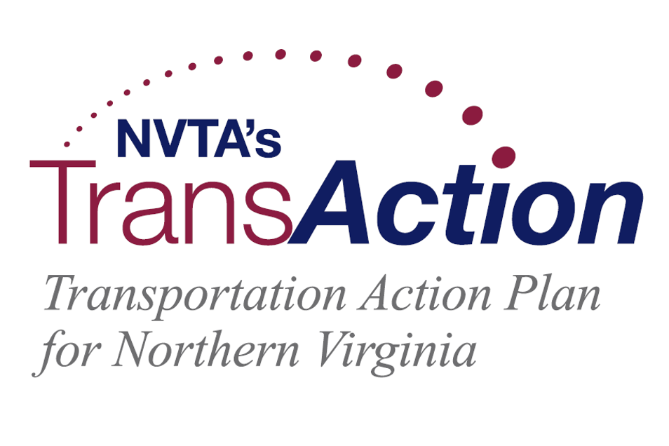
TransAction Update
Region’s long-range plan updated every five years
Projects required to be in TransAction for eligibility of 70% revenues
Current TransAction adopted October 2017
Kick-off for the update to TransAction held in January 2020
TransAction update anticipated for adoption in the Fall of 2022

Slide 16
Regional Revenues Making A Difference Economic Impact Analysis of HB 2313

Slide 17
Economic Impact Analysis of NVTA Funded Projects with HB 2313 Revenues
Study conducted by an independent firm – Chmura Economics & Analytics
For each $1 of direct economic impact, NoVA receives a total regional impact of $1.58.
Statewide -NVTA projects are producing 26,000 jobs, with 90% of those in Northern Virginia.
NVTA’s funding of $1.9 billion in projects has resulted in;
additional commitments of $3.8 billion,
bringing the total transportation investment to $5.7 billion.
NVTA projects are reducing travel times through 2030 by;
209 million hours,
producing cost savings of $3.1 billion;
and adding valuable time for Northern Virginians to spend time with their families.
NVTA to update the study in the coming months, adding the projects just adopted in the FY2020-2025 SYP.
Notes:
Notes:

Slide 18
Thank you!
TheNoVaAuthority.org and NVTATransAction.org
Northern Virginia Transportation Authority
@TheNVTA
Subscribe to our newsletters at TheNoVaAuthority.org to stay in the know!
@NVTAuthority and @NVTATransAction
Contact us at TheAuthority@thenovaauthority.org

